Slide 1




Fundamentals
of Bibliometric Analysis
Authors:
Tilagavati Subramaniam
Anna Arokia Nathen
Rajespari Kumar
Year: 2025
CC BY-NC-SA 4.0
Designed by Freepik

Slide 2
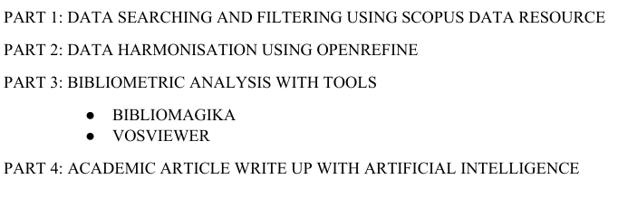
Overview

Slide 3
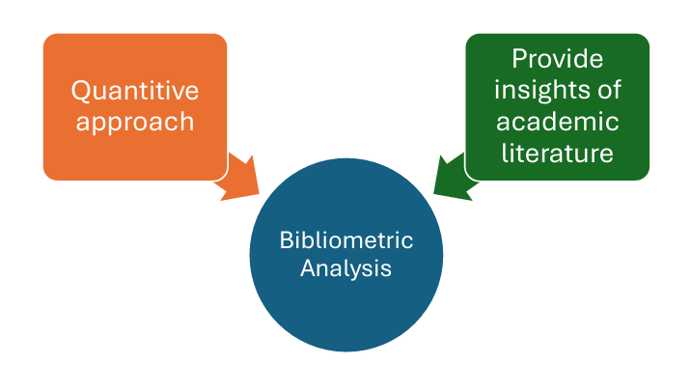
INTRODUCTION TO BIBLIOMETRIC ANALYSIS

Slide 4
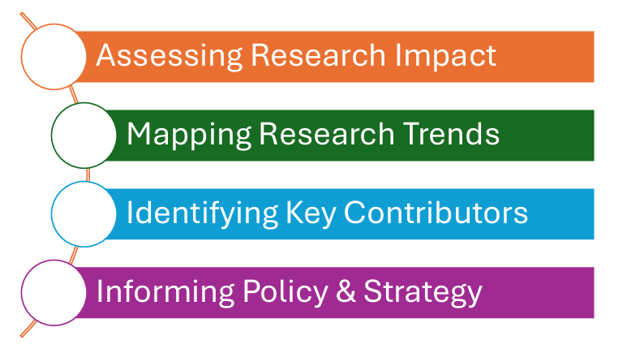
IMPORTANCE OF BIBLIOMETRIC ANALYSIS
IN
RESEARCH

Slide 5

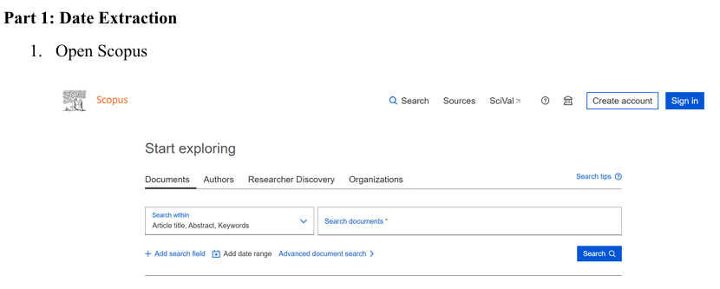

Slide 6
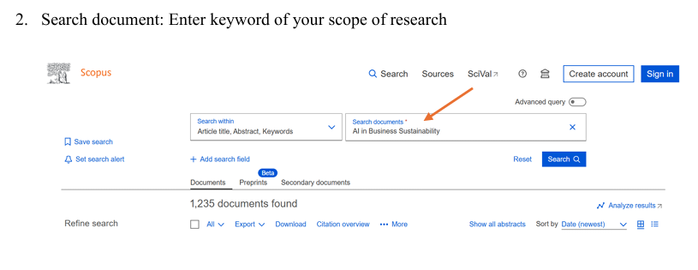

Slide 7
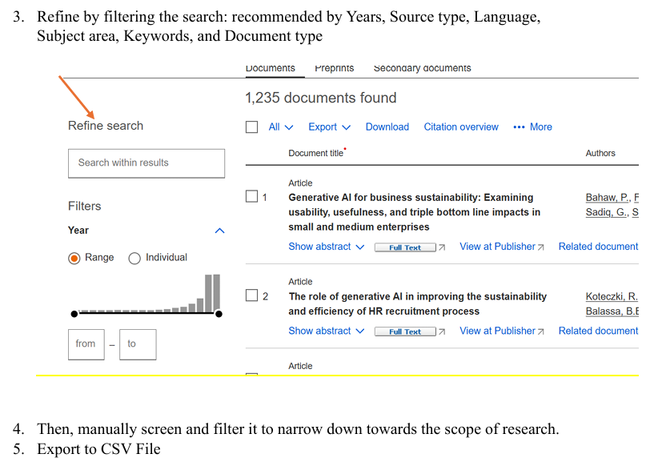

Slide 8
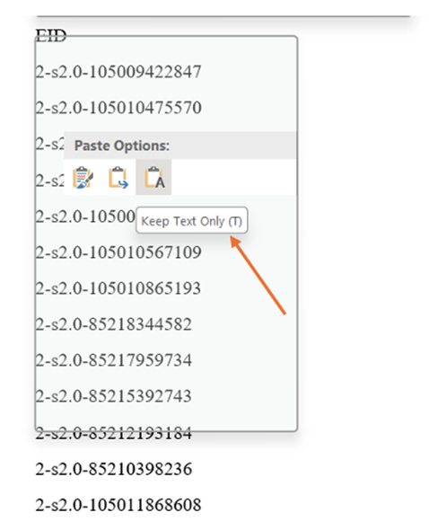
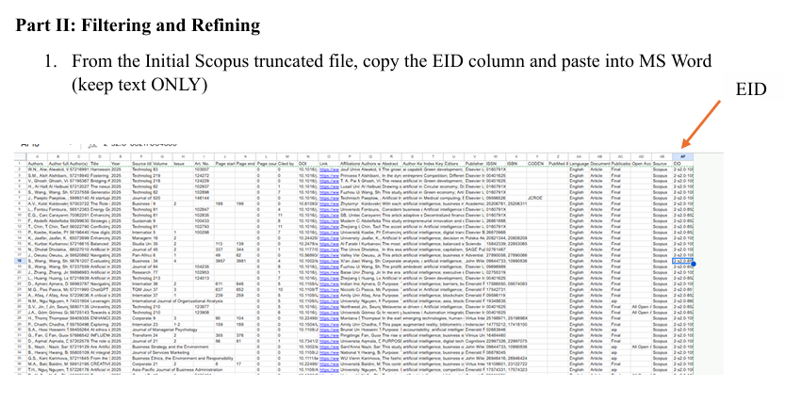

Slide 9
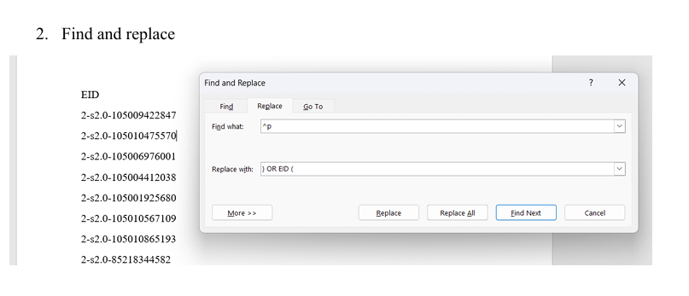
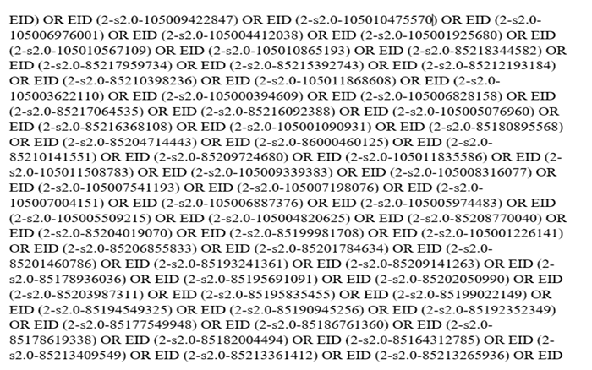

Slide 10
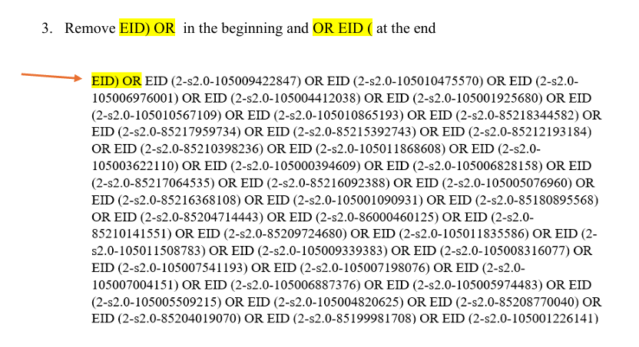
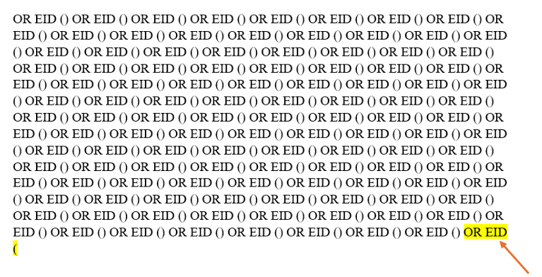

Slide 11
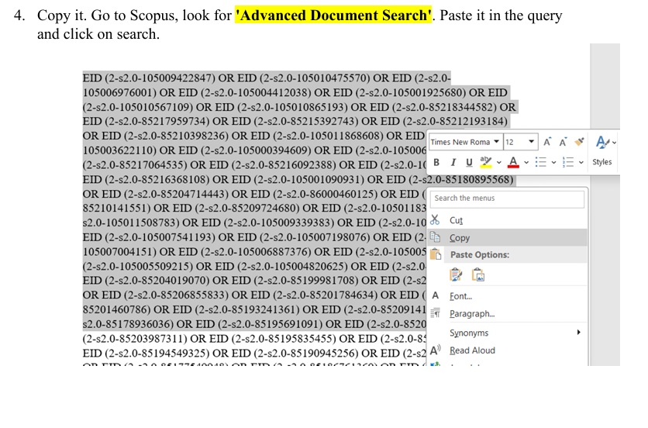
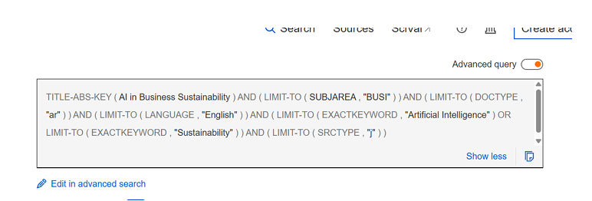

Slide 12
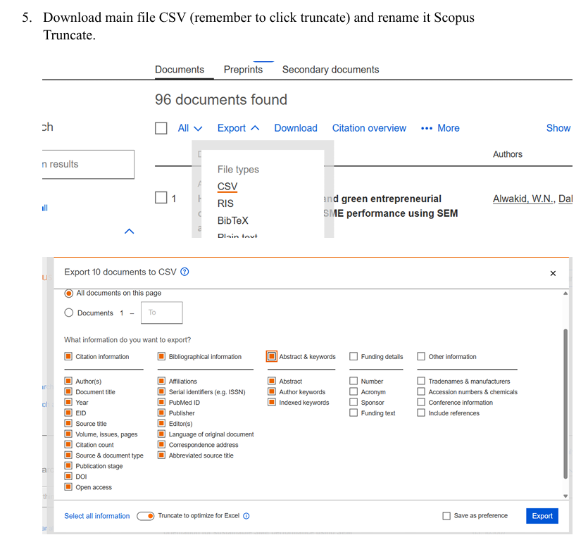

Slide 13
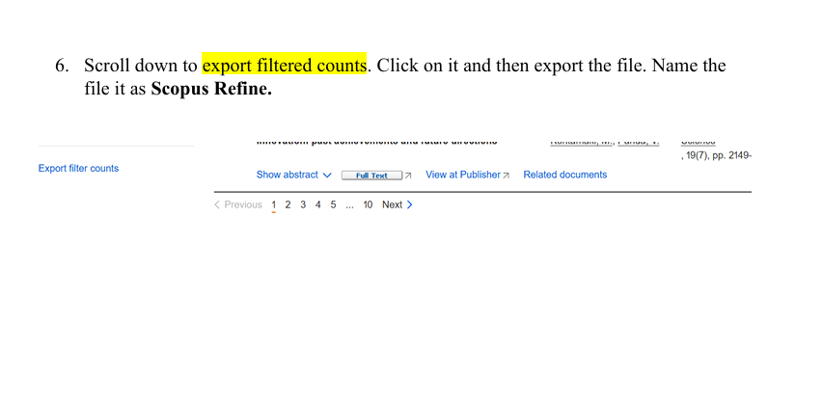

Slide 14
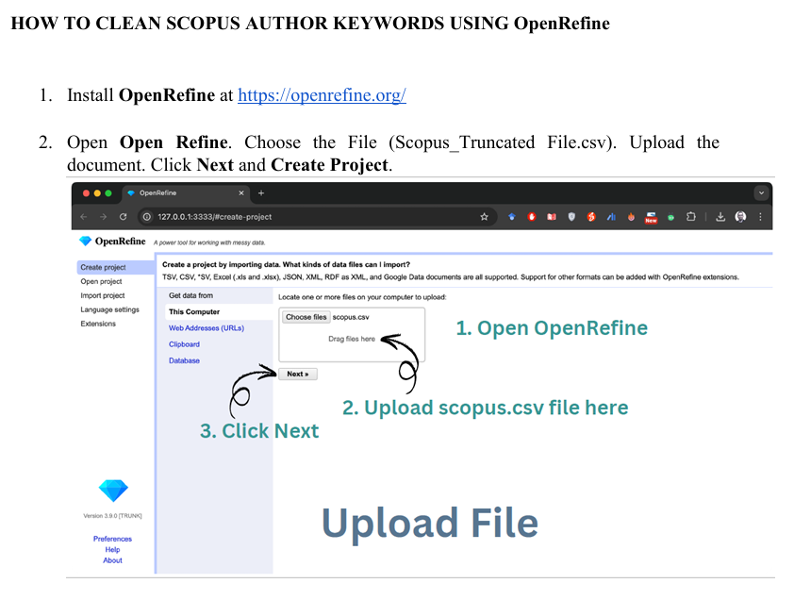

Slide 15
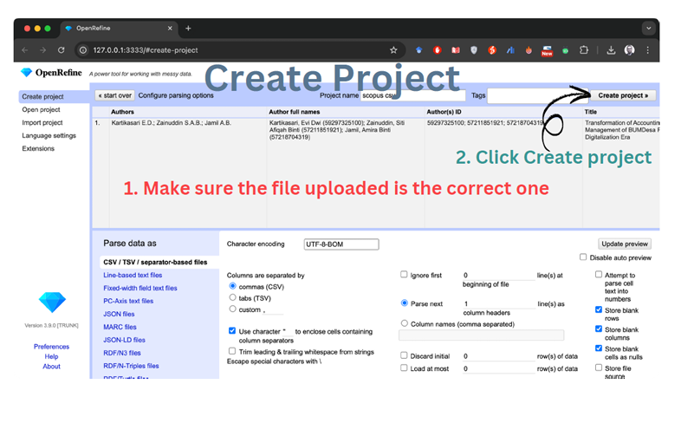

Slide 16
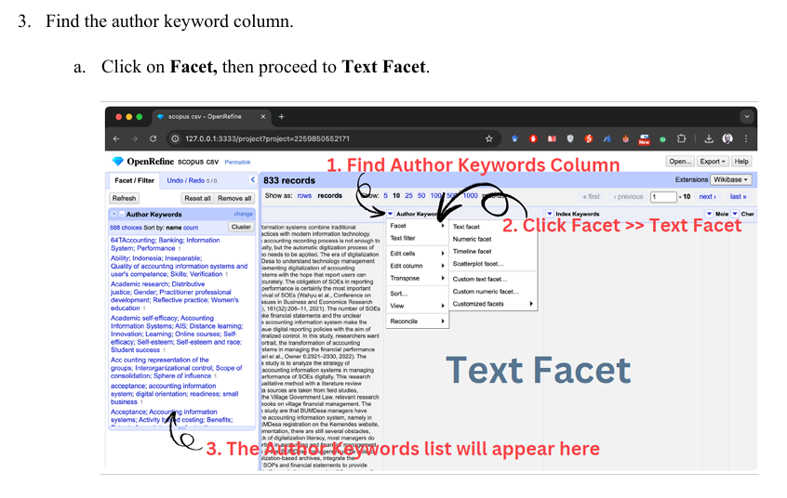

Slide 17
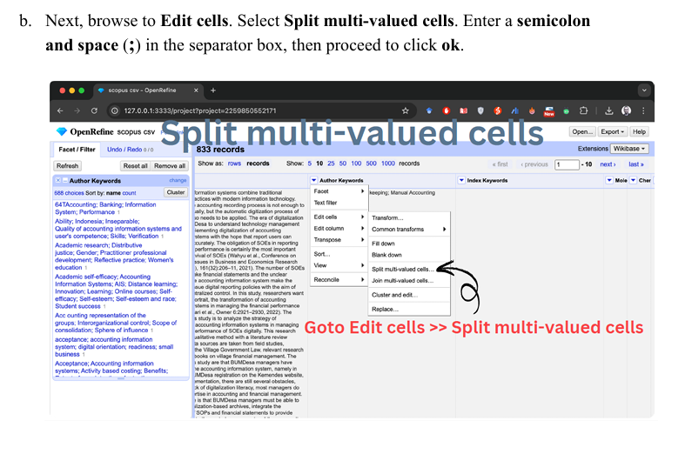

Slide 18
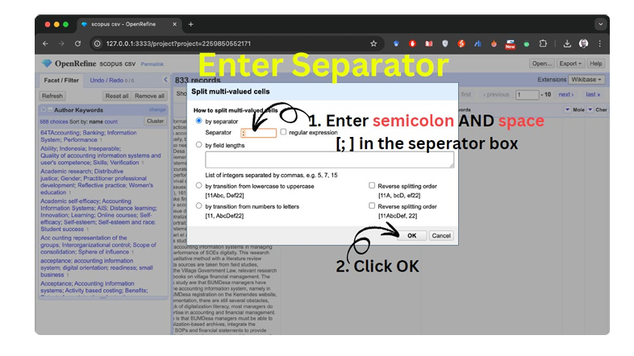

Slide 19
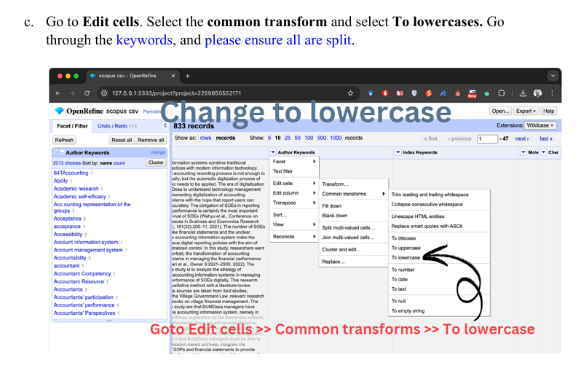

Slide 20
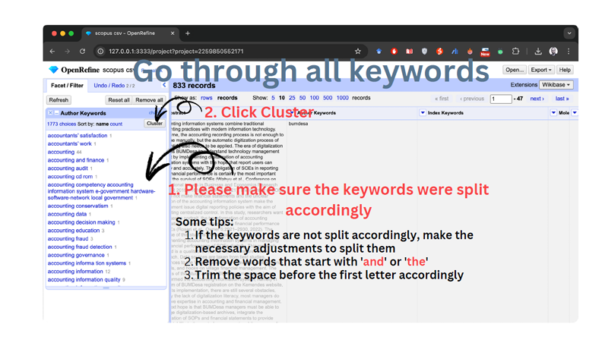

Slide 21
d. Next, moving to the Cluster Technique, by selecting CLUSTER at the index
keywords.
At the cluster and edit box;
At Method,
● Select Key collision, and in the Keying function select
Fingerprint. Checked the auto-update box.
● Click the box to merge and enter the term that you want to
standardise, then proceed to Merge selected and re-cluster.
(Normalizes strings by removing punctuation, converting to lowercase,
sorting tokens, and removing duplicates)

Slide 22
ii. At Method,
● Select Key collision, and in the Keying function select Cologne
phonetic. Checked the auto update box.
● Click the box to merge, then proceed to Merge selected and re
cluster.
(e.g: group “Smith” and “Smyth”)
iii. At Method (Additionly)
● Select Key collision, and in the Keying function select
Metaphone3. Checked the auto update box.
● Click the box to merge, then proceed to Merge selected and re
cluster.
(To identify and group similar-sounding entries in your data, even if they
are spelled differently)

Slide 23
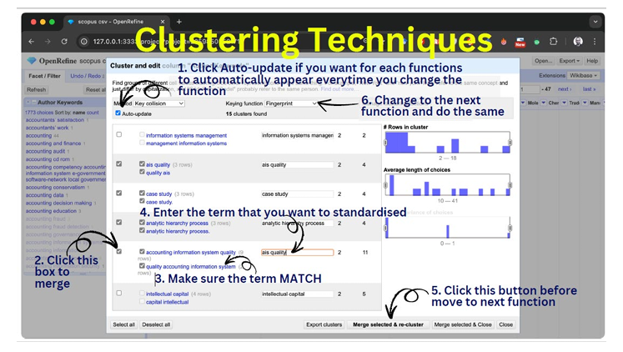

Slide 24
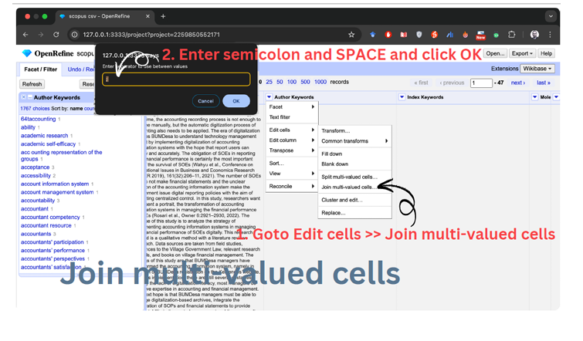
e. Now, proceed to the author keyword column.
Select Edit cells to Join
multi-valued cells.
Enter a semicolon and a space (;) in the separator box.
Then, proceed to click on ok.

Slide 25
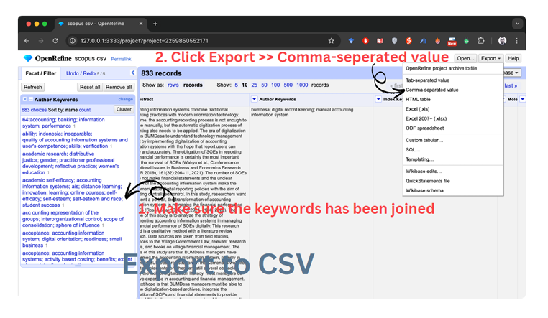
f. Lastly, export the file to CSV (Common Separated Value) and rename it as
openrefinetruncated.

Slide 26
*Unblock Macros in Excel
• Close the Excel file
• In File Explorer, browser to the location where the file is located
• Right-click the file, and select Properties
• In the Properties dialog box, check the unblock box and then click ok
• Click the File, in the Security Warning area, click Enable Content
Bibliomagika Analysis

Slide 27
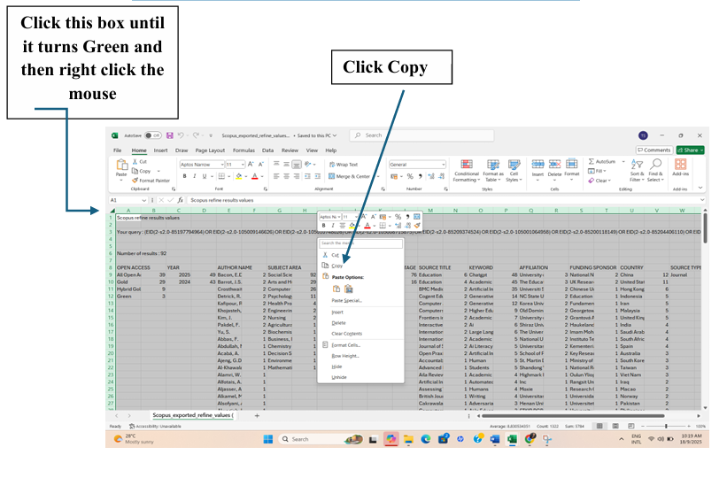
Getting Start with Bibliomagika
• Open Scopus exported Refine values.csv file and then copy

Slide 28
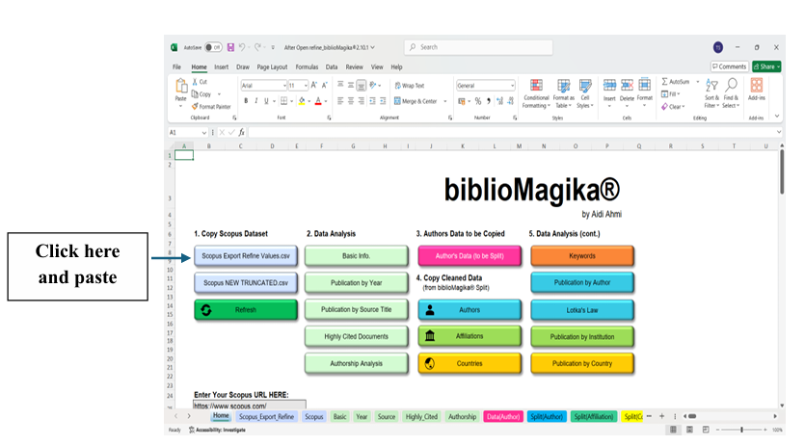
Paste into BilioMagika
• Open BilioMagika, then paste the Scopus exported Refine values.csv file into BilioMagika

Slide 29
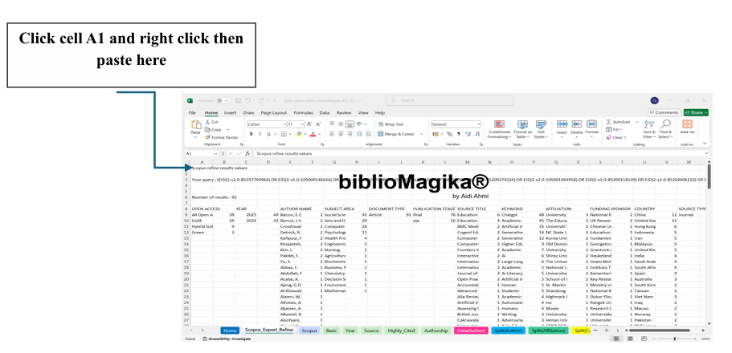

Slide 30
Copy Scopus Truncated File
• Open the scopus TRUNCATED.cvs file
• Copy use same technique as above
• Click the corner arrow box until turns green then right click the mouse
• Then click copy and paste into BiblioMagika file at Scopus NEW TRUNCATED.csv

Slide 31
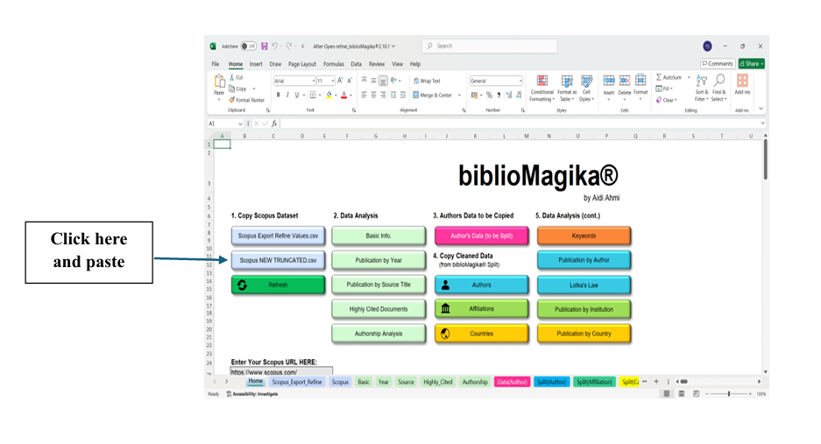

Slide 32
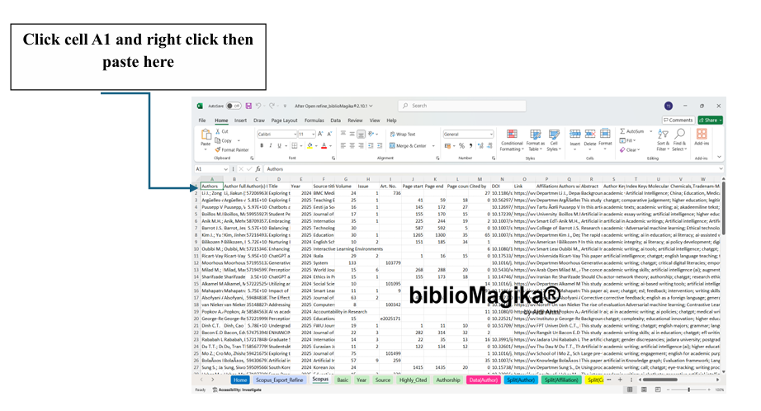

Slide 33
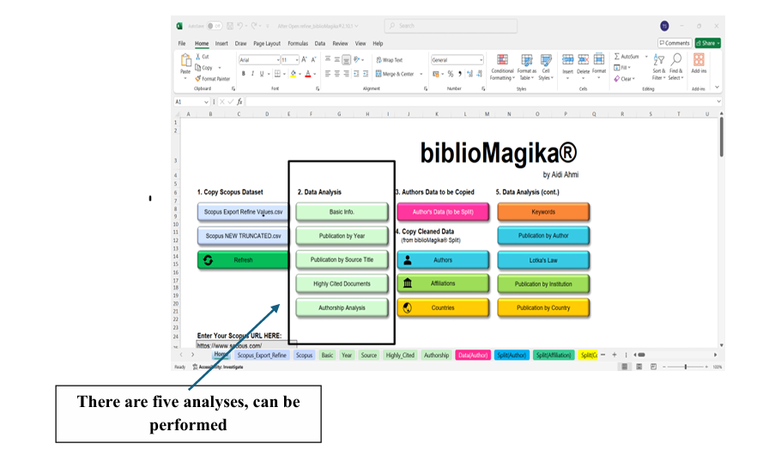

Slide 34
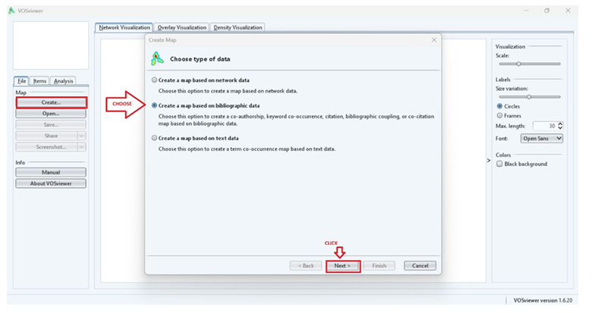
HOW TO ANALYSE USING VOSVIEWER
Install VOSviewer → https://www.vosviewer.com/download
2. Open VOSviewer. Under the file column, choose Create.
3. In the type of data, select
Create a map based on bibliographic data. Click Next

Slide 35
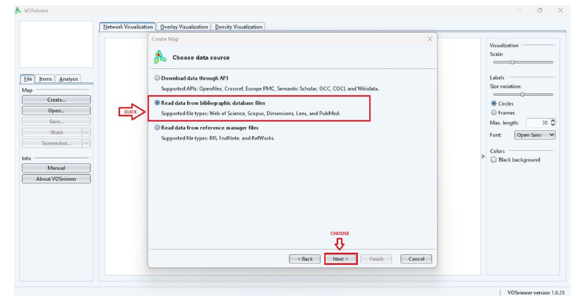
3. Select Read Data from the bibliographic database file, then click Next.

Slide 36
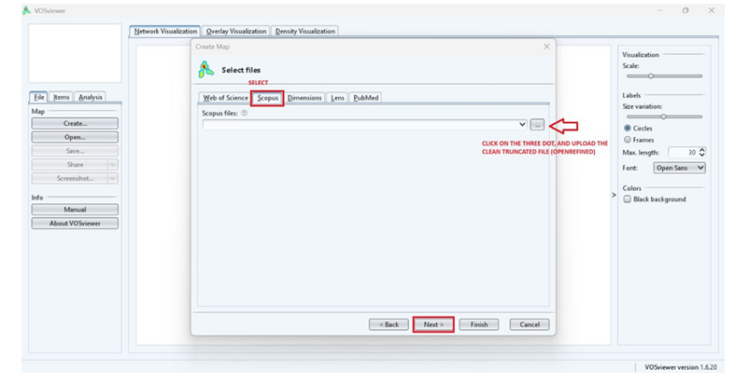
4. Select the files based on your data source and upload the refined/cleaned data. The select NEXT

Slide 37
CO-OCCURRENCE ANALYSIS OF KEYWORDS
It is important to analyse the presences of the keywords to reveal the significant relationships and trends within the research domain.
As such, can provide insights into the research themes and topics that are frequently studied in the chosen research area by highlighting the trends and evolution occurs.

Slide 38
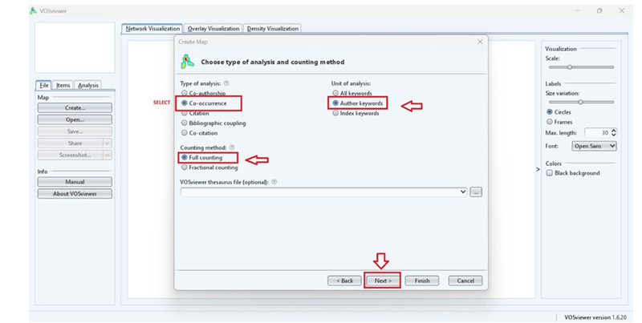
5. In type of analysis, choose co-occurrence. Ensure to select the unit of analysis is “Author Keywords” and counting method is “Full counting”. Then, click NEXT.

Slide 39
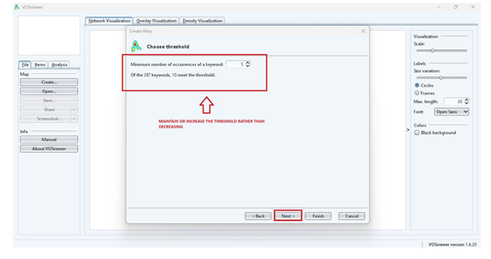
a) Under the threshold, maintain or increase the number rather than decreasing. Then select NEXT.

Slide 40
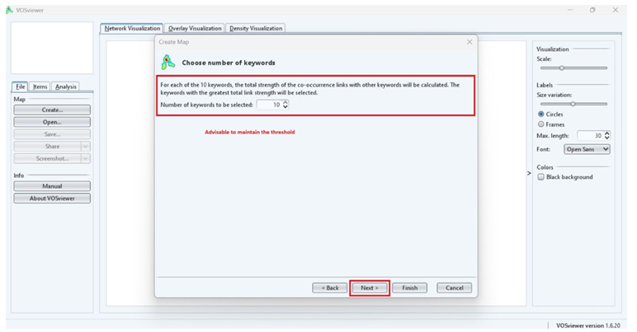
b) Advisable to maintain the threshold number of keywords to be selected by default.

Slide 41
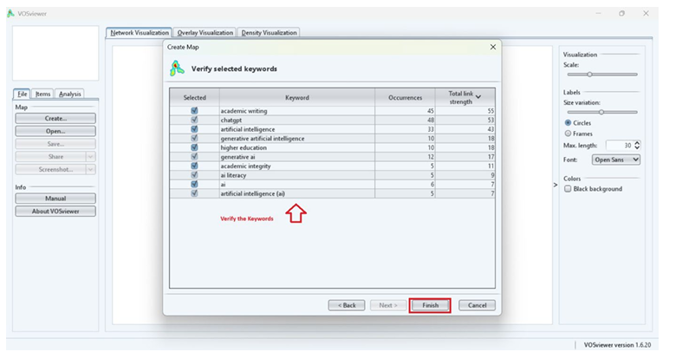
c) Then, verify the selected keywords. Again, select FINISH.

Slide 42
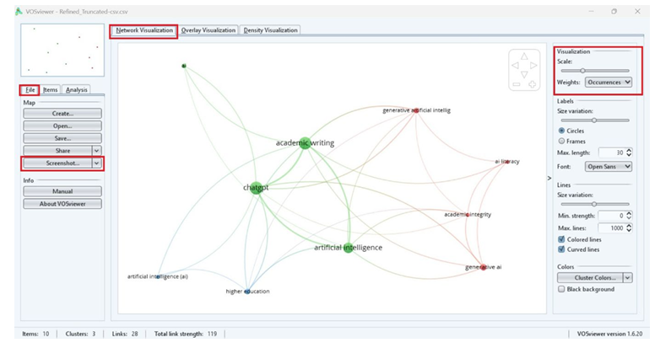
6. Analysis Part: - Network Visualisation
i) At top, Click Network Visualisation and ensure the chosen weight is Occurrences. Then you may click Screenshot to save the image.

Slide 43
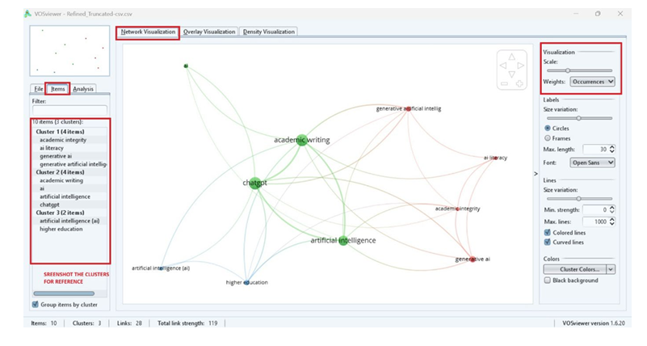
ii) While on your left panel, click on Items. You may view the grouped/clusters based on the keywords. You may screenshot the clusters for your reference.

Slide 44
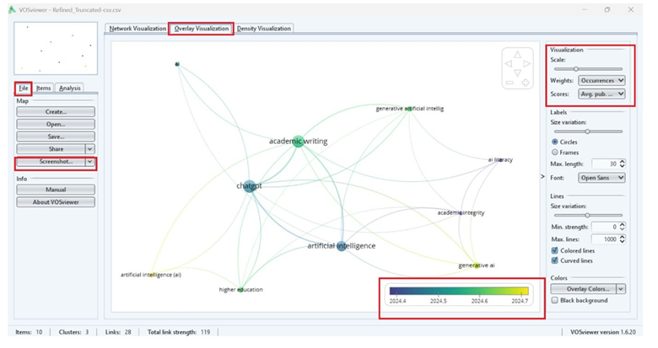
Overlay Visualisation
i) At top, Click Overlay Visualisation. Ensure the chosen weight is Occurrences and scores is Average Publication year. Then you may click Screenshot to save the image.

Slide 45
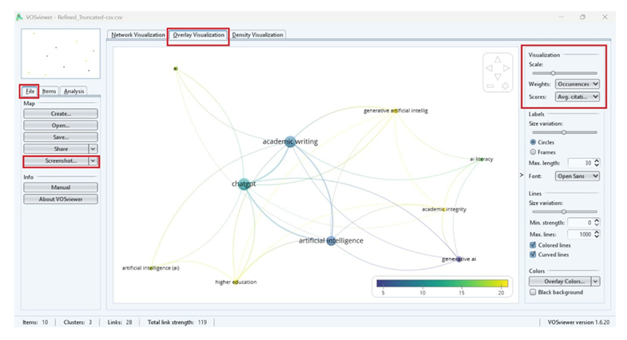
ii) At top, Click Overlay Visualisation. Ensure the chosen weight is Occurrences and scores is Average Citation year. Then you may click Screenshot to save the image.

Slide 46
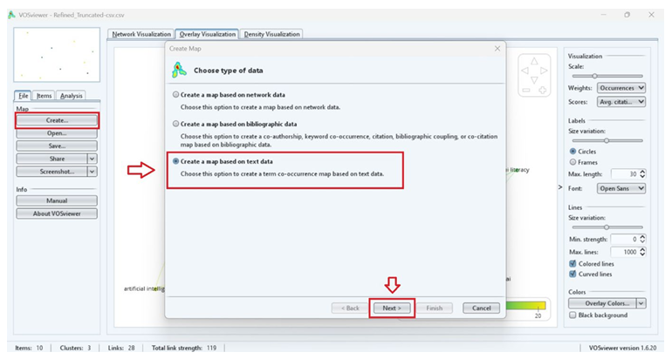
7. Term Co-Occurrence Map
- Is a tool to identify and visualise the relationship between the key terms within the
given set of documents.
a) Under the file column, choose Create. In the type of data, select Create a map based
on text data. Click Next. Then, upload again the same file based on your research data
source.

Slide 47
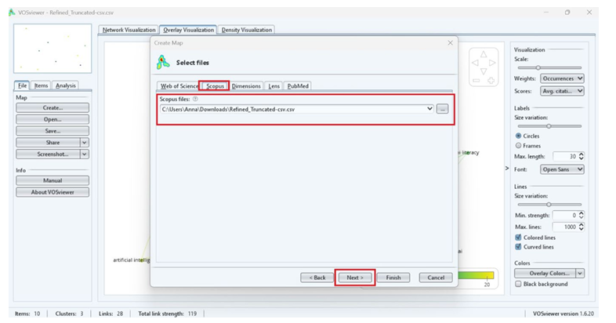

Slide 48
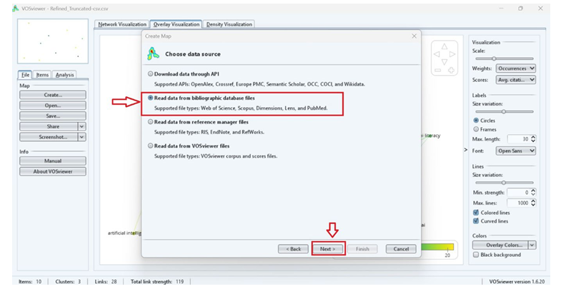
b) Select “Real data from bibliographic database files” then select NEXT.

Slide 49
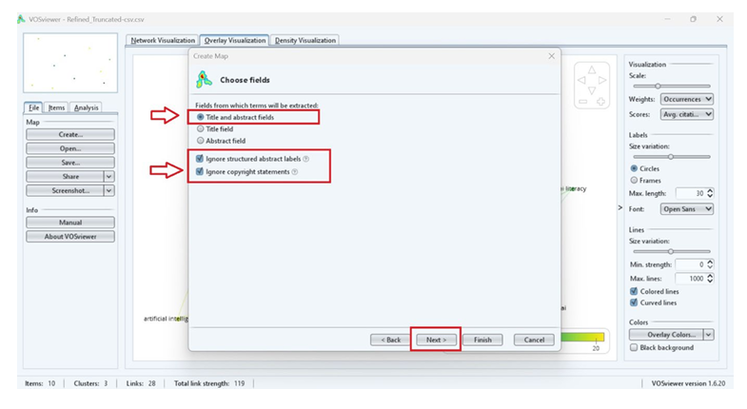
c) Choose “Title and abstract fields” and checked the boxes for Ignore structure abstracts labels and copyrights statements. Click NEXT.

Slide 50
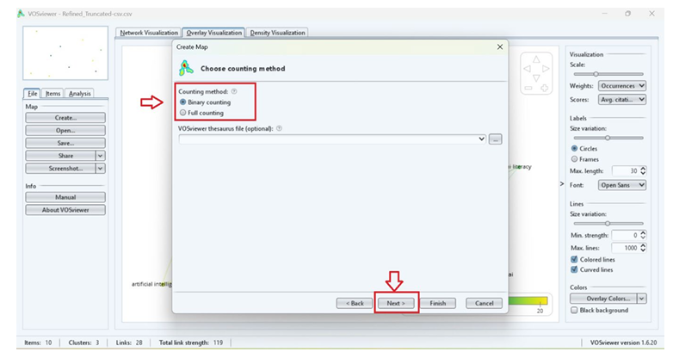
d) Choose “Binary Counting” under the counting method section. Click NEXT.

Slide 51
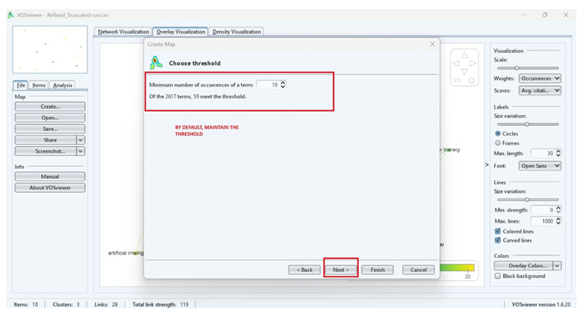
e) Under the threshold, maintain or increase the number rather than decreasing. Then select NEXT. Advisable to maintain the threshold number of keywords to be selected by default.

Slide 52
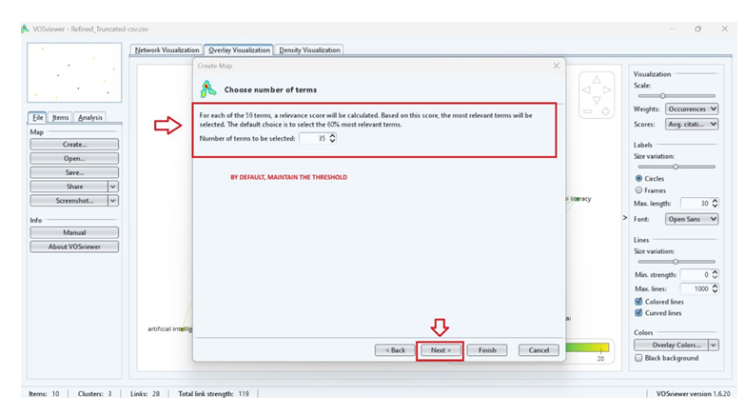

Slide 53

f) Then, verify the selected keywords. Again, select FINISH.

Slide 54

Analysis Part
Network Visualisation
i) At top, Click Network Visualisation and ensure the chosen weight is Occurrences. Then you may click Screenshot to save the image.

Slide 55

ii) While on your left panel, click on Items. You may view the grouped/clusters based on the keywords. You may screenshot the clusters for your reference.

Slide 56

Overlay Visualisation
i) At top, Click Overlay Visualisation. Ensure the chosen weight is Occurrences and
scores is Average Publication year. Then you may click Screenshot to save the
image.

Slide 57

ii) At top, Click Overlay Visualisation. Ensure the chosen weight is Occurrences and scores is Average Citation year. Then you may click Screenshot to save the image.

Slide 58
Methodology
Please describe the methodology of my study based on the attached diagram.
[INSERT DIAGRAM HERE}
AI Prompt for Academic Writing

Slide 59
Hi, for Data Cleaning, Harmonization, and Tools we employed OpenRefine to clean and harmonize the author keywords. Additionally, BiblioMagika (Ahmi, 2024) was utilized to conduct performance analysis, including the following metrics: TP=total number of publications;
NCA=Number of contributing authors; NCP=number of cited publications; TC=total citations; C/P=average citations per publication; C/CP=average citations per cited publication; h=h-index; g=g-index; m=m-index. Furthermore, VOSviewer was used to generate network, overlay, and density visualizations of author keywords. Please enhance the following section.
Data Cleaning Harmonization and tools

Slide 60
I would now like you to analyze and interpret these results. My goal is to publish this work in a high-impact journal. Rather than reiterating the data already presented in the tables and figures, I believe the discussion should focus on interpreting the findings—providing deeper insights that go beyond the numerical results. Insert your objective.
Data Analysis
Document Profile

Slide 61
Click Year in BiblioMagika and Copy paste the Table, then analyse it
To answer RQ2 (In terms of authors, institutions, countries, and source titles, who are the most productive contributors to the study of AI in academic writing?), this section presents publication statistics by authors, institutions, countries, and source titles.
Most Productive Author – Author
Most Productive Institutions – Affiliation
Most Productive Source Title- Source
Objective 1
Current State of Publication on AI in Academic Writing

Slide 62
This section will answer RQ3 (In the research on AI in academic writing, what documents are most often cited?).
Objective 3 Highly Cited Documents

Slide 63
I would like your assistance in interpreting the network visualization of the co-occurrence analysis based on author keywords from the VOSviewer results. Specifically, I need the following:
1.Explanation of Co-occurrence Analysis of Author Keywords: Provide a detailed explanation of the cooccurrence analysis of author keywords as performed using VOSviewer.
2.Explanation of Map Settings: Describe the settings used to generate the co-occurrence map. In our case, we used the full counting method, with a minimum threshold of 7 occurrences per keyword. Out of a total of 3308 keywords, 63 met the threshold, and of those, 62 were connected to each other. We also set 10 minimum number of keywords per cluster.
Objective 4 What are the important keywords and themes in the research of Islamic bank
corporate governance?

Slide 64
3.Terminology Explanation: Clarify the key terminology used in the visualization. For instance, explain that different colors in the map represent distinct clusters, and the size of each node
represents the frequency of keyword occurrences.
4. Detailed Explanation of Clusters: Based on the settings, four clusters were generated. Please elaborate on each of these clusters in detail, interpreting the findings from the table provided
below.
5. Contribution to the Body of Knowledge: Conclude with an explanation of how these findings contribute to the existing body of knowledge, discussing the significance of the results in the broader context of the research field
Objective 4 What are the important keywords and themes in the research of Islamic bank
corporate governance?

Slide 65
I am an academician. I writing a high-impact article with the title "Breast Cancer Detection Using Artificial Intelligence". Write a comprehensive introduction. Give into 3 paragraph and limit words
to 600-800 ONLY.
The introduction should include:
1.A brief overview of the topic, including its importance and relevance in the field.
2. A summary of the current state of research, highlighting key studies and findings.
3. Identification of any gaps, controversies, or unresolved issues in the existing literature.
4. Give some opinion, recommendation and future direction
Introduction

Slide 66
License Deed
You are free to:
Share — copy and redistribute the material in any medium or format
Adapt — remix, transform, and build upon the material
Under the following terms:
Attribution — You must give appropriate credit , provide a link to the license, and indicate if changes were made . You may do so in any reasonable manner, but not in any way that suggests the licensor endorses you or your use
NonCommercial — You may not use the material for commercial purposes .
ShareAlike — If you remix, transform, or build upon the material, you must distribute your contributions under the same license as the original.
Creative Commons Attribution-
NonCommercial-
ShareAlike 4.0 International

Slide 67

License Declaration
2025 Quest International University Fundamentals of Bibliometric Analysis, Tilagavati Subramaniam, Anna Arokia Nathen, Rajespari Kumar . Except where otherwise noted, this work is licensed under the terms of the Creative Commons Attribution 4.0 International License

Slide 68
If you have modified or adapted this OER, explicitly state that your version is an adaptation or derivative, and optionally describe the nature of your changes.
Example:
This slide is adapted from Fundamentals of Bibliometric Analysis by Tilagavati Subramaniam, Anna Arokia Nathen, Rajespari Kumar, licensed under a Creative Commons Attribution 4.0 International License (CC BY-NC-SA). Changes include …
Attribution Statement

Slide 69
The materials provided in this institutional Open Educational Resource (iOER) are intended solely for educational and training (Learning & Development) purposes. Quest International University assumes no responsibility for any misuse, misinterpretation, or unintended application of the content. The views and opinions expressed within these materials are those of the individual authors and do not necessarily reflect the official stance or policy of Quest International University.
No derivative works may use the name, logo, or official branding of Quest International University without prior written approval.
Disclaimer
For any enquiries, kindly email Academic Affairs Division (AAD) at aad@qiu.edu.my

