Slide 1


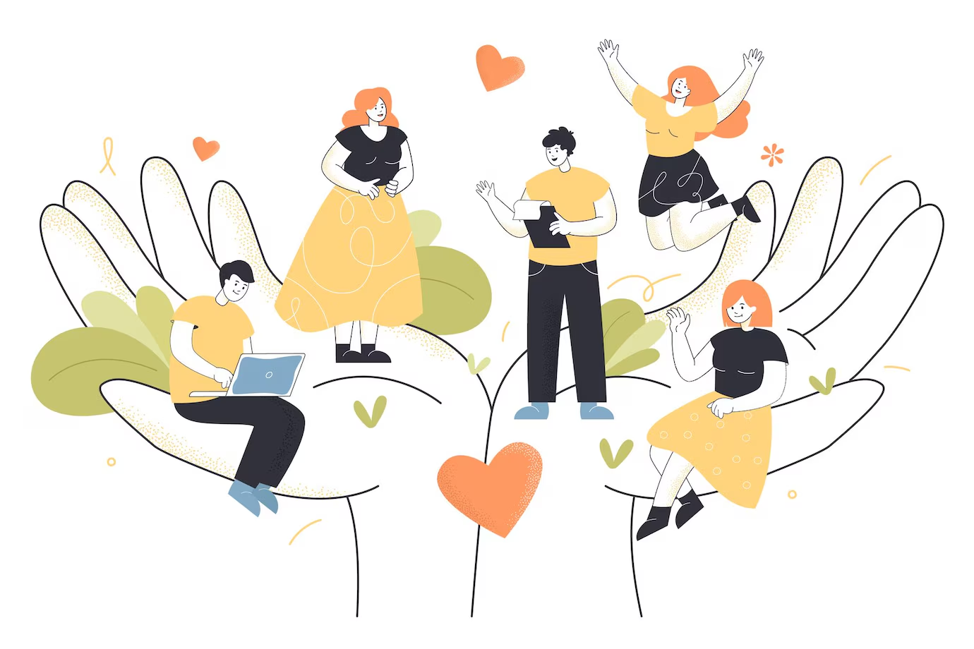

Social Emotional Learning
Author:
Eka Natasha
Muhamad Fanashim Benson
Year: 2022
CC BY-NC-SA 4.0
Designed by Freepik

Slide 2
Definition
Needs of Student
Key Skills
Areas of Social Emotional Learning (SEL) in Classroom
Example
Benefits
Overview

Slide 3

01 Definition
Social and Emotional Learning (SEL)
The process through which all young people and adults acquire and apply the knowledge, skills, and attitudes to develop:
healthy identities
manage emotions
achieve personal and collective goals,
feel and show empathy for others
establish and maintain positive relationships
make responsible and caring decisions.

Slide 4
Social Well-being
Social well-being can be defined as the sharing, developing, and sustaining of meaningful relationships with others. This allows you to feel authentic and valued and provides a sense of connectedness and belonging.
Emotional Well-being
Emotional well-being refers to the emotional quality of an individual's experiences. Emotional well-being is influenced by a variety of psychological, demographic, economic, and situational factors.

Slide 5

According to the Mental Health Foundation:
“A positive sense of well-being…enables an individual to be able to function in society and meet the demands of everyday life. Well-being generally includes global judgments of life satisfaction and feelings ranging from depression to joy.”
Designed by Freepik

Slide 6
02 Needs of Student
Positive relationship with educators and peers
Sense of belonging in the community
Adults in the community to trust and care about them
Validation of emotion and issue that arises
Meaningful choices & opportunity for their goals

Slide 7

03 Key Skills of Social and Emotional Learning
Self –Awareness
Self – Management
Social Awareness
Relationship Skills
Responsible Decision Making
Designed by Freepik

Slide 8
Self –Awareness
The abilities to understand one’s own emotions, thoughts, and values and how they influence behavior across contexts.
Identifying one’s emotions
Demonstrating honesty and integrity
Linking feelings, values, and thoughts
Examining prejudices and biases
Experiencing self-efficacy
Having a growth mindset
Developing interests and a sense of purpose

Slide 9
Self – Management
The abilities to manage one’s emotions, thoughts, and behaviors effectively in different situations and to achieve goals and aspirations.
Managing one’s emotions
Identifying and using stress management strategies
Exhibiting self-discipline and self-motivation
Setting personal and collective goals
Using planning and organizational skills
Showing the courage to take initiative

Slide 10
Social Awareness
The abilities to understand the perspectives of and empathize with others, including those from diverse backgrounds, cultures, and contexts.
Taking others’ perspectives
Recognizing strengths in others
Demonstrating empathy and compassion
Showing concern for the feelings of others
Understanding and expressing gratitude
Identifying diverse social norms, including unjust ones
Sense of belonging

Slide 11
Relationship Skills
The abilities to establish and maintain healthy and supportive relationships and to effectively navigate settings with diverse individuals and groups.
Developing positive relationships
Demonstrating cultural competency
Practicing teamwork and collaborative problem-solving
Resolving conflicts constructively
Resisting negative social pressure
Showing leadership in groups
Seeking or offering support and help when needed
Standing up for the rights of others

Slide 12
Responsible Decision Making
The ability to make caring and constructive choices about how to behave, based on consideration of ethical standards (“benefits and consequences for personal, social, and collective well-being”) as well as relevant social norms and safety concerns.

Slide 13
Demonstrating curiosity and open-mindedness
Learning how to make a reasoned judgment after analyzing information, data, and facts
Making ethical decisions based upon mutual respect and appropriate culturally-relevant social norms
Recognizing one’s responsibility to behave ethically
Identifying solutions for personal and social problems
Anticipating and evaluating the consequences of one’s actions

Slide 14
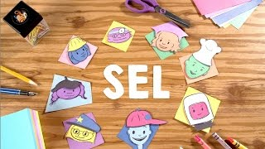
What is SEL and Why SEL Matters?

Slide 15
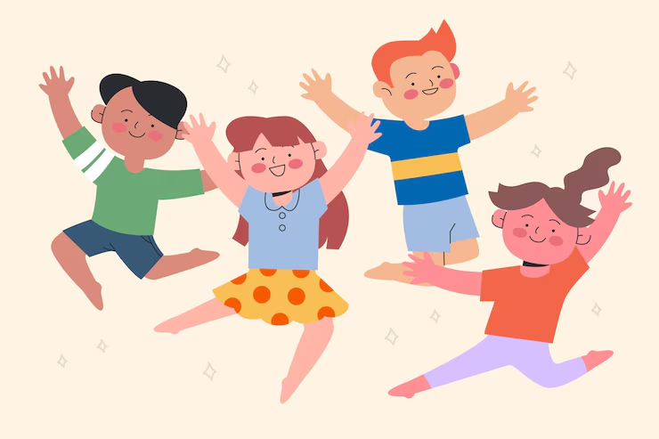
Students who maintain their social network and support systems do better under stress
Designed by Freepik

Slide 16
04 Areas of SEL in a Classroom
Students spend the majority of their university day in classrooms, SEL implementation requires cultivating supportive classroom environments and teaching practices that effectively engage students in deep academic, social and emotional learning.
Three essential areas of hiqh-quality, SEL-focused classrooms:
Supportive classroom climate
Integration of SEL into academic instruction
Explicit SEL instruction

Slide 17
Supportive Classroom
A supportive classroom climate where students feel emotionally safe, part of a community of learners, motivated and challenged. This type of environment creates a strong foundation for students to engage fully and take academic risks (Darling-Hammond et al., 2017). This includes:
Community-building
Belonging and emotional safety
Student-centered discipline

Slide 18
Academic Instruction
Integration of SEL into academic instruction that weaves deep academic learning with opportunities for students to understand their own emotions, empathize with diverse perspectives, cultivate trusting relationships, solve problems constructively, and make decisions while considering the needs of others. This includes:
Fostering academic mindsets
Aligning SEL and academic objectives
Using interactive pedagogy

Slide 19
Explicit SEL Instruction
Explicit SEL instruction that provides consistent opportunities to cultivate, practice, and reflect on social and emotional competencies in ways that are developmentally appropriate and culturally responsive.

Slide 20
Effective SEL instruction has four elements represented by the acronym SAFE:
Sequenced—connected and coordinated activities to foster skills development;
Active—active forms of learning to help students master new skills;
Focused—containing activities that clearly emphasize developing personal and social skills;
Explicit—targeting specific social and emotional skills (Durlak et al., 2010, 2011)

Slide 21
05 Example
Model and cultivate self-awareness
Prompt your class with their own self reflection. Eg: ideas, feelings, and/or goals
Today, my goal is to _________in this class. I am struggling with ______ at the moment, and I know I could do better at________. Now, write about your goal today and three ways in how you could accomplish this.

Slide 22
You are modeling this as well because after this time (maybe 5 minutes) is up, share with them your own thoughts. In being real with them, you are showing your students your human side.
Students need to see that being more self-aware allows one to make corrections to improve and grow from weak areas.

Slide 23
Grow student responsibility
Taking responsibility in the classroom will help students feel like contributors. It will increase their confidence and show them how a community works.
Assign responsibilities such as class greeter, clean-up crew, board cleaner, paper collector, etc.
Taking ownership of things that make a difference to the entire class will show students the role they play in a community setting.

Slide 24
Kind Classroom
This sounds simplistic and obvious, but by having the SEL lens in the classroom, our language and behavior should be warm, encouraging and supportive. This will only help students be more relational inside and outside the classroom.
Self- aware of the importance of our word choice, the tone of voice, and body language and how they can quickly alter an atmosphere into a positive or negative one

Slide 25
For example, when we are walking around the room, we can point out positive behavior (vs focusing on the behavior problems). “Juan, I love how you are using your quiet voice to work with Sara.”
Instead of “Can you stop tapping your pencil, Billy?”, we can say, “Billy, show me what a great listener you are!”
“Bob, I love how you disagreed with kind words and then gave your opinion in an understanding, helpful way.”

Slide 26
This self-fulfilling prophecy allows the student to make a change without feeling belittled or embarrassed. As we model our positive language, we can remind students that we expect this in our classroom.

Slide 27
Positive Self-Talk
You’ve probably heard, “I can’t do this!” or, “I’m just stupid,” more than once.
For students, writing a paper or figuring out a new theory can be incredibly stressful. If they struggle, they are usually immediately tempted to think negatively about themselves and their abilities.
Catch negative self-talk right when it happens — in group or one-on-one settings.
Encourage positive self-talk even further by repeating self-affirmations with your students daily.

Slide 28
Consider setting boundaries in the classroom like, “We don’t say that in this classroom.”
Validate your students’ emotions and invite them to see things differently.
Try saying, “I can see that you feel frustrated with this math problem. It is challenging! And, the truth is that you can do it! You just need to put in a little extra effort. I will help

Slide 29
Acknowledge Emotions
Some educators approach students and their learning in a purely pragmatic way, forgetting that they’re dealing with the whole of the child — body, heart, and mind.
Children are still learning to recognize and handle their emotions, so make sure you approach your students and your teaching with that awareness.

Slide 30
Acknowledge, talk about, and validate your students’ emotions, as they are a huge part of the learning process.
If a student is feeling sad, lonely, or anxious, it will get in the way of their learning. Let your students know that all emotions are okay, that you expect them to feel all sorts of things, and that you will help them learn to manage these emotions.

Slide 31
Rephrase Questions
Do you have any questions?” → “Who has the first question?” or “Ask me two questions about…”
“What did you get?” → “How did you start? Talk through your thinking.”
“What didn’t you get?” → “What do you know?” and “What do you wish you knew?”

Slide 32
“What are you working on?” → “What are you learning?”
“Where were you?” → “We missed you. Is everything OK?”
“What do you want to talk about?” → “What’s on your mind?”
“How are you?”→ “What are your top three feelings today?”
“What do you have to do today?” → “What do you get to do today?”

Slide 33
06 Benefits
Students exposed to SEL programs, academic achievement increased by 11% points.
Students have the proper emotional skills (identify their emotions; develop empathy, increase self-control and manage stress) to realize their potential and adapt to any obstacles they may encounter

Slide 34
Encourage student to be themselves, feel more accepted, work towards goals, be willing to take risks, and just love learning.
Student has a space to talk about mental health with the peers and educators
SEL skills = Desired employability skills

Slide 35
License Deed
You are free to:
Share — copy and redistribute the material in any medium or format
Adapt — remix, transform, and build upon the material
Under the following terms:
Attribution — You must give appropriate credit , provide a link to the license, and indicate if changes were made . You may do so in any reasonable manner, but not in any way that suggests the licensor endorses you or your use
NonCommercial — You may not use the material for commercial purposes .
ShareAlike — If you remix, transform, or build upon the material, you must distribute your contributions under the same license as the original.
Creative Commons Attribution-
NonCommercial-
ShareAlike 4.0 International

Slide 36
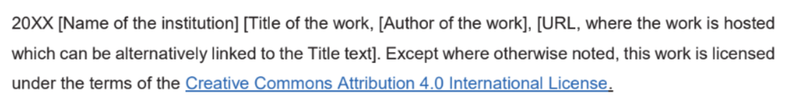
License Declaration
2022 Quest International University Social Emotional Learning, Eka Natasha Muhamad Fanashim Benson. Except where otherwise noted, this work is licensed under the terms of the Creative Commons Attribution 4.0 International License

Slide 37
If you have modified or adapted this OER, explicitly state that your version is an adaptation or derivative, and optionally describe the nature of your changes.
Example:
This slide is adapted from Social Emotional Learning by Eka Natasha Muhamad Fanashim Benson, licensed under a Creative Commons Attribution 4.0 International License (CC BY-NC-SA). Changes include …
Attribution Statement
Notes:
https://opentextbc.ca/adaptopentextbook/chapter/adaptation-statement/
https://guides.skylinecollege.edu/c.php?g=1176803&p=8601457
https://nmoer.pressbooks.pub/facultyguide/chapter/adaptation-statement/

Slide 38
The materials provided in this institutional Open Educational Resource (iOER) are intended solely for educational and training (Learning & Development) purposes. Quest International University assumes no responsibility for any misuse, misinterpretation, or unintended application of the content. The views and opinions expressed within these materials are those of the individual authors and do not necessarily reflect the official stance or policy of Quest International University.
No derivative works may use the name, logo, or official branding of Quest International University without prior written approval.
Disclaimer
For any enquiries, kindly email Academic Affairs Division (AAD) at aad@qiu.edu.my

