Slide 1




Outcome-Based Education (OBE)
Author:
Chin Sook Fui
Year: 2023
CC BY-NC-SA 4.0
Designed by Freepik

Slide 2

COURSE OUTLINE
Topic | Sub-topics |  | Course Learning Outcomes
Introduction to OBE | 1.1 | What is OBE? | Discuss the fundamental concepts of OBE in higher educational context. (C2)
 | 1.2 | Why OBE?
 | 1.3 | Outcomes: PEOs vs PLOs vs CLOs
 | 1.4 | OBE Principles & Characteristics
OBE Curriculum | 2.1 | OBE Approach | Align assessments with intended outcomes. (C5).
 | 2.2 | PDCA Cycle
 | 2.3 | Constructive alignment: Mapping Outcomes
 | 2.4 | Constructive alignment: Mapping CLOs to Assessments

Slide 3
Introduction to OBE

Slide 4
1.1
What is OBE?

Slide 5
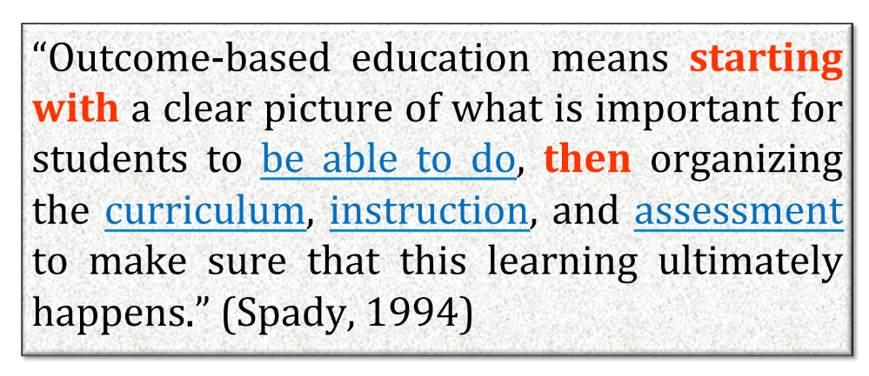
WHAT IS OUTCOME-BASED EDUCATION ?

Slide 6
WHAT IS OUTCOME-BASED EDUCATION ?
OBE is an approach that focuses on the attainment of intended learning outcomes where students develop behaviours that are authentic to their discipline and are assessed holistically within the context of their learning.
It clearly specifies what students are expected to learn and arranges the curriculum such that these intended outcomes are achieved (Harden, 2007).

Slide 7
OBE….
Defines course outcomes to explicate what a student is expected to know, understand or do;
Provides learning activities that help students attain these outcomes;
Assesses the extent to which students achieve these outcomes through the use of explicit assessment criteria as performance indicator.

Slide 8
1.2
Why OBE?

Slide 9
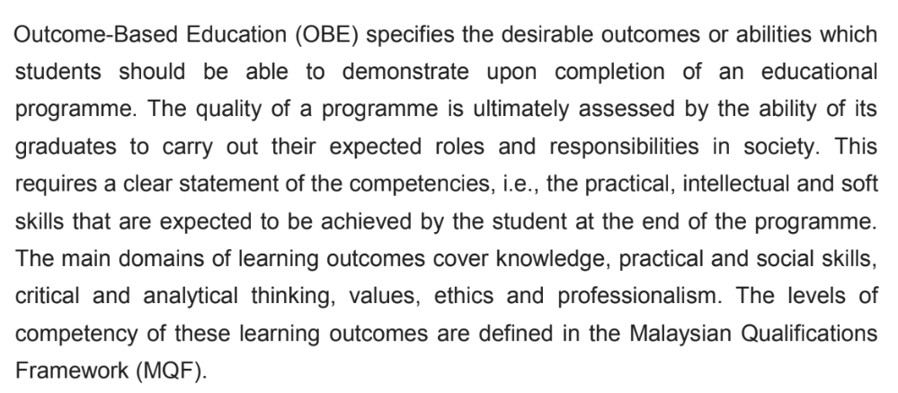
Why OBE?
No OBE,
No Accreditation!
Code of Practice for Programme Accreditation (COPPA) (p.8)

Slide 10
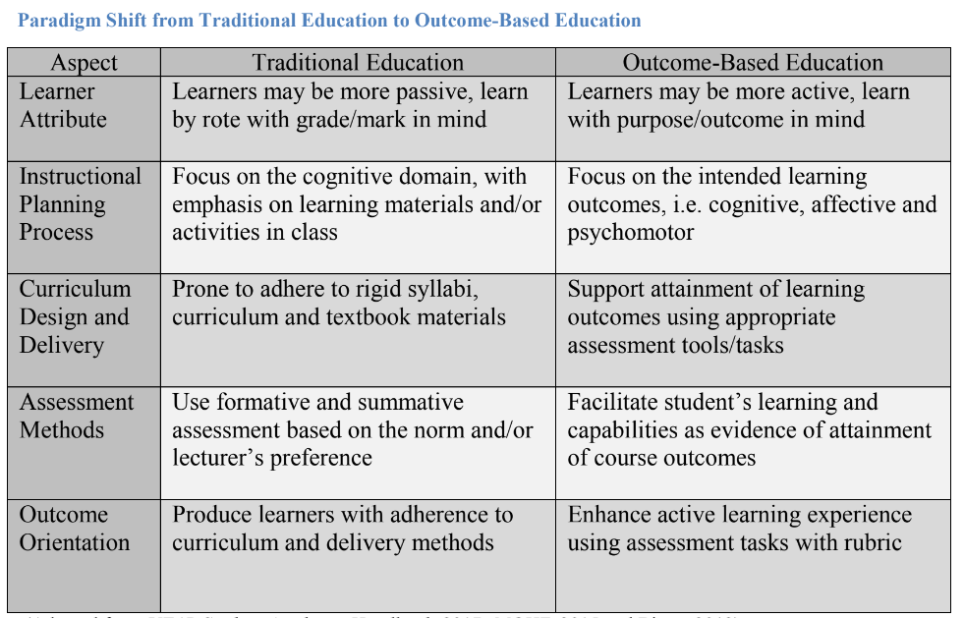
Paradigm Shift from Traditional Education to OBE
(Adapted from MOHE, 2015 and Biggs, 2013)

Slide 11

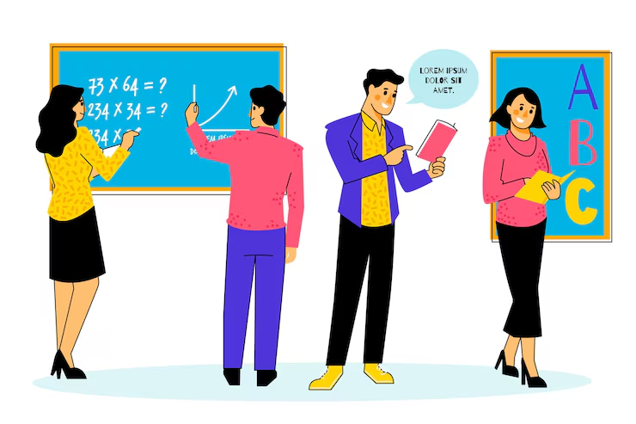
Teacher-Centered
Student-Centered
Designed by Freepik
Teachers | Students | Teachers | Students
Performers | Spectators | Trainers | Active Players
Transfer knowledge | Repeat this knowledge in exam | Both form a society for discovering and creating knowledge
Active | Passive | Both are active
Focused on grading |  | Focused on understanding
Learning Environment |  | Learning Environment
Individual & competitive |  | Cooperative & collaborative

Slide 12
Role of Lecturer in OBE
The lecturer becomes more of a facilitator of learning by stimulating creativity, self learning and critical thinking
Focus on the outcomes of education rather than merely teaching information.
Plan all activities based on outcomes.

Slide 13
1.3
Outcomes:
PEOs, PLOs, CLOs

Slide 14
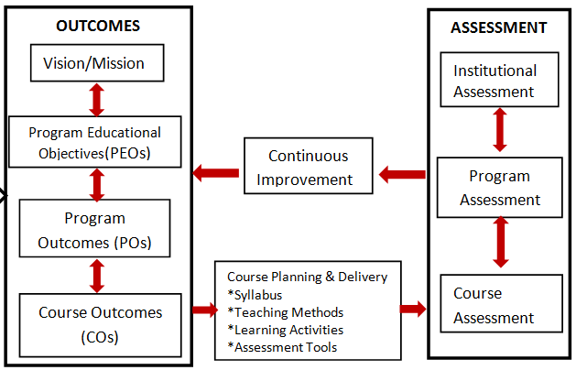
The shift from INPUTS to OUTCOMES !

Slide 15

“So, what is OUTCOME ?”
Designed by Freepik

Slide 16
Few years after Graduation – 3 to 5 years
Programme Educational Objectives
(PEO)
Specific goals consistent with the university’s mission and vision that are responsive to the expressed interest of programme stakeholders, in particular the requirements of professional bodies.
Programme Learning Outcome
(PLO)
Upon Graduation
Describe what students are expected to know and be able to perform or attain by the time of graduation.
Upon course completion
Describes what students are expected to know and be able to perform or attain upon completion of a course.
Each CO contributes to the achievement of PLO via curriculum design, course delivery and assessment tasks that are most appropriate to attain that CLO.
Course Learning Outcome
(CLO)

Slide 17
1.4
OBE Principles & Characteristics

Slide 18
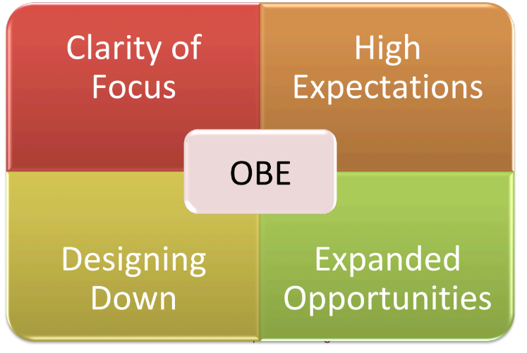
OBE Principles
An OBE curriculum is starting with a clear picture of what is important for students to be able to do, then organizing the curriculum, instruction and assessment to make sure this learning ultimately happens.
(Spady, 1994)

Slide 19
(1) Clarity of Focus
Clearly focused on what we want students to know, understand and be able to do.
Focus on helping students to develop the knowledge, skills and personalities that will enable them to achieve the intended outcomes that have been clearly articulated.

Slide 20
(2) High Expectations
Establish high, challenging standards of performance in order to encourage students to engage deeply in what they are learning.

Slide 21
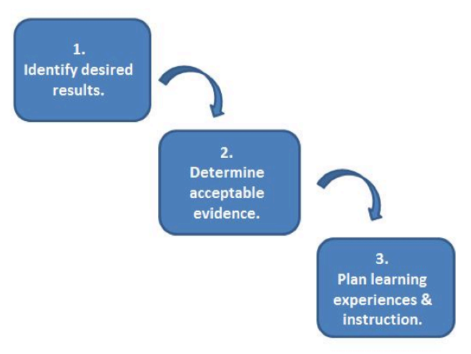
(3) Designing Down
The curriculum design must start with a clear definition of the intended outcomes that students are to achieve by the end of the program.
Once this has been done, all instructional decisions are then made to ensure achieve this desired end result.

Slide 22
(4) Expanded Opportunities
Strive to provide expanded opportunities for all students.
Not all learners can learn the same thing in the same way and in the same time. However, most students can achieve high standards if they are given appropriate opportunities.

Slide 23
Characteristics of OBE Curriculum
Clear programme objectives, programme outcomes, course outcomes and performance indicators/criteria or rubrics.
Stated objectives and outcomes can be assessed and evaluated.
Centered around the needs of the students and the stakeholders.

Slide 24
Programme outcomes address Knowledge, Skills and Attitudes to be attained by students.
Course outcomes must satisfy the stated programme outcomes.
Teaching/ Learning method may have to be integrated to include different delivery methods to complement the traditional Lecturing method.
Learning outcomes are intentional and assessed using suitable performance indicators.

Slide 25
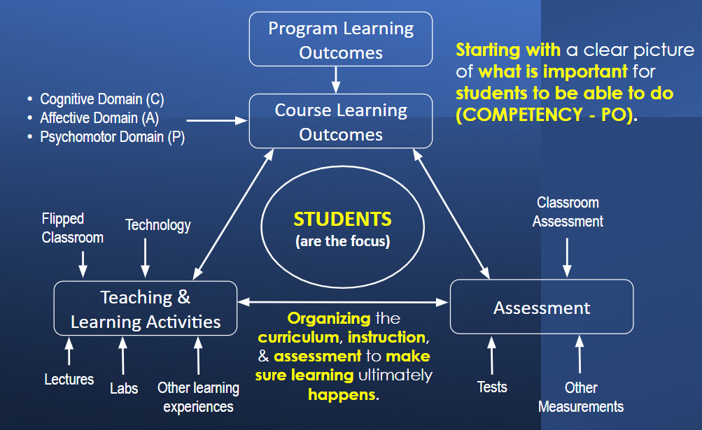
OBE - Constructive Alignment

Slide 26
OBE Curriculum

Slide 27
2.1
OBE Approach

Slide 28
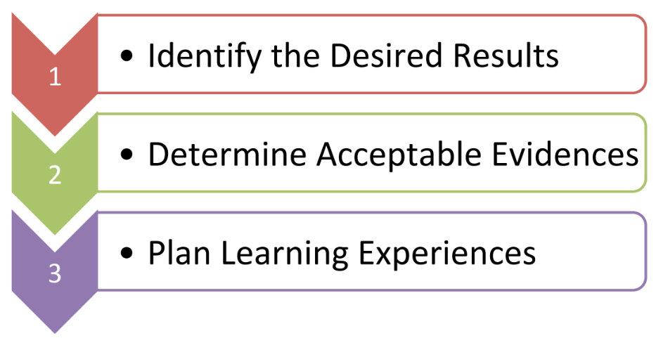
OBE Approach
Backward Design

Slide 29
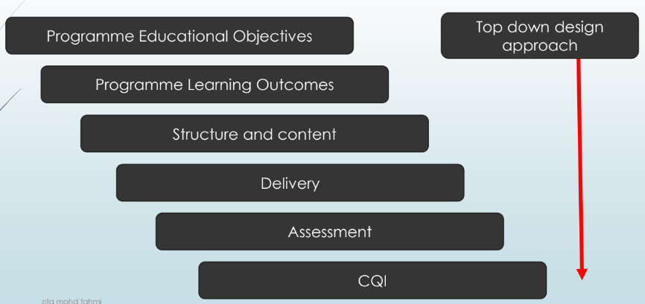
OBE : Well designed and constructively aligned curriculum

Slide 30
OBE addresses the following:
What do we want the students to have or be able to do?
How can we best help students achieve it?
How will we know whether the students have achieved it?
How do we close the loop for further improvement?
Knowledge, Skills, Attitude
Teaching & learning (student-centred)
Assessment
Continuous Quality Improvement (CQI)

Slide 31
OBE Process
Desired Outcomes
Curriculum Designs
Assessments
Continual Quality Improvement

Slide 32
2.2
PDCA Cycle in OBE

Slide 33
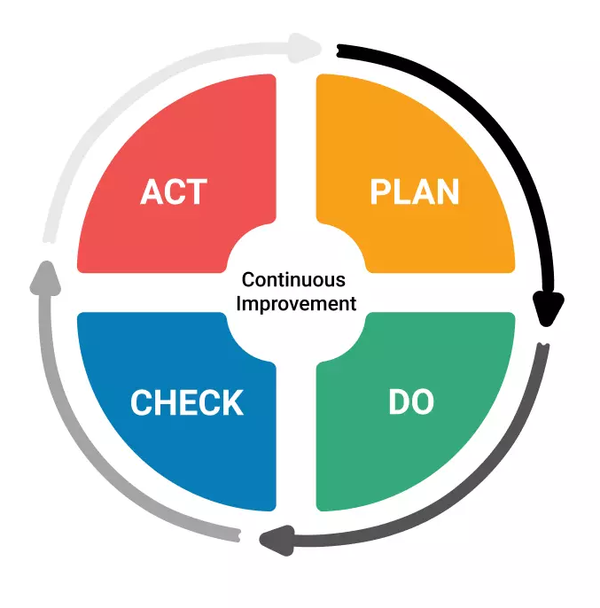
PDCA Cycle
The Plan-Do-Check-Act cycle, also known as PDSA, the "Deming Wheel," and "Shewhart Cycle", is a strategy tool pioneered by Dr William Edwards Deming to formulate theories about what needs to change, and then test them in a "continuous feedback loop."
It’s a problem-solving iterative method for improving processes, services or products continuously.

Slide 34
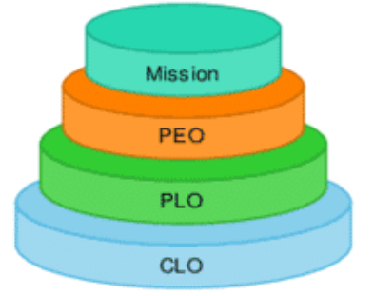
(1) Plan
Outcomes
The desired outcomes are determined first.

Slide 35
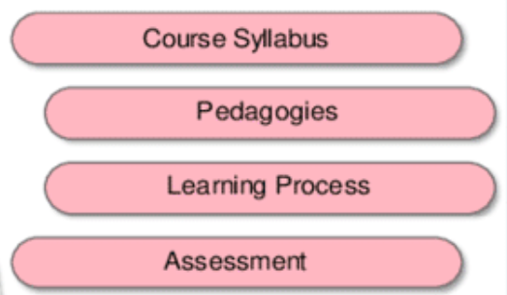
(2) DO
Teaching and Learning Process
The programme curriculum, teaching and learning methodology and supporting facilities are designed to support the intended outcomes.

Slide 36
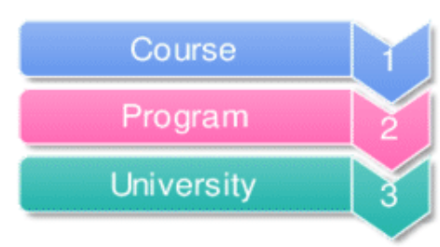
(3) Check
Assessment
The students’ achievements of the outcomes are measured during the course of the study and after the students have graduated and work in industry.

Slide 37
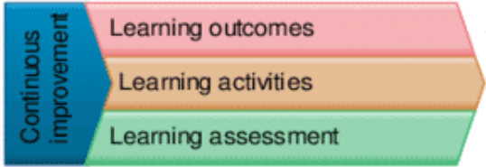
(4) Act
Improvement
Data are collected and analysed for Continual Quality Improvement (CQI).

Slide 38
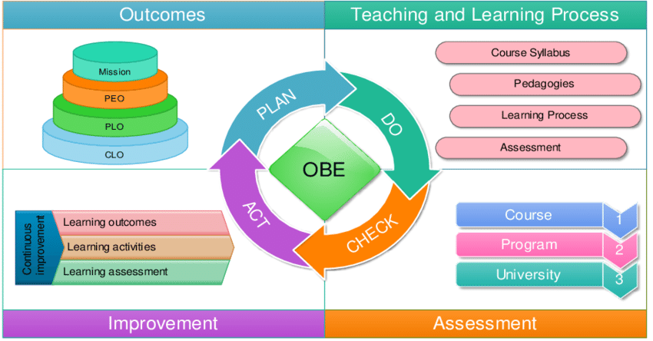
PDCA Cycle in OBE

Slide 39
2.3
Constructive Alignment:
Mapping Outcomes

Slide 40
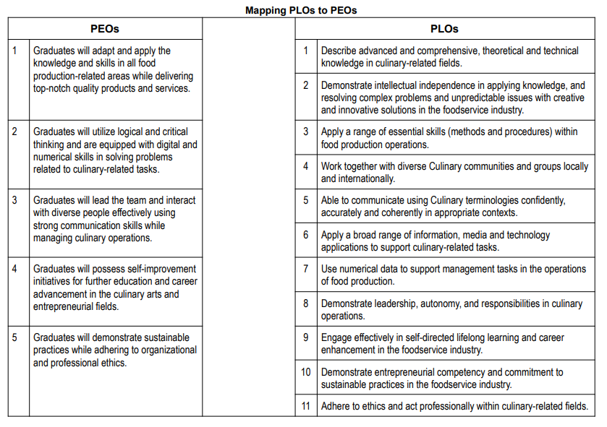
Activity:
Mapping PLOs to PEOs
Note: Answer is on the next slide

Slide 41
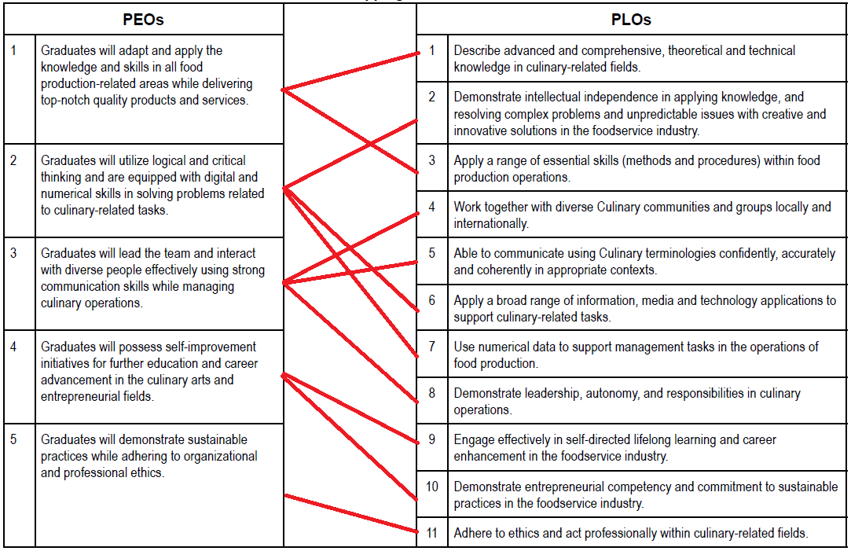

Slide 42
2.4
Constructive Alignment:
Mapping CLOs to Assessments

Slide 43
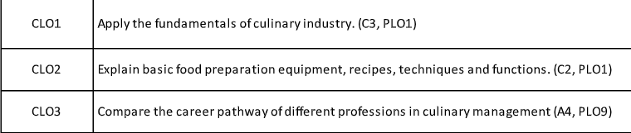
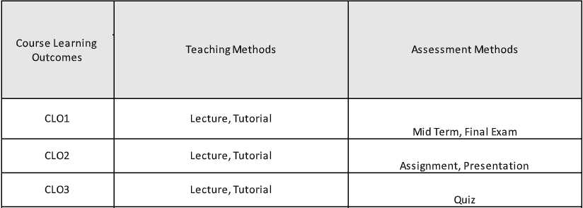
Check the constructive alignment between CLOs and Assessment Method

Slide 44
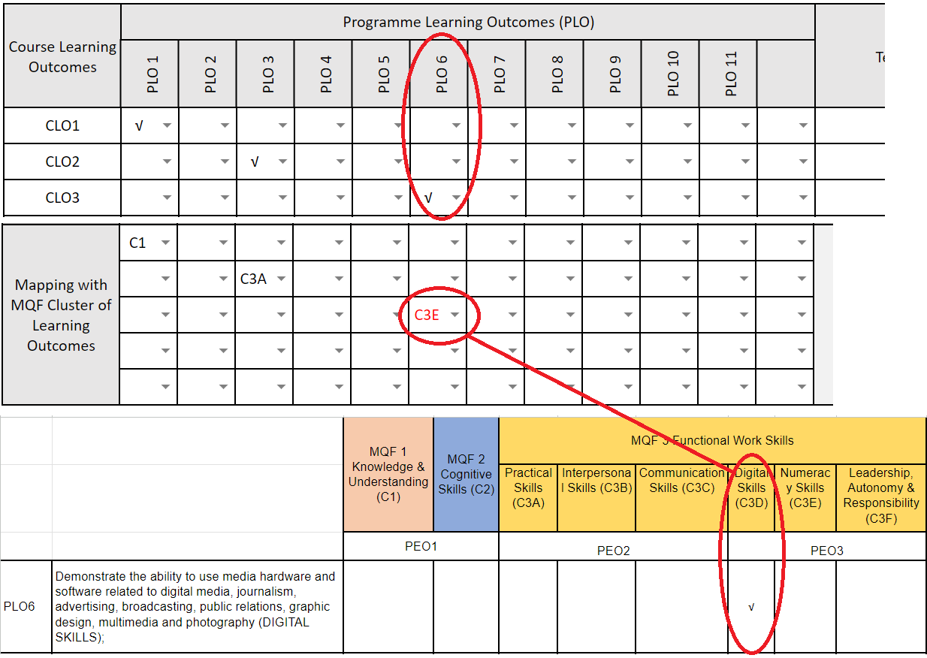

Slide 45
License Deed
You are free to:
Share — copy and redistribute the material in any medium or format
Adapt — remix, transform, and build upon the material
Under the following terms:
Attribution — You must give appropriate credit , provide a link to the license, and indicate if changes were made . You may do so in any reasonable manner, but not in any way that suggests the licensor endorses you or your use
NonCommercial — You may not use the material for commercial purposes .
ShareAlike — If you remix, transform, or build upon the material, you must distribute your contributions under the same license as the original.
Creative Commons Attribution-
NonCommercial-
ShareAlike 4.0 International

Slide 46
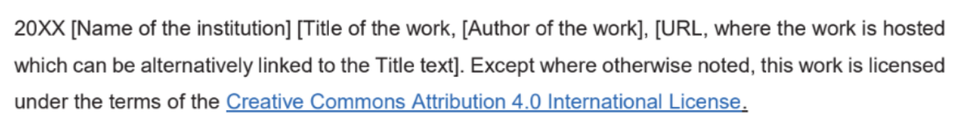
License Declaration
2023 Quest International University Outcome-Based Education (OBE), Chin Sook Fui. Except where otherwise noted, this work is licensed under the terms of the Creative Commons Attribution 4.0 International License

Slide 47
If you have modified or adapted this OER, explicitly state that your version is an adaptation or derivative, and optionally describe the nature of your changes.
Example:
This slide is adapted from Outcome-Based Education (OBE) by Chin Sook Fui, licensed under a Creative Commons Attribution 4.0 International License (CC BY-NC-SA). Changes include …
Attribution Statement
Notes:
https://opentextbc.ca/adaptopentextbook/chapter/adaptation-statement/
https://guides.skylinecollege.edu/c.php?g=1176803&p=8601457
https://nmoer.pressbooks.pub/facultyguide/chapter/adaptation-statement/

Slide 48
The materials provided in this institutional Open Educational Resource (iOER) are intended solely for educational and training (Learning & Development) purposes. Quest International University assumes no responsibility for any misuse, misinterpretation, or unintended application of the content. The views and opinions expressed within these materials are those of the individual authors and do not necessarily reflect the official stance or policy of Quest International University.
No derivative works may use the name, logo, or official branding of Quest International University without prior written approval.
Disclaimer
For any enquiries, kindly email Academic Affairs Division (AAD) at aad@qiu.edu.my

