Slide 1




Open Educational Resources
Author:
Tina Lim
Year: 2020
CC BY-NC-SA 4.0
UNESCO
Notes:
Image: https://www.freepik.com/

Slide 2
Basics of Creative Commons (CC)
CC License Chooser Tool
TASL
License Deeds
Overview

Slide 3





WHERE TO SEARCH FOR OER?
https://openstax.org/subjects
https://open.umich.edu/find/open-
educational-resources/medical-resources
https://open.bccampus.ca/browse-our-collection/find-open-textbooks/?subject
https://www.merlot.org/merlot/materials.htm

Slide 4
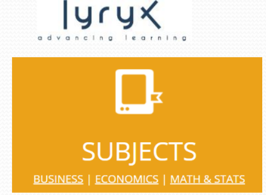


https://lyryx.com/subjects/business/
https://lyryx.com/subjects/economics/
https://lyryx.com/subjects/mathematics
-statistics/
https://www.saylor.org/books/
https://irsc.libguides.com/business/OER

Slide 5




https://open.umn.edu/opentextbooks/
https://www.textbookequity.org/
https://libguides.humboldt.edu/openedu/
https://ocw.mit.edu/index.htm

Slide 6
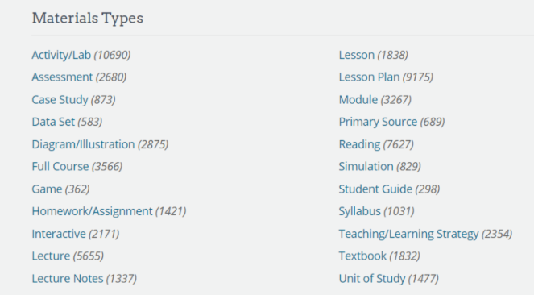
OER COMMONS: https://www.oercommons.org/

Slide 7


Open Educational Resources (OER): Images
https://libguides.astate.edu/oer/images
Open Educational Resources (OER): Audio
https://libguides.library.cityu.edu.hk/oer/audio

Slide 8
BASICS OF CREATIVE COMMONS (CC)
Enables creators to share creative works legally by providing a number of copyright licenses and tools that creators may use to grant the public specific permissions on how to use their works

Slide 9
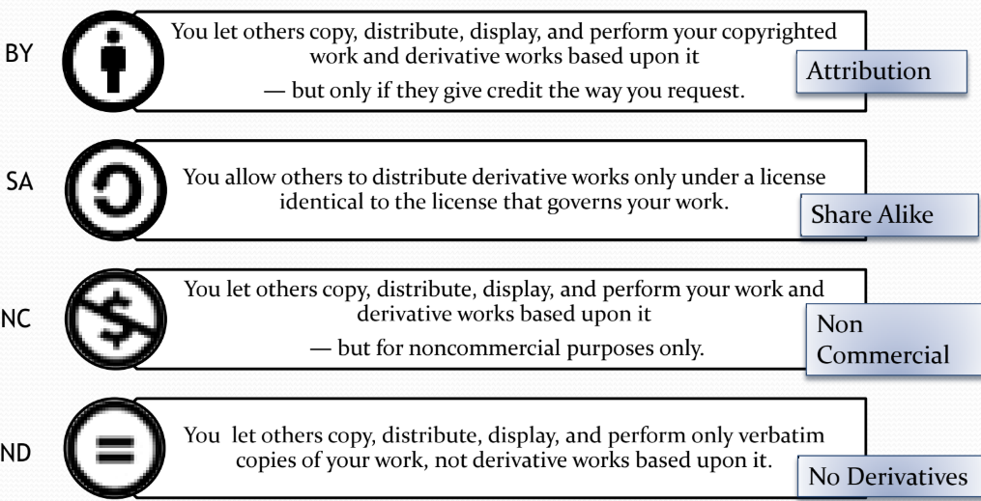
CREATIVE COMMONS
Four terms (with abbreviations and standard symbols)

Slide 10
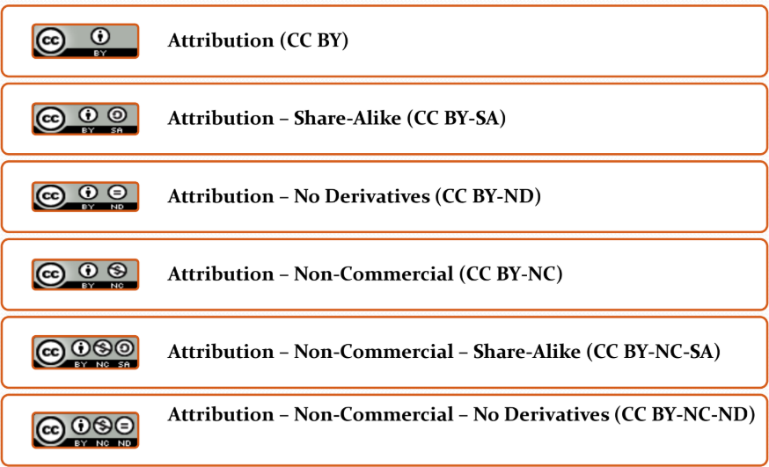
6 CC Licenses

Slide 11
CC LICENCE CHOOSER TOOL
https://creativecommons.org/choose/#metadata

Slide 12

TASL
TASL
Title of material – What is the name?
Author – Who owned it?
Source – Where to find?
License – Which CC license?
https://wiki.creativecommons.org/wiki/Best_practices_for_attribution#This_is_a_good_attribution_for_
material_you_modified_slightly

Slide 13
LICENSE DEEDS
Attribution
Attribution — Share-Alike
Attribution — No Derivatives
Attribution — Non-Commercial
Attribution — Non-Commercial — Share-Alike
Attribution — Non-Commercial — No Derivatives

Slide 14
License Deed
You are free to:
Share — copy and redistribute the material in any medium or format
Adapt — remix, transform, and build upon the material
Under the following terms:
Attribution — You must give appropriate credit , provide a link to the license, and indicate if changes were made . You may do so in any reasonable manner, but not in any way that suggests the licensor endorses you or your use
NonCommercial — You may not use the material for commercial purposes .
ShareAlike — If you remix, transform, or build upon the material, you must distribute your contributions under the same license as the original.
Creative Commons Attribution-
NonCommercial-
ShareAlike 4.0 International

Slide 15
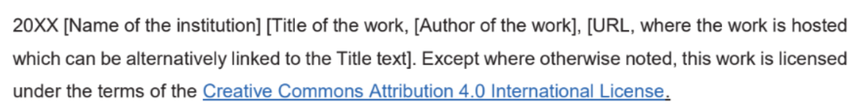
License Declaration
2020 Quest International University Open Educational Resources, Tina Lim. Except where otherwise noted, this work is licensed under the terms of the Creative Commons Attribution 4.0 International License

Slide 16
If you have modified or adapted this OER, explicitly state that your version is an adaptation or derivative, and optionally describe the nature of your changes.
Example:
This slide is adapted from Open Educational Resources by Tina Lim, licensed under a Creative Commons Attribution 4.0 International License (CC BY-NC-SA). Changes include …
Attribution Statement
Notes:
https://opentextbc.ca/adaptopentextbook/chapter/adaptation-statement/
https://guides.skylinecollege.edu/c.php?g=1176803&p=8601457
https://nmoer.pressbooks.pub/facultyguide/chapter/adaptation-statement/

Slide 17
The materials provided in this institutional Open Educational Resource (iOER) are intended solely for educational and training (Learning & Development) purposes. Quest International University assumes no responsibility for any misuse, misinterpretation, or unintended application of the content. The views and opinions expressed within these materials are those of the individual authors and do not necessarily reflect the official stance or policy of Quest International University.
No derivative works may use the name, logo, or official branding of Quest International University without prior written approval.
Disclaimer
For any enquiries, kindly email Academic Affairs Division (AAD) at aad@qiu.edu.my

