Slide 1




KAHOOT!
Authors:
Racheal Har Ann Li
Quratul Ain
Year: 2020
CC BY-NC-SA 4.0
Notes:
Image: https://www.freepik.com/

Slide 2
Introduction
How to create a Kahoot!
Presenting a Kahoot!
Students’ progress report
Assigning self-paced challenges
Overview

Slide 3

INTRODUCTION
Kahoot! is a game based learning platform and is a very popular educational tool.
Kahoot! can be used in a variety ways including:
Set induction
As a quiz to test students’ understanding
To get students’ feedback
To assess students’ progress in the content

Slide 4
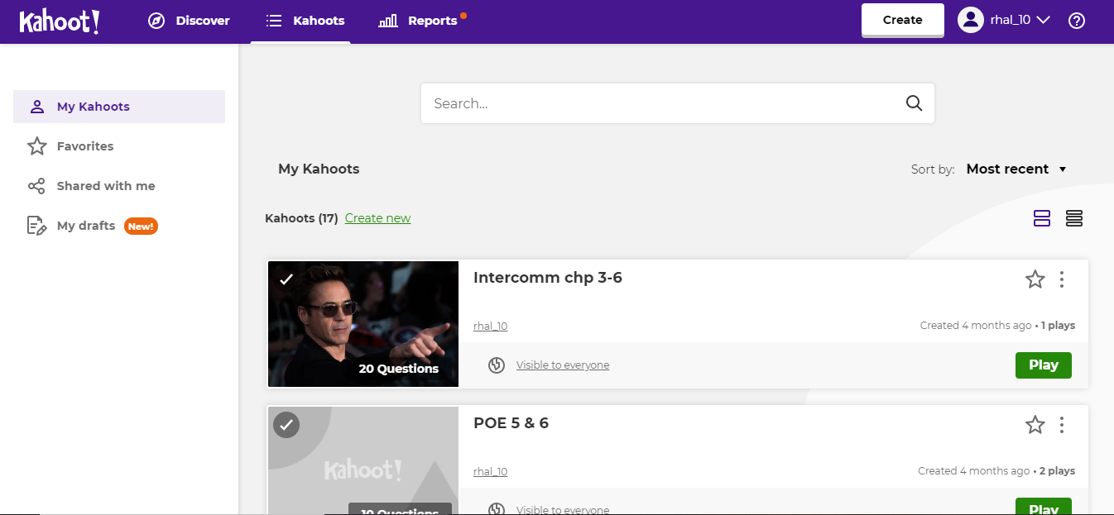
HOW TO CREATE KAHOOT!
Step 1: My Kahoots > create new

Slide 5
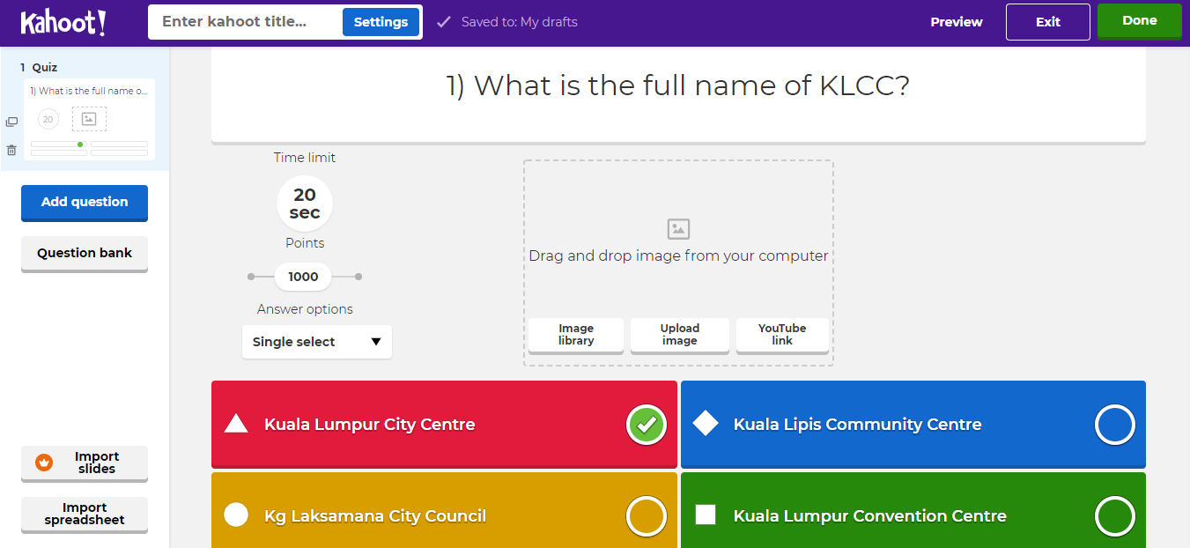
Step 2: Type your question into the space. Play around with the quiz settings

Slide 6
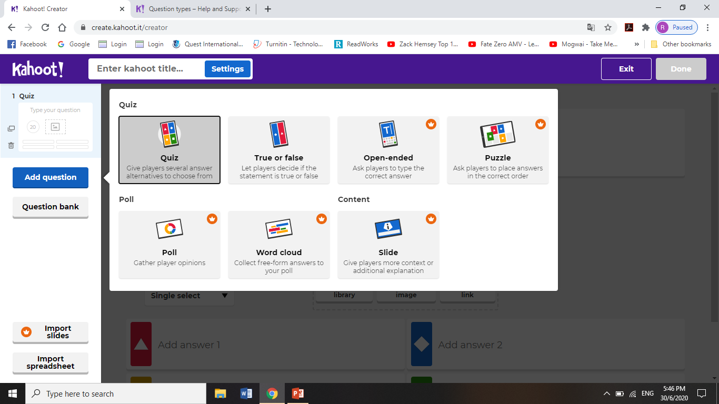
As a basic user, only Quiz and True/False formats are allowed.
Other advanced feature would require a paid subscription.

Slide 7
PRESENTING A KAHOOT!
Present your Kahoot! Questions just like you would do for your regular PowerPoint slides.
Ideally, students should have 2 devices on hand when playing Kahoot!
Laptop/ Computer to view the questions
Smartphone to answer or vice versa
However, if your students only have one device…

Slide 8
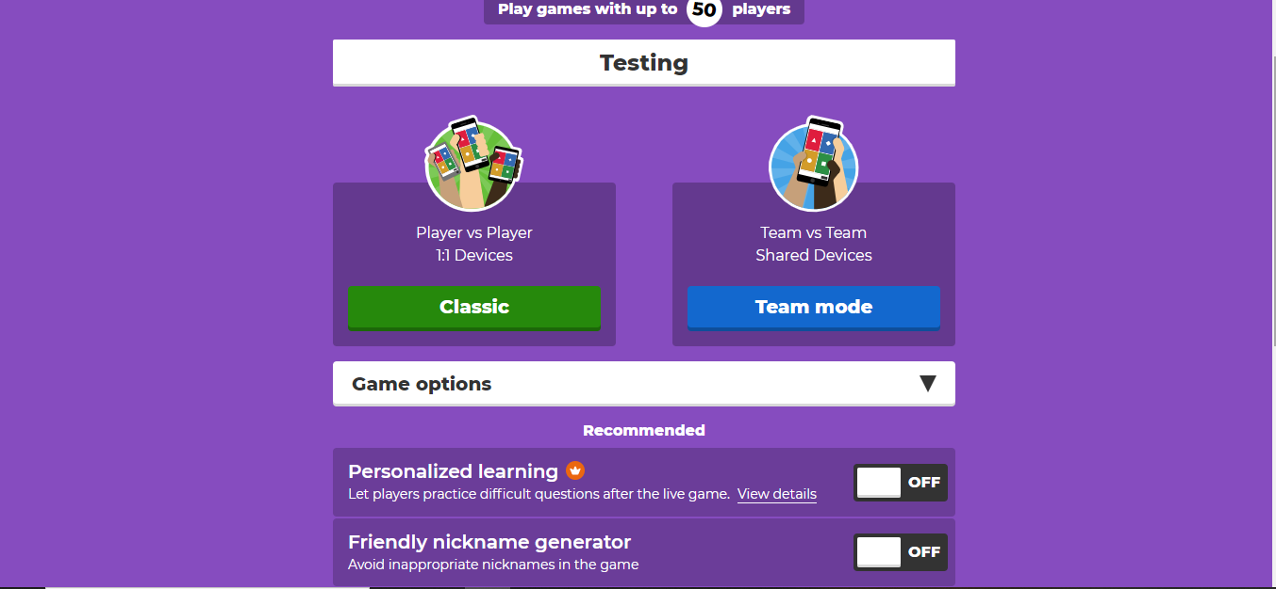
Before starting
Customize the options to your liking

Slide 9
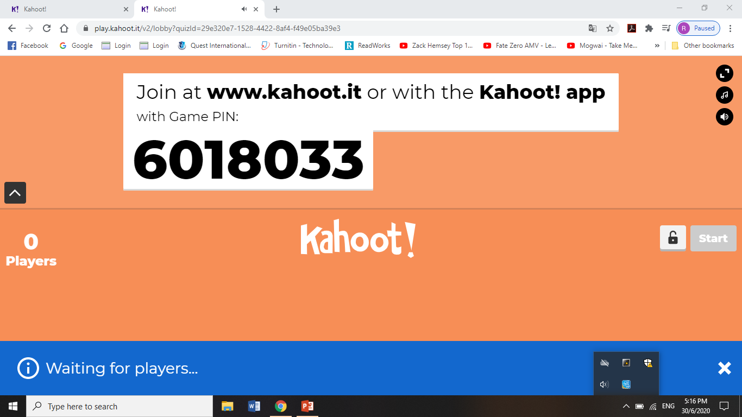
To join:
1) If students use their smartphones to play and view questions on their second device, then it’s no problem.

Slide 10
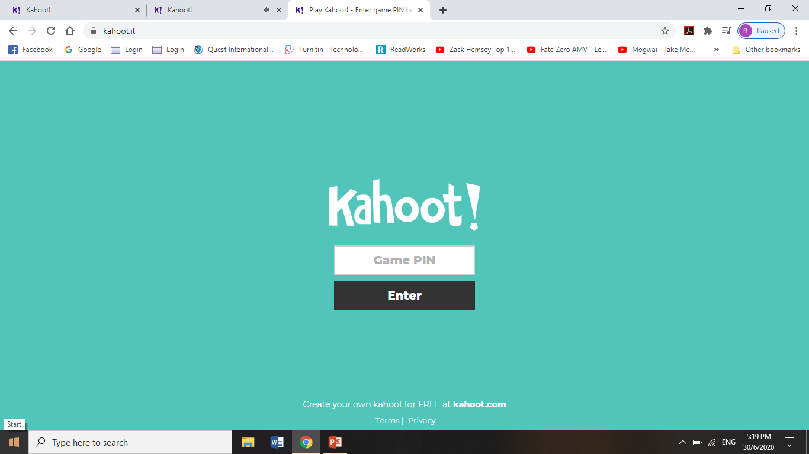
On 1 device:
Get students to open a new tab.

Slide 11
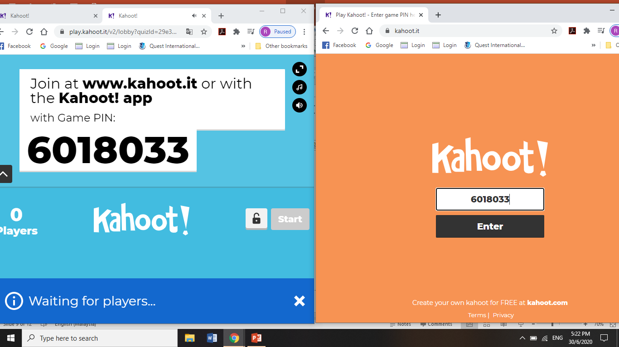
Then, get them to drag that tab out to create a new window. It will look like this.

Slide 12
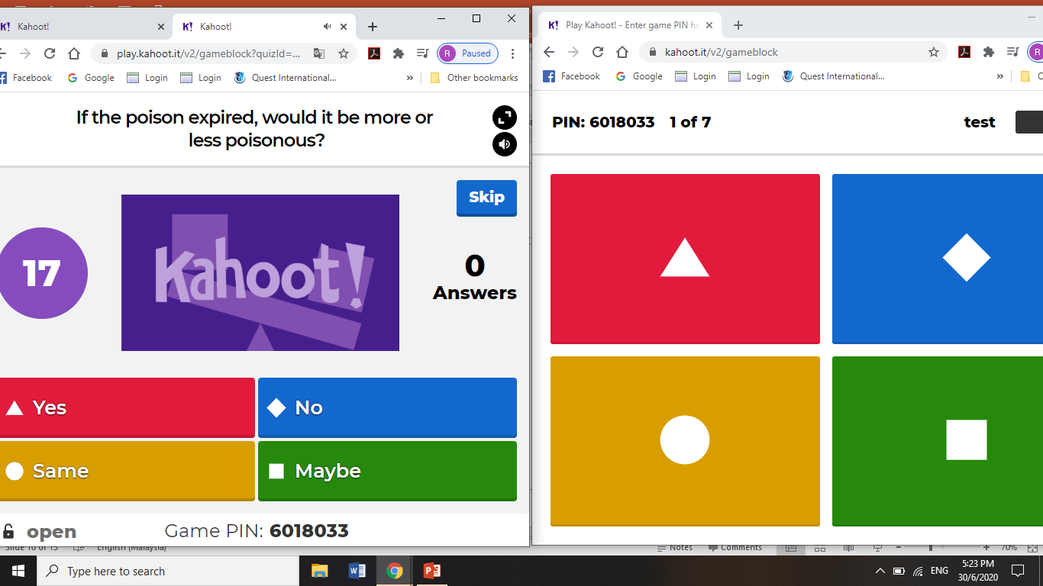
This is students’ view (if using only 1 device)

Slide 13
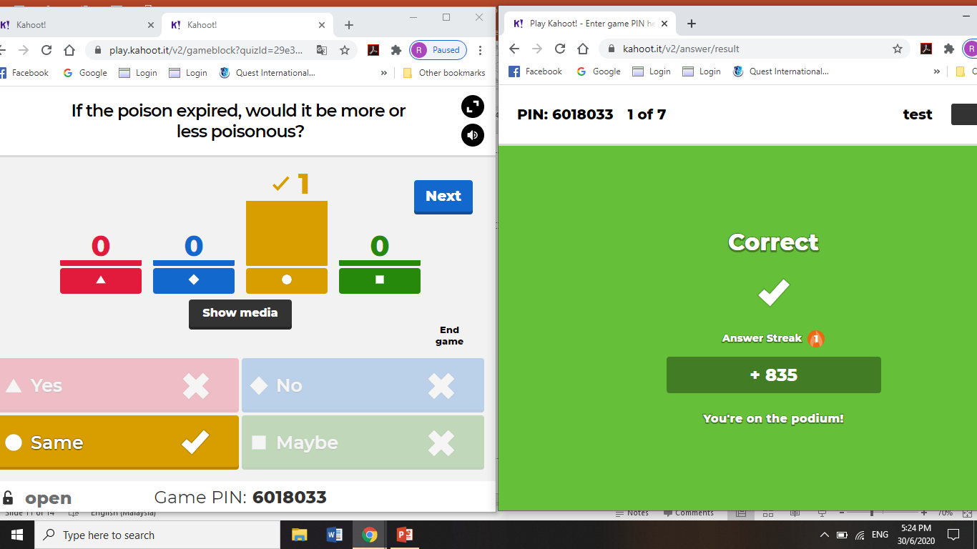
More examples

Slide 14
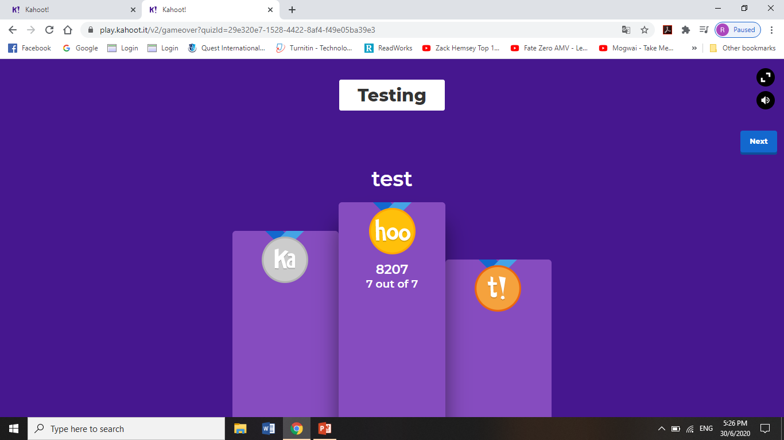
At the end of the game…
Students can see their scores

Slide 15
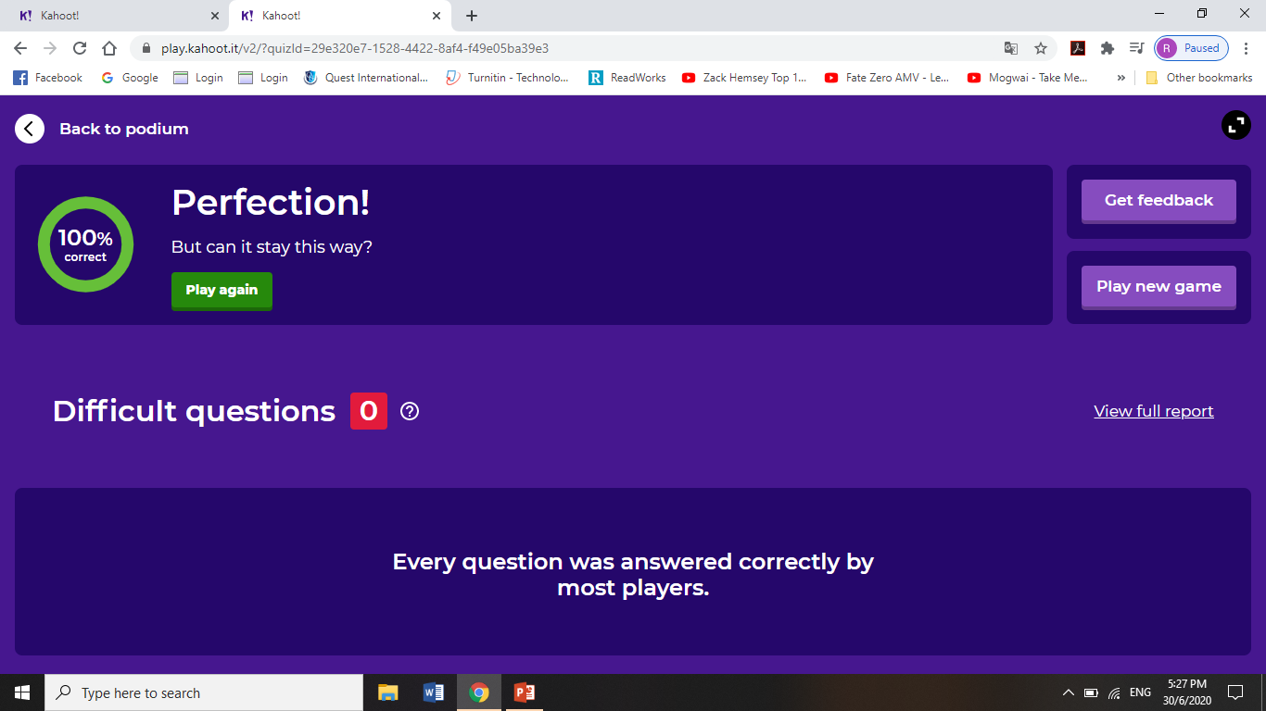
STUDENTS’ PROGRESS REPORT
You can choose to get students’ feedback or view a report on their performance

Slide 16
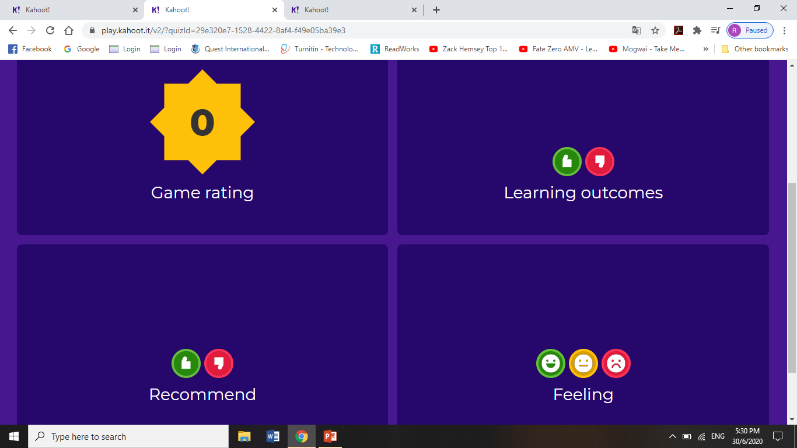
You can get students’ to feedback on:

Slide 17
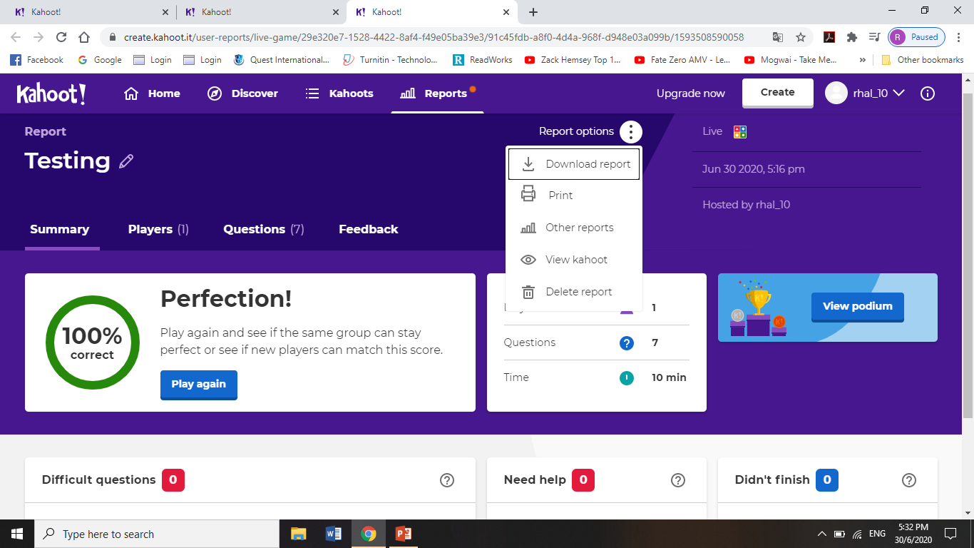
You can view the statistics and even download for your own analysis:

Slide 18
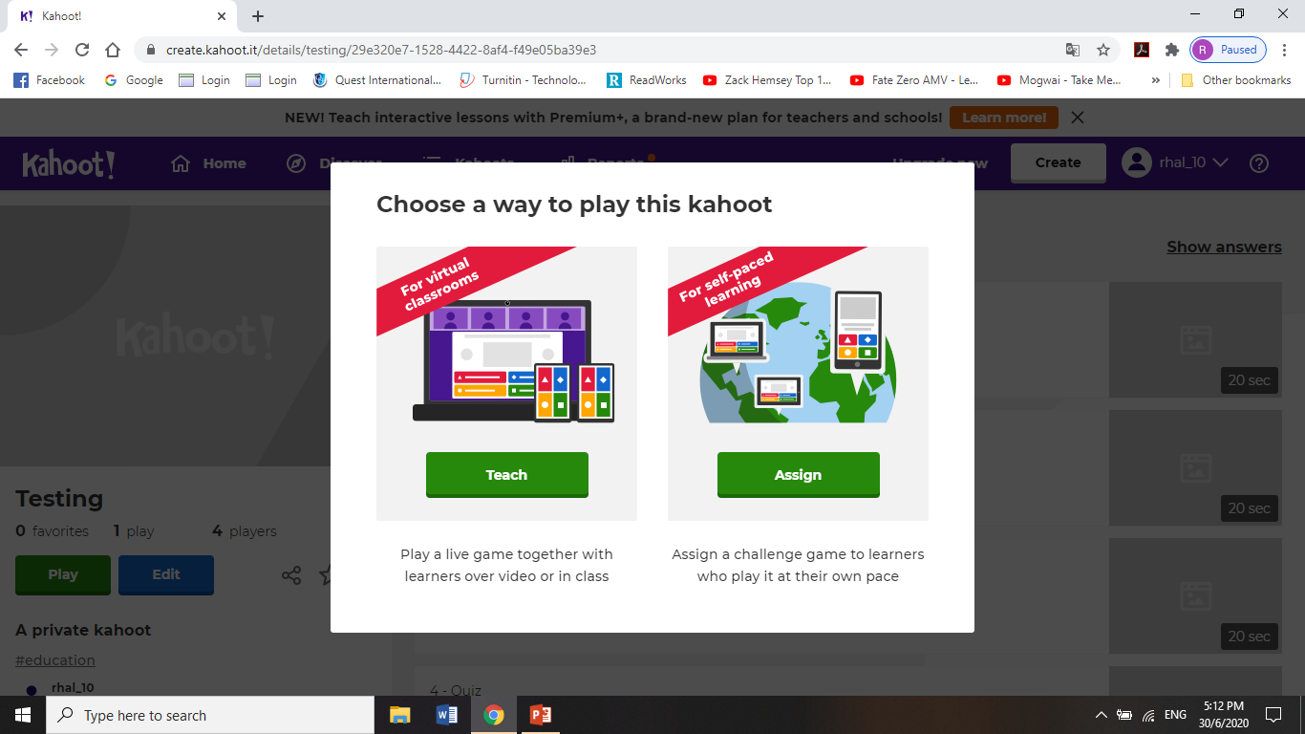
ASSIGNING SELF-PACED CHALLENGES

Slide 19
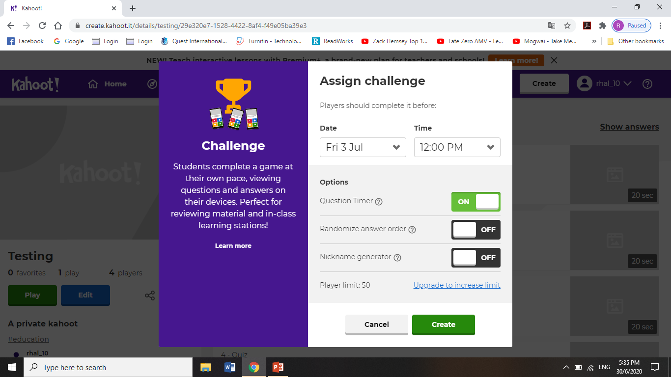

Slide 20
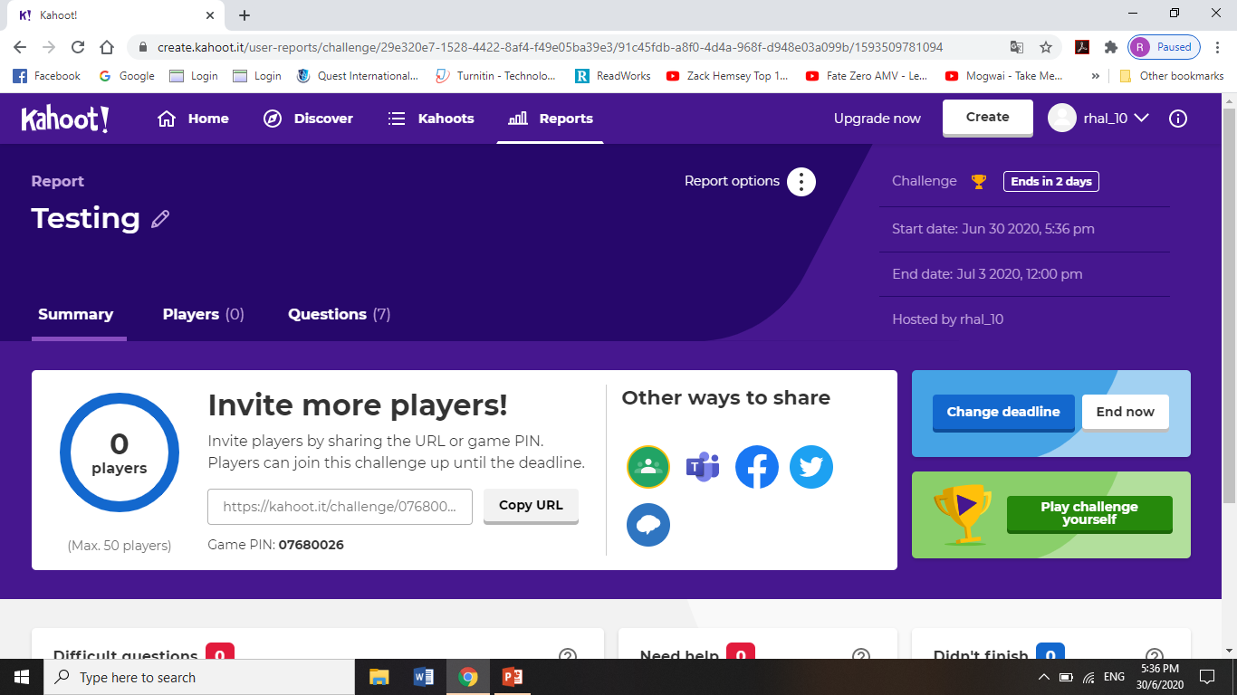

Slide 21
License Deed
You are free to:
Share — copy and redistribute the material in any medium or format
Adapt — remix, transform, and build upon the material
Under the following terms:
Attribution — You must give appropriate credit , provide a link to the license, and indicate if changes were made . You may do so in any reasonable manner, but not in any way that suggests the licensor endorses you or your use
NonCommercial — You may not use the material for commercial purposes .
ShareAlike — If you remix, transform, or build upon the material, you must distribute your contributions under the same license as the original.
Creative Commons Attribution-
NonCommercial-
ShareAlike 4.0 International

Slide 22
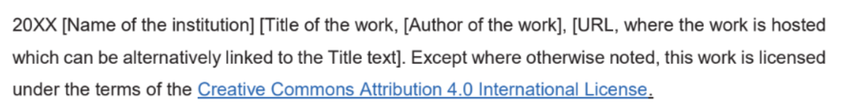
License Declaration
2020 Quest International University Kahoot!, Racheal Har Ann Li, Quratul Ain. Except where otherwise noted, this work is licensed under the terms of the Creative Commons Attribution 4.0 International License

Slide 23
If you have modified or adapted this OER, explicitly state that your version is an adaptation or derivative, and optionally describe the nature of your changes.
Example:
This slide is adapted from Kahoot! by Racheal Har Ann Li, Quratul Ain, licensed under a Creative Commons Attribution 4.0 International License (CC BY-NC-SA). Changes include …
Attribution Statement
Notes:
https://opentextbc.ca/adaptopentextbook/chapter/adaptation-statement/
https://guides.skylinecollege.edu/c.php?g=1176803&p=8601457
https://nmoer.pressbooks.pub/facultyguide/chapter/adaptation-statement/

Slide 24
The materials provided in this institutional Open Educational Resource (iOER) are intended solely for educational and training (Learning & Development) purposes. Quest International University assumes no responsibility for any misuse, misinterpretation, or unintended application of the content. The views and opinions expressed within these materials are those of the individual authors and do not necessarily reflect the official stance or policy of Quest International University.
No derivative works may use the name, logo, or official branding of Quest International University without prior written approval.
Disclaimer
For any enquiries, kindly email Academic Affairs Division (AAD) at aad@qiu.edu.my

