Slide 1




Inferential Statistics
Author:
Sandheep Sugathan
Year: 2021
CC BY-NC-SA 4.0
Designed by Freepik

Slide 2
Inferential Statistics
Dependent and Independent Variables
Null Hypothesis and Alternate (Research) Hypothesis
P-Value
Overview

Slide 3

INFERENTIAL STATISTICS
Inferential statistics or statistical inference is the process of applying statistical methods in order to draw conclusions about population from the available sets of data which is collected from a sample
otherwise known as Analytical Statistics

Slide 4
Inferential statistics makes:
inferences about populations using data drawn from a sample from that population
inference or prediction of association between a dependent and an independent variable
prediction of difference in a dependent variable between 2 or more groups of independent variable

Slide 5
Dependent and Independent Variables
Variable
A variable is an element, feature, or factor that is liable to vary or change. Variables in a study can be dependent variables or independent variables.
Dependent Variable or Outcome Variable
Dependent variable is a factor or phenomenon that is changed by the effect of an associated factor called the independent variable.
It is a variable whose value depends on independent variable.

Slide 6
Independent variable or predictor variable
The independent variable is typically the variable which is manipulated or changed
The dependent variable is the variable which is affected by the changes or manipulations in the independent variable.

Slide 7
Examples:
Regular physical activity can affect the variable body mass index.
So regular physical activity is the independent variable and body mass index is the dependent variable.
Body mass index is dependent on physical activity

Slide 8
Examples:
Obesity can lead to the development of Type 2 Diabetes mellitus.
So obesity is the independent variable and development of Type 2 Diabetes mellitus is the dependent variable.
Type 2 DM is dependent on obesity. So it is a dependent variable.
Same variable can be dependent or independent based on the situation.

Slide 9
Inferential statistics checks if there is:
A real difference in the dependent variable between two or more groups of the independent variable, indicating a statistically significant difference
A real association between the dependent variable and the independent variable, indicating a statistically significant association

Slide 10
Tests of statistical significance are applied to determine if
the difference between mean values in 2 or more groups
the difference between proportions in 2 or more groups or
the difference in the occurrence of disease or problem between 2 or more categories
the association between 2 variables
the linear relationship between 2 continuous variables
is statistically significant.

Slide 11
Null Hypothesis
Before applying the appropriate statistical test, the researcher need to have a null hypothesis.
Null Hypothesis is a general assumption that there is no relationship or association between dependent and independent variables or there is no difference between dependent variable in different groups of independent variables.
If there is any difference or association seen, it is due to chance.

Slide 12
Alternate (Research) Hypothesis
Alternative hypothesis or the research hypothesis
is a general statement or assumption that there is a relationship or association between dependent and independent variables or there is a difference in dependent variable between different groups of independent variable.
Statistical test of significance is applied to prove or disprove the null hypothesis.

Slide 13
P-Value
Inferential statistics is conducted using:
Parametric tests
Non-parametric tests of statistical significance
In both cases, we examine the significance value or p-value.

Slide 14
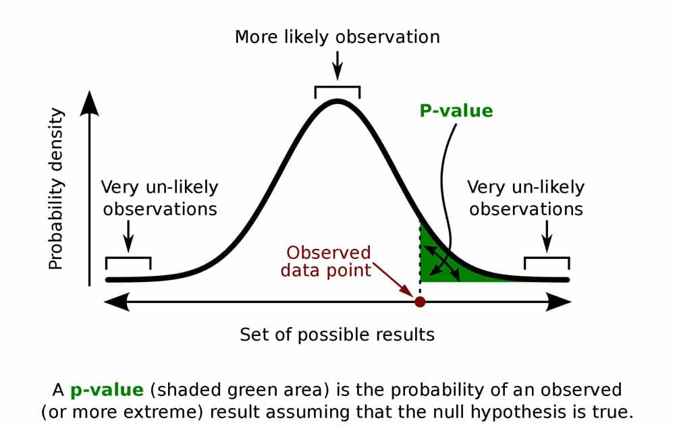
P-Value
The p-value (or significance value) represents the probability that the observed association between the dependent variable and the independent variable occurred by chance alone.
Source: Simply Psychology

Slide 15
If the p-value (or significance value) from a parametric or non-parametric test is less than 0.05 (or less than 5%), then the observed association or difference is unlikely due to chance and is considered statistically significant.

Slide 16
If the p-value (or significance value) from a parametric or non-parametric test is greater than 0.05 (or greater than 5%),
then the observed association or difference is likely due to chance and is considered NOT statistically significant.

Slide 17
License Deed
You are free to:
Share — copy and redistribute the material in any medium or format
Adapt — remix, transform, and build upon the material
Under the following terms:
Attribution — You must give appropriate credit , provide a link to the license, and indicate if changes were made . You may do so in any reasonable manner, but not in any way that suggests the licensor endorses you or your use
NonCommercial — You may not use the material for commercial purposes .
ShareAlike — If you remix, transform, or build upon the material, you must distribute your contributions under the same license as the original.
Creative Commons Attribution-
NonCommercial-
ShareAlike 4.0 International

Slide 18
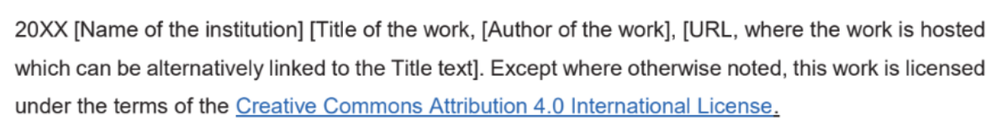
License Declaration
2021 Quest International University Inferential Statistics, Sandheep Sugathan. Except where otherwise noted, this work is licensed under the terms of the Creative Commons Attribution 4.0 International License

Slide 19
If you have modified or adapted this OER, explicitly state that your version is an adaptation or derivative, and optionally describe the nature of your changes.
Example:
This slide is adapted from Inferential Statistics by Sandheep Sugathan, licensed under a Creative Commons Attribution 4.0 International License (CC BY-NC-SA). Changes include …
Attribution Statement
Notes:
https://opentextbc.ca/adaptopentextbook/chapter/adaptation-statement/
https://guides.skylinecollege.edu/c.php?g=1176803&p=8601457
https://nmoer.pressbooks.pub/facultyguide/chapter/adaptation-statement/

Slide 20
The materials provided in this institutional Open Educational Resource (iOER) are intended solely for educational and training (Learning & Development) purposes. Quest International University assumes no responsibility for any misuse, misinterpretation, or unintended application of the content. The views and opinions expressed within these materials are those of the individual authors and do not necessarily reflect the official stance or policy of Quest International University.
No derivative works may use the name, logo, or official branding of Quest International University without prior written approval.
Disclaimer
For any enquiries, kindly email Academic Affairs Division (AAD) at aad@qiu.edu.my

