Slide 1




How to Turn PowerPoint From a Lecture Tool to a Learning Tool
Author:
Tina Lim
Year: 2020
CC BY-NC-SA 4.0
Designed by Freepik
Notes:
Image: https://www.freepik.com/

Slide 2
Cut Your Slide Deck Into Half
Use Images to Teach Concepts
Determine what is
KISS (Keep It Short and Simple)
Lose the Template
Check for Font Size, Colour, Spelling etc.
Use the 10 - 20 Minute Rule
Overview

Slide 3

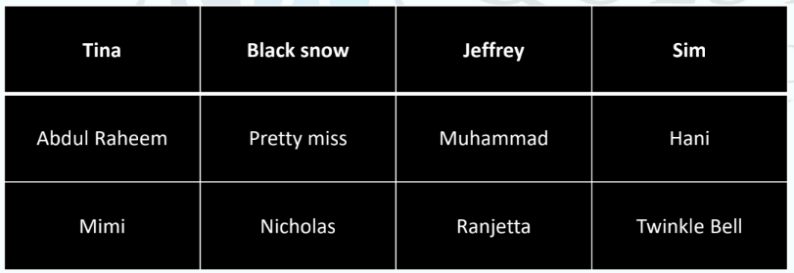
During Google Meet sessions, what could be happening behind the screens when you are lecturing?

Slide 4
HOW TO TURN POWERPOINT FROM A LECTURE TOOL TO A LEARNING TOOL ?
Source: https://bowperson.com/resources/modules/preventing-death-by-powerpoint.html

Slide 5
1. Cut Your Slide Deck Into Half
What to do with the other half?
• If using the flipped class approach, give full set ahead of
class, with instructions for students to read through first
• If not flipped approach, the full set of notes can be
posted in Google classroom after the class

Slide 6

2. Use Images to Teach Concepts

Slide 7
3. Determine What Is
Need to know vs Nice to know

Slide 8
4. KISS (Keep It Short and Simple)
• Use essential words only
• Don’t need complete sentences

Slide 9
5. Lose the Template
Attention drops when slides look boringly alike.
“Habituation” kicks in and the brain begins to screen out repetitive images and data, causing learners to daydream.

Slide 10
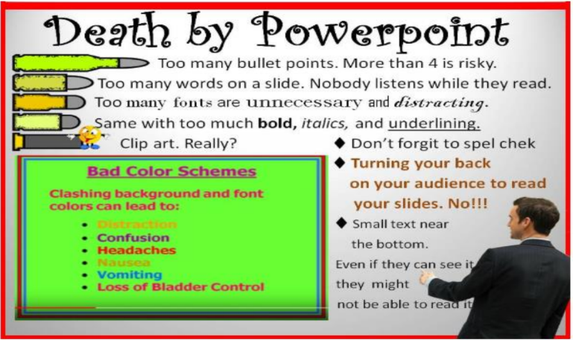
6. Check for Font Size, Colour, Spelling etc.
Image taken from:
https://www.mindto
ols.com/blog/5-
ways-to-avoid-death-
by-powerpoint-
presentation/

Slide 11
7. Use the 10 - 20 Minute Rule
Break your synchronous sessions in to 10 to 20 minute chunks
In between, ask questions, seek comments or conduct activities

Slide 12
License Deed
You are free to:
Share — copy and redistribute the material in any medium or format
Adapt — remix, transform, and build upon the material
Under the following terms:
Attribution — You must give appropriate credit , provide a link to the license, and indicate if changes were made . You may do so in any reasonable manner, but not in any way that suggests the licensor endorses you or your use
NonCommercial — You may not use the material for commercial purposes .
ShareAlike — If you remix, transform, or build upon the material, you must distribute your contributions under the same license as the original.
Creative Commons Attribution-
NonCommercial-
ShareAlike 4.0 International

Slide 13
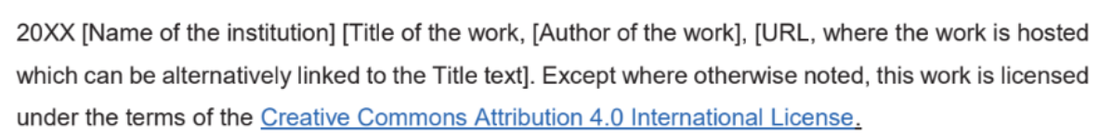
License Declaration
2020 Quest International University How to Turn PowerPoint From a Lecture Tool to a Learning Tool, Tina Lim. Except where otherwise noted, this work is licensed under the terms of the Creative Commons Attribution 4.0 International License

Slide 14
If you have modified or adapted this OER, explicitly state that your version is an adaptation or derivative, and optionally describe the nature of your changes.
Example:
This slide is adapted from How to Turn PowerPoint From a Lecture Tool to a Learning Tool by Tina Lim, licensed under a Creative Commons Attribution 4.0 International License (CC BY-NC-SA). Changes include …
Attribution Statement
Notes:
https://opentextbc.ca/adaptopentextbook/chapter/adaptation-statement/
https://guides.skylinecollege.edu/c.php?g=1176803&p=8601457
https://nmoer.pressbooks.pub/facultyguide/chapter/adaptation-statement/

Slide 15
The materials provided in this institutional Open Educational Resource (iOER) are intended solely for educational and training (Learning & Development) purposes. Quest International University assumes no responsibility for any misuse, misinterpretation, or unintended application of the content. The views and opinions expressed within these materials are those of the individual authors and do not necessarily reflect the official stance or policy of Quest International University.
No derivative works may use the name, logo, or official branding of Quest International University without prior written approval.
Disclaimer
For any enquiries, kindly email Academic Affairs Division (AAD) at aad@qiu.edu.my

