Slide 1


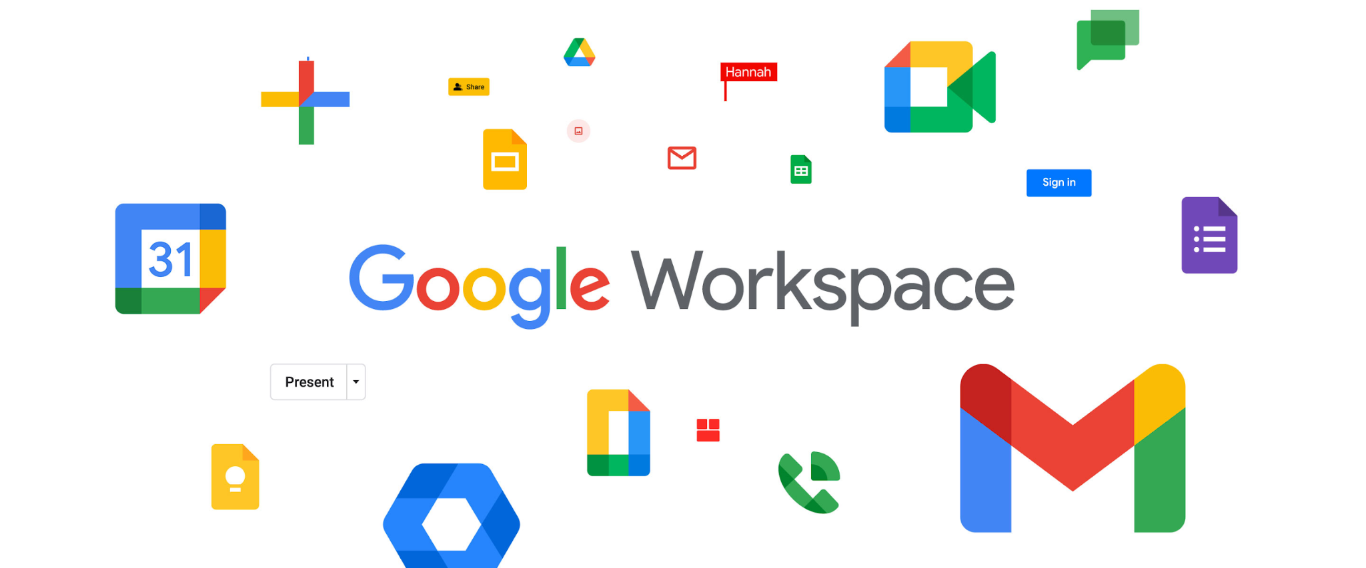

Google Workspace & Shared Drive for Teaching and Learning
Author:
Chin Sook Fui
Year: 2024
Source: Google Workspace Blog
CC BY-NC-SA 4.0
Notes:
Image: https://www.freepik.com/

Slide 2
Google Drive
Google Docs
Google Forms
Google Meet
Google Slides
Google Sheets
Overview

Slide 3


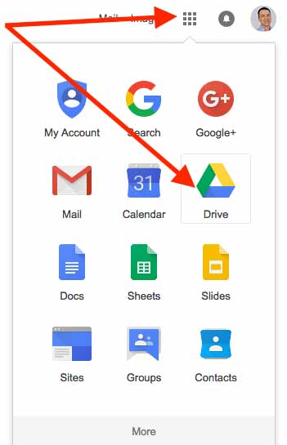
Google Drive
What is Google Drive?
Google Drive is a file storage and synchronization service.
A place where you can create, share, collaborate, and keep all of your stuff.
Users can upload any type of file to the cloud, share them with others, and access them from any computer, tablet, or smartphone.
Users can sync files between their device and the cloud.

Slide 4
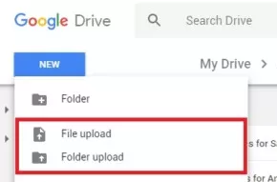
UPLOAD Google Drive files
In order to access your files on Google Drive, you first need to upload them via the web, PC,
or mobile client.
Two ways:
Drag and drop method: select a file you want to upload from your PC, drag it to Drive in a browser window, and drop it.
New button (top-left corner)
> select File upload or Folder upload
> choose the files or folders you want to upload
> click Open or Upload

Slide 5
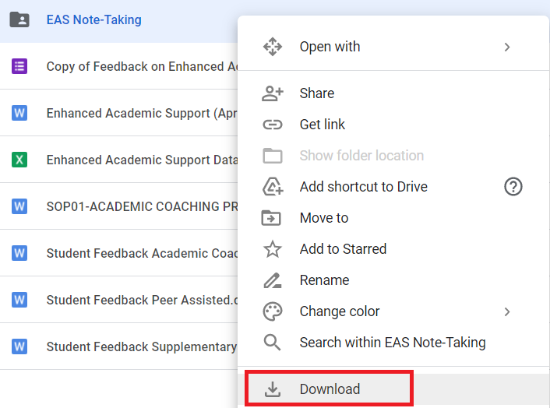
DOWNLOAD Google Drive files
Fast and easy on any device with an internet connection.
Choose the file you want to download > right click > Download.
This works for both individual files and entire folders.

Slide 6
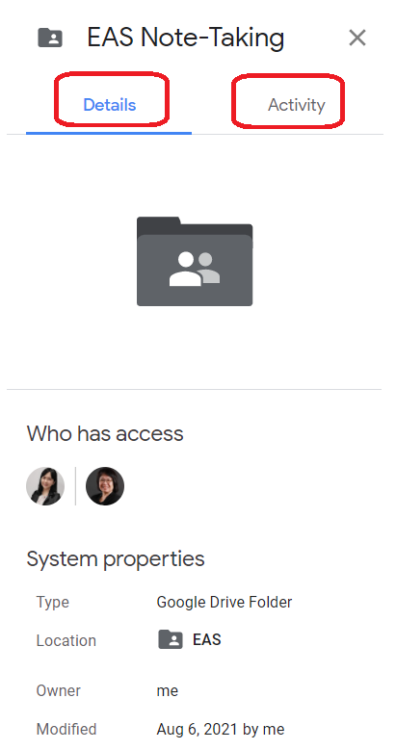

File Details and Activity Checking
Click on any file/folder, click on the icon (at right).
Details
file type, location, owner
date modified/opened/created
Activity
History on editing/ commenting/ sharing/
transferring etc.

Slide 7
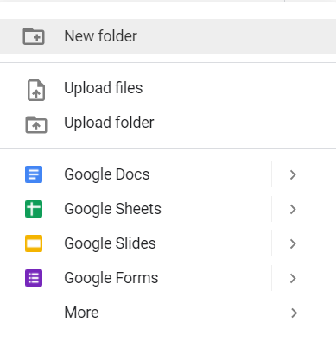
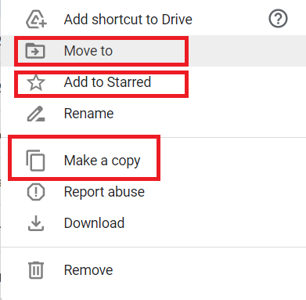
Create, Organise and Delete Files
Create
Right click > select New Folder /
Google Docs etc
(B) Organise & Delete
Right click on any
folder/file

Slide 8
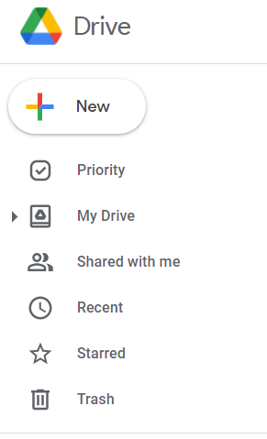
Left Panel - Quick Access
To provide quick access / navigation
My Drive
Shared with me
Recent
Starred
Trash
Will be deleted forever after 30 days.

Slide 9
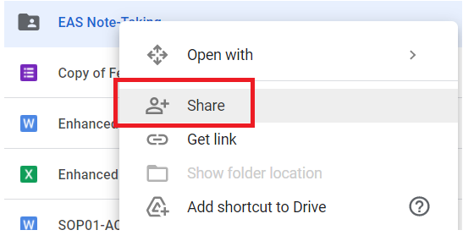
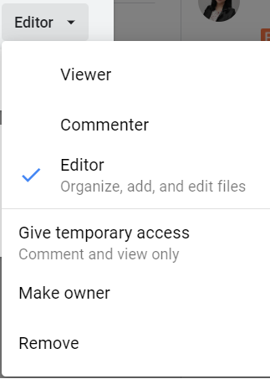
File Sharing
To share a Google Drive file or folder, select it and click the Get shareable link icon, then copy and share the link with the people you want.
Privacy Control
Viewer, Commenter or Editor
Can set temporary access
Make owner / Remove
Restricted mode - only people you explicitly add can see the file.

Slide 10

Google Docs
What is Google Docs?
A word processor
Write reports, create joint project proposals, keep track of meeting notes,
and more.
With Google Docs, you can create and edit text documents right in your web browser—no special software is required.
Even better, multiple people can work at the same time, you can see people’s changes as they make them, and every change is saved automatically.

Slide 11
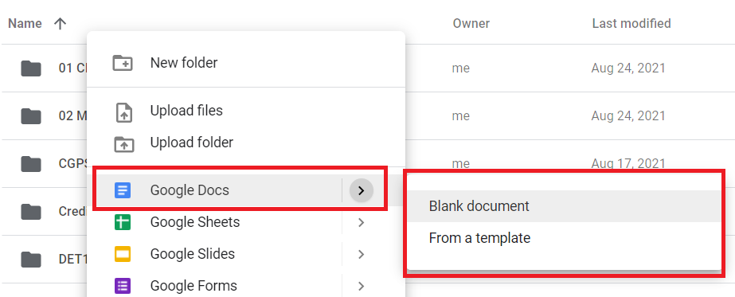
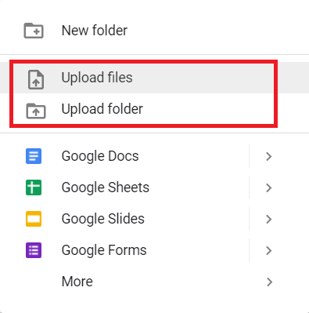
Create Files
Import Files
In Drive, right click > go to Google Docs
> click Blank document or From a template
In Drive, right click
> click Upload files or
Upload folder

Slide 12
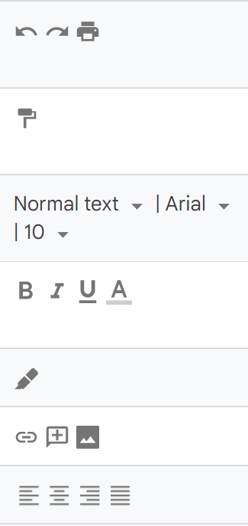
Edit and Format
Add or edit text
Just click in the page and start typing
Customize the document: margins, page colour, orientation
File > Page Setup
Customize text, images, tables and more
Toolbar options
Add pictures, links, tables and more
Insert menu
Create page columns
Format > Columns)

Slide 13
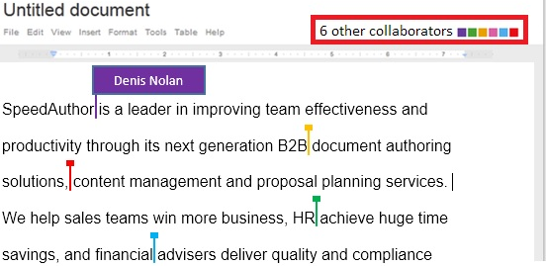
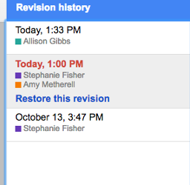
Collaboration
Up to 100 people with view, edit, or comment permissions can work on a Google Docs at the same time.
When more than 100 people are accessing a file, only the owner and some users with editing permissions can edit the file.
While people are editing the doc, you can see it in real time.
See Revision History - track every change and versions with time stamps.
Restore version - roll back to a previous version

Slide 14
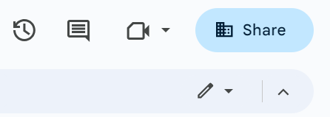
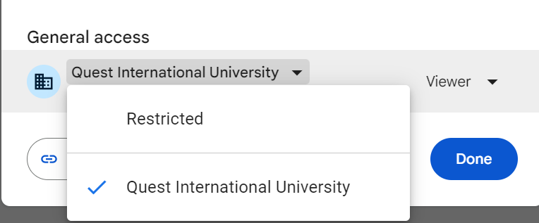
File Sharing
To allow general access:
Under “General access”, click the Down arrow
Choose who to give access to
To share the Google Docs, click the “Share” icon on the top right corner
Enter the email address you want to share with

Slide 15


Google Slides
What is Google Slide?
Google Slides is an online presentation app that lets you
create and format presentations and work with other people.
Features
Create a presentation
Edit and format a presentation
Insert and arrange text, shapes and lines
Add, delta & organize slides
Add animations to a slide
Change the theme, background or layout in Google slides
Share and work with others

Slide 16
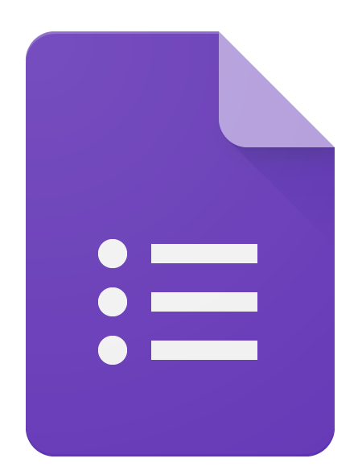

Google Form
What is Google Form?
Google Forms is a survey application.
Forms features all of the collaboration and sharing features found in Docs, Sheets, and Slides.
It can also be used to create quizzes, including some specialized functions that are of use in educational settings

Slide 17
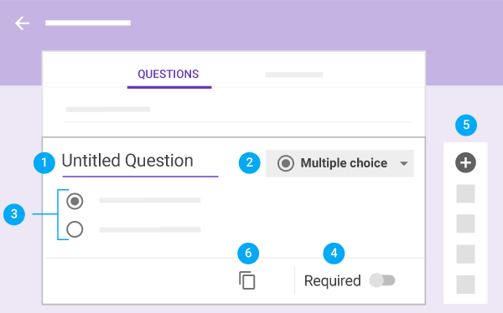
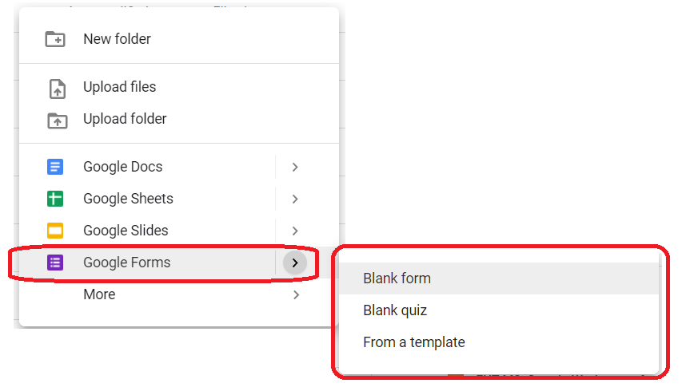
Features
Add and edit questions
Create and name the form
Add a description, header, change the theme and background color
Click Customize Theme

Slide 18
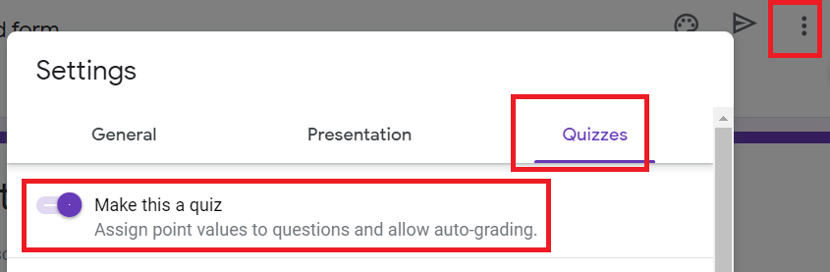
Use Google From as Quiz
You can make an answer key on certain question types:
Short answer
Multiple choice
Checkboxes
Dropdown
Multiple choice grid
Checkbox grid
At the top of the form, click Settings. Turn on Make this a quiz.

Slide 19
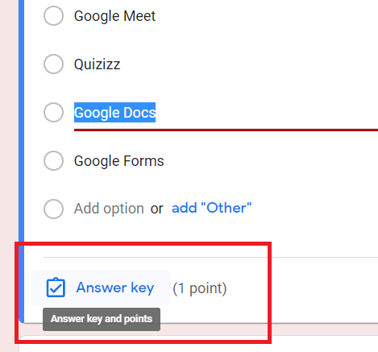
Use Google From as Quiz
Create an answer key
To add a question, click Add question Add question.
Fill out your question and answers.
In the bottom left of the question, click Answer key.
Choose the answer or answers that are correct.
In the top right of the question, choose how many points the question is worth.
To add a written or YouTube video explanation to an answer, click Add answer feedback.
You can edit questions or answers when you click on them.
Note: You can assign points and add feedback on all question types.

Slide 20
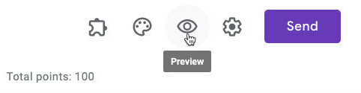
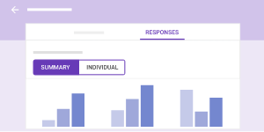
Preview the Form
When you’re done adding questions, you can choose your form's settings and preview your changes before sending it out.
Analyze Form Responses
See responses in Forms
See responses in Sheets
Download responses

Slide 21
Preview the Form
When you’re done adding questions, you can choose your form's settings and preview your changes before sending it out.
Analyze Form Responses
See responses in Forms
See responses in Sheets
Download responses

Slide 22
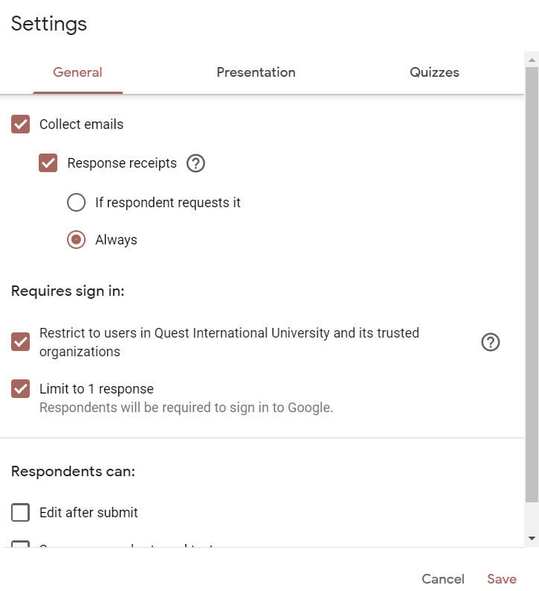
Choose Settings
Decide who can access your form and whether to collect email addresses from people.
By default, form sharing is limited to your organization and email collection is turned off.
Click Settings > General to change the options.

Slide 23

Google Meet
What is Google Meet?
Google Meet is a standards-based Video Conferencing application,
using proprietary protocols for video, audio and data transcoding.
Basic: up to 100 participants

Slide 24
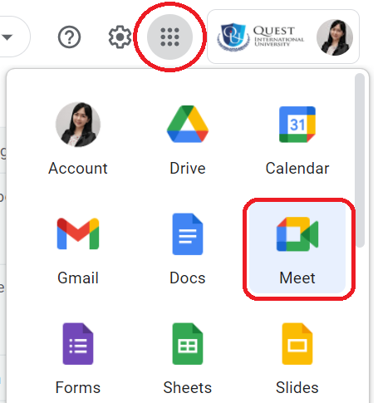
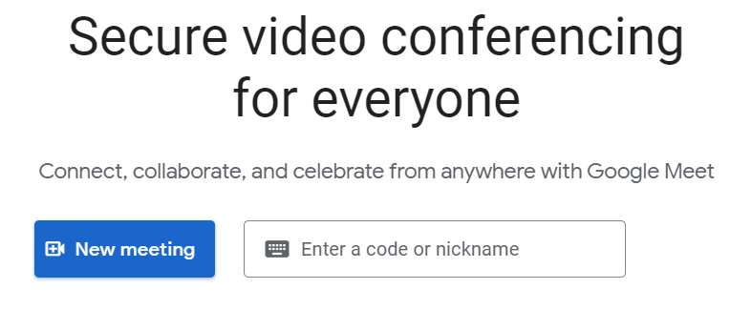
Start and Join Video Meetings
Join, Start or schedule a meeting
Meet, Gmail, Google Calendar

Slide 25


Add people to a video meeting in progress
Add people to a meeting
At the bottom right, click People and then Add people .
Enter the name or email address and then Send email.
Share joining info
At the bottom right, click meeting details .
Click Copy joining info.
Paste the meeting details into an email, or other app, and send.

Slide 26
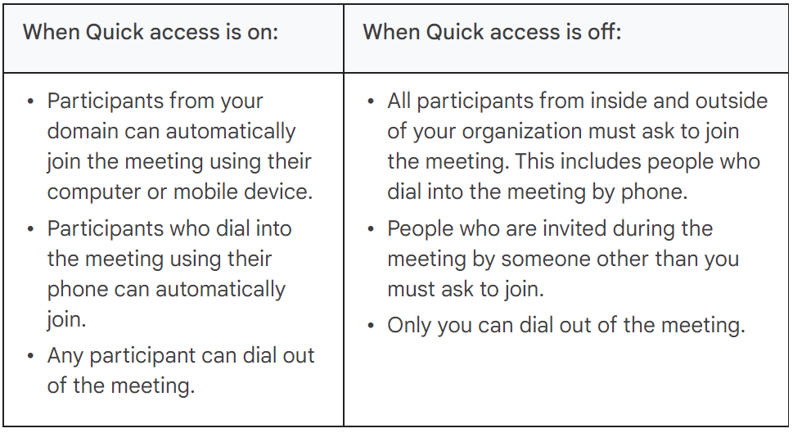
Control access to a video meeting
For Google Workspace for Education users, the meeting organizer can use Quick access to decide if participants must ask to join the video meeting.
Quick access is turned on by default. After you start a video meeting, you can change the setting as often as you need.

Slide 27
Collaborate in Video Meetings
View meeting details and attachments
Send chat messages to video meeting participants
Present during a video meeting
Raise your hand during a video meeting
Use a whiteboard in a video meeting

Slide 28

Google Sheet
What is Google Sheets?
An online spreadsheet app for creating and formatting spreadsheets, and also work with other people.
With Google Sheets, you can:
Sort and organise data
Filter data
Create charts and graphs
Analyse and visualise data
Share and work with others

Slide 29
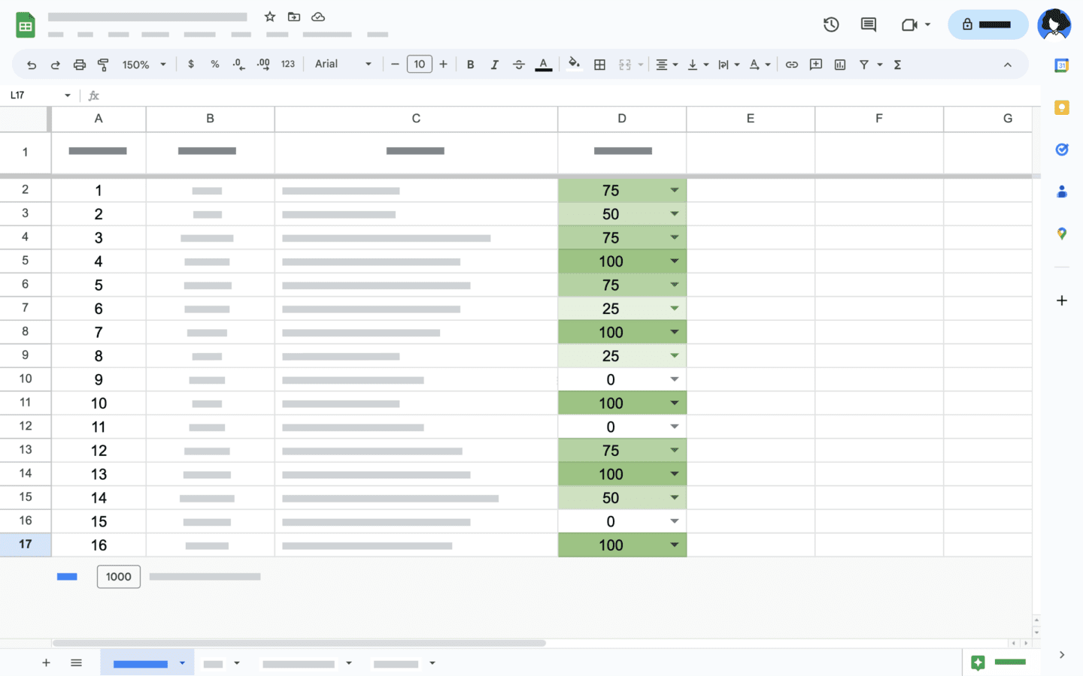
Visualise Key Data
Use conditional formatting rules to format cells to turn a specific color when they meet certain criteria.

Slide 30
Example
To highlight test scores to see which students scored less than 80%.
On your computer, open a spreadsheet in Google Sheets.
Select the test scores.
Click Format > Conditional formatting.
Under "Format cells if," click Less than. If there's already a rule, click it or
Add new rule > Less than.
Click Value or formula and enter 0.8.
To choose a red color, click Fill
Click Done. The low scores will be highlighted in red.

Slide 31

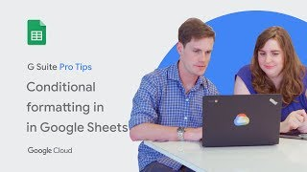
To Create Drop-down Lists

Slide 32

References
How to use Google Drive: Everything you need to know
Get started with Docs
Get started with Google Slides
Get started with Forms
Create & grade quizzes with Google Forms
Google Meet training and help
Google Sheets Cheat Sheet

Slide 33
License Deed
You are free to:
Share — copy and redistribute the material in any medium or format
Adapt — remix, transform, and build upon the material
Under the following terms:
Attribution — You must give appropriate credit , provide a link to the license, and indicate if changes were made . You may do so in any reasonable manner, but not in any way that suggests the licensor endorses you or your use
NonCommercial — You may not use the material for commercial purposes .
ShareAlike — If you remix, transform, or build upon the material, you must distribute your contributions under the same license as the original.
Creative Commons Attribution-
NonCommercial-
ShareAlike 4.0 International

Slide 34
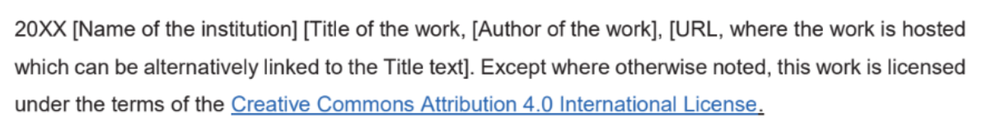
License Declaration
2024 Quest International University Google Workspace & Shared Drive for Teaching and Learning, Chin Sook Fui. Except where otherwise noted, this work is licensed under the terms of the Creative Commons Attribution 4.0 International License

Slide 35
If you have modified or adapted this OER, explicitly state that your version is an adaptation or derivative, and optionally describe the nature of your changes.
Example:
This slide is adapted from Google Workspace & Shared Drive for Teaching and Learning by Chin Sook Fui, licensed under a Creative Commons Attribution 4.0 International License (CC BY-NC-SA). Changes include …
Attribution Statement
Notes:
https://opentextbc.ca/adaptopentextbook/chapter/adaptation-statement/
https://guides.skylinecollege.edu/c.php?g=1176803&p=8601457
https://nmoer.pressbooks.pub/facultyguide/chapter/adaptation-statement/

Slide 36
The materials provided in this institutional Open Educational Resource (iOER) are intended solely for educational and training (Learning & Development) purposes. Quest International University assumes no responsibility for any misuse, misinterpretation, or unintended application of the content. The views and opinions expressed within these materials are those of the individual authors and do not necessarily reflect the official stance or policy of Quest International University.
No derivative works may use the name, logo, or official branding of Quest International University without prior written approval.
Disclaimer
For any enquiries, kindly email Academic Affairs Division (AAD) at aad@qiu.edu.my

