Slide 1




Exit Task as
Formative Assessment
Author:
Chin Sook Fui
Year: 2021
CC BY-NC-SA 4.0
Designed by Freepik
Notes:
Image: https://www.freepik.com/

Slide 2

What is
Formative Assessment?

Slide 3
What are the types of formative assessment?

Slide 4
Mode of Delivery
(a) Written
(b) Verbal
(C) Both

Slide 5
The KEY of assessment…..
Information

Slide 6
Formative Assessment
On-going process and continuous process that is carried out during the learning process to inform students’ learning.
(William, 2011)
Assessment carried out during the instructional process for the purpose of improving teaching or learning.
(Shepard et al., 2005)

Slide 7

How do you end your lesson?
CLASS is almost done!
You need to know which students grasped (and didn’t grasp) the lesson.
And you need to know it quickly.

Slide 8
What is Exit Task?
The ROLE of Exit Task as a formative assessment
Success Criteria of an EXIT TASK
Types of EXIT TASK
Design an exit task
Outline

Slide 9

What is EXIT TASK?
A simple and short activity conducted at the END of a lesson.
Provide teachers with informal information about students’ learning.
Allow students to reflect on what they have learnt.
Designed by Freepik

Slide 10
To be effective, an exit ticket should have specific prompts for students and take only about five minutes to complete.
Students can record their responses on index cards, sticky notes, notebook paper, or online (e.g., Google Forms, Padlet, Schoology, etc.).
Ideally, student responses inform the next stages of learning by highlighting whether teachers should clarify ideas, reteach them, extend them, offer practice, introduce new ideas, or restructure future instructional activities. (Marshall 2018)

Slide 11
Why use EXIT TASK?
Feedback
Self-
Reflection
Adjustment
What went well,
What are the areas of improvement
Reflect and consolidate understanding
For next lesson planning

Slide 12
Forms of EXIT TASK
Verbal
Written

Slide 13
Example - Verbal Exit Task
👍
Verbal Exit Ticket
Have students line up at the end of class while you stand at the door.
As they reach the door, students must share an idea or concept they learned with you.
Each student must give a different answer.
As students stand in line, they can discuss different possible answers before they reach you.
👍
👍
I get it!
I understand everything!
I can tell you what I learned.
I kinda get it!
I need a little help.
I still have a few questions.
I don’t get it!
I need a lot of help.
I still have a lot of questions.

Slide 14
HOW TO PLAN AN EXIT TASK?

Slide 15
Success Criteria
(1) KEEP IT ALIGNED
Align the exit task with the learning objectives.
Learning Goals and Objectives
ALIGN
Teaching and Learning Activities
Feedback and Assessment

Slide 16


Success Criteria
(2) KEEP IT SPECIFIC
Avoid general questions which give limited information about students’ progress on the LOs taught.
What have you learned today?
List down the 3 states of matter.

Slide 17
Success Criteria
(3) KEEP IT SIMPLE
Write an essay to describe global warming.
(500 words)
Easy for students to complete (and for the instructors to review) while still giving detailed information
It shouldn’t be more than 5 minutes to complete.
Can be marked/assessed quickly.
What is global warming?
What are the causes of global warming?

Slide 18
Can you recall the
THREE success criteria
of exit task?

Slide 19
Types of EXIT TASK
Lesson Content
Level of Understanding
Students’ need

Slide 20
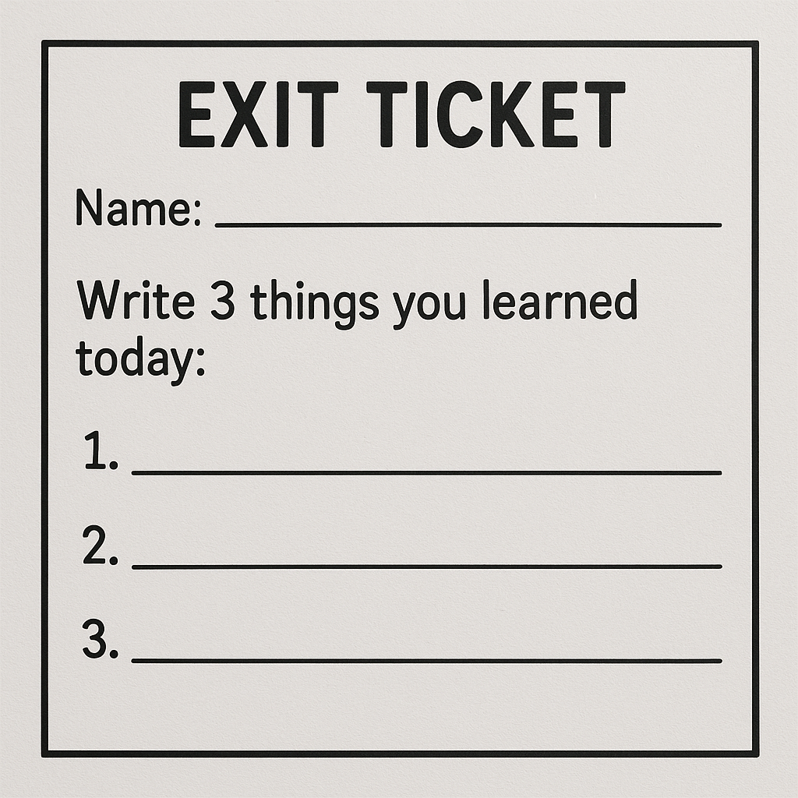
(1) Lesson Content
Gauge specific content grasped
Source: Image generated with ChatGPT

Slide 21
(2) Level of Understanding
Help learners to reflect on their own learning and give us insight as to who needs further instruction.
On a scale of 1 to 10, 1 being terrible and 10 being amazing, how would you rate your learning?
1
2
3
4
5
6
7
8
9
10
Terrible
Amazing

Slide 22

Circle the emoji that shows how the lesson went today
(3) Students’ Need
Struggles, questions, support needed, feelings.
Designed by Freepik
Reason:
___________________________
___________________________

Slide 23

No boundary…
You can choose to use any type of exit task in your lesson.
GOAL:
Obtain useful information to improve our teaching and learning.
Designed by Freepik

Slide 24
DESIGN YOUR OWN EXIT TASK
Step 1: Verbal or Written
Step 2: Types
Content, Understanding, Students’ Need
Step 3: Tools
Physical or Virtual
Step 4: Criteria
Aligned, Specific, Simple

Slide 25




VIRTUAL EXIT TICKET
Google
Form
Padlet

Slide 26
License Deed
You are free to:
Share — copy and redistribute the material in any medium or format
Adapt — remix, transform, and build upon the material
Under the following terms:
Attribution — You must give appropriate credit , provide a link to the license, and indicate if changes were made . You may do so in any reasonable manner, but not in any way that suggests the licensor endorses you or your use
NonCommercial — You may not use the material for commercial purposes .
ShareAlike — If you remix, transform, or build upon the material, you must distribute your contributions under the same license as the original.
Creative Commons Attribution-
NonCommercial-
ShareAlike 4.0 International

Slide 27
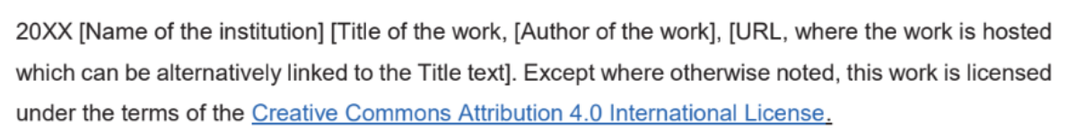
License Declaration
2021 Quest International University Exit Task as Formative Assessment, Chin Sook Fui. Except where otherwise noted, this work is licensed under the terms of the Creative Commons Attribution 4.0 International License

Slide 28
If you have modified or adapted this OER, explicitly state that your version is an adaptation or derivative, and optionally describe the nature of your changes.
Example:
This slide is adapted from Exit Task as Formative Assessment by Chin Sook Fui, licensed under a Creative Commons Attribution 4.0 International License (CC BY-NC-SA). Changes include …
Attribution Statement
Notes:
https://opentextbc.ca/adaptopentextbook/chapter/adaptation-statement/
https://guides.skylinecollege.edu/c.php?g=1176803&p=8601457
https://nmoer.pressbooks.pub/facultyguide/chapter/adaptation-statement/

Slide 29
The materials provided in this institutional Open Educational Resource (iOER) are intended solely for educational and training (Learning & Development) purposes. Quest International University assumes no responsibility for any misuse, misinterpretation, or unintended application of the content. The views and opinions expressed within these materials are those of the individual authors and do not necessarily reflect the official stance or policy of Quest International University.
No derivative works may use the name, logo, or official branding of Quest International University without prior written approval.
Disclaimer
For any enquiries, kindly email Academic Affairs Division (AAD) at aad@qiu.edu.my

