Slide 1




Developing Research Proposal
Authors:
Loke Siew Phaik
Gurdip Kaur
Tina Lim
Year: 2021
CC BY-NC-SA 4.0
Designed by Freepik
Notes:
Image: https://www.freepik.com/

Slide 2

WHAT?
INTRODUCTION
Provides the background information
Purpose is to establish a framework for the research
(Wilkinson, 1991)

Slide 3
WHY?
PROBLEM STATEMENT
“A problem might be defined as the issue that exists in the literature, theory, or practice that leads to a need for the study” (Creswell, 1994, p. 50).
i.e. Identifying a gap

Slide 4
RESEARCH QUESTIONS & OBJECTIVES
Relevant
Clear
Precise
Researchable
If study involves inferential stats, state the hypotheses

Slide 5
LITERATURE REVIEW
Results of other studies that are closely related to the study being reported
Relates to the larger, ongoing dialogue in the literature about a topic, filling in gaps and extending prior studies
Provides a framework for establishing the importance of the study
“Frames” the problem earlier identified

Slide 6
The 5 C’s of writing a literature review:
Cite
Compare
Contrast
Critique
Connect

Slide 7

WHY?
SIGNIFICANCE OF STUDY
How will your research refine, revise, or extend existing knowledge?
How will the findings contribute to resolving educational problems/ influence educational policy decisions?
Designed by Freepik

Slide 8
METHODOLOGY
Instrument
Example: surveys, interview protocols,
observation grids
Include as Appendix
Participants
Population and Type of Sampling

Slide 9
Data Collection
- Administration of survey, interview procedure etc.
- Timeline
Data Collection
- Quantitative/ Qualitative
- Descriptive or inferential statistics
- Analytic tools e.g. SPSS

Slide 10
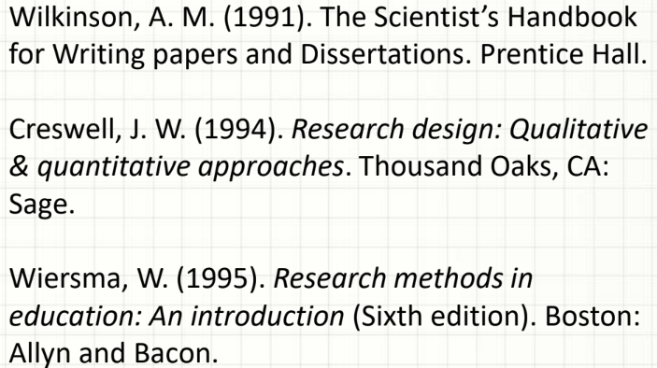
APPENDICES
REFERENCES
APA style 7th edition
References vs Bibliography
Can you identify the errors in the list here?
Reference: https://libguides.usc.edu/APA7th

Slide 11
IMPORTANT NOTE !
Always refer to Actual Required Format for the Conference / Journal that you wish to submit to.

Slide 12
License Deed
You are free to:
Share — copy and redistribute the material in any medium or format
Adapt — remix, transform, and build upon the material
Under the following terms:
Attribution — You must give appropriate credit , provide a link to the license, and indicate if changes were made . You may do so in any reasonable manner, but not in any way that suggests the licensor endorses you or your use
NonCommercial — You may not use the material for commercial purposes .
ShareAlike — If you remix, transform, or build upon the material, you must distribute your contributions under the same license as the original.
Creative Commons Attribution-
NonCommercial-
ShareAlike 4.0 International

Slide 13
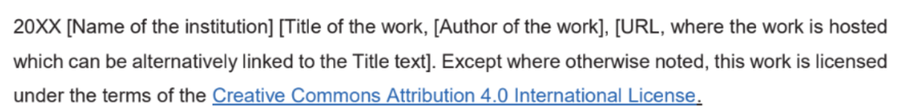
License Declaration
2021 Quest International University Developing Research Proposal, Loke Siew Phaik, Gurdip Kaur, Tina Lim. Except where otherwise noted, this work is licensed under the terms of the Creative Commons Attribution 4.0 International License

Slide 14
If you have modified or adapted this OER, explicitly state that your version is an adaptation or derivative, and optionally describe the nature of your changes.
Example:
This slide is adapted from Developing Research Proposal by Loke Siew Phaik , Gurdip Kaur, Tina Lim, licensed under a Creative Commons Attribution 4.0 International License (CC BY-NC-SA). Changes include …
Attribution Statement
Notes:
https://opentextbc.ca/adaptopentextbook/chapter/adaptation-statement/
https://guides.skylinecollege.edu/c.php?g=1176803&p=8601457
https://nmoer.pressbooks.pub/facultyguide/chapter/adaptation-statement/

Slide 15
The materials provided in this institutional Open Educational Resource (iOER) are intended solely for educational and training (Learning & Development) purposes. Quest International University assumes no responsibility for any misuse, misinterpretation, or unintended application of the content. The views and opinions expressed within these materials are those of the individual authors and do not necessarily reflect the official stance or policy of Quest International University.
No derivative works may use the name, logo, or official branding of Quest International University without prior written approval.
Disclaimer
For any enquiries, kindly email Academic Affairs Division (AAD) at aad@qiu.edu.my

