Slide 1




Developing Open & Distance Learning Self Instructional Materials
Author:
Tina Lim
Year: 2021
CC BY-NC-SA 4.0
Designed by Freepik
Notes:
Image: https://www.freepik.com/

Slide 2
MQA Requirements
Sample ODL SIM from OUM
Developing Learning Materials for ODL
Guidelines
Overview

Slide 3

MQA REQUIREMENT
Not more than 30% of programmes may be offered via the ODL mode for conventional universities
More than 60% of courses in programme in ODL mode
At least 80% of SLT are online for courses in ODL mode
LMS available
Specific unit responsible for working with faculty to
develop SIM

Slide 4
When applying for Provisional Accreditation, SIM for all courses in the first semester must be ready
After receiving PA from MQA and approval from MOHE to conduct the programme, all SIMs for the first year of study must be ready by the end of the first semester
When applying for FA, SIM for ALL courses in ODL mode in the programme must be ready
SIM for courses where students have obtained credit transfer need to be developed

Slide 5
SAMPLE ODL SIM FROM OUM
https://www.academia.edu/29724139/OUMM2103_Keusahawanan

Slide 6
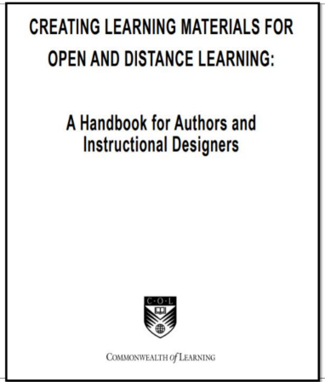
DEVELOPING LEARNING MATERIALS FOR ODL
CREATING LEARNING MATERIALS FOR OPEN AND DISTANCE LEARNING: A Handbook for Authors and Instructional Designers

Slide 7
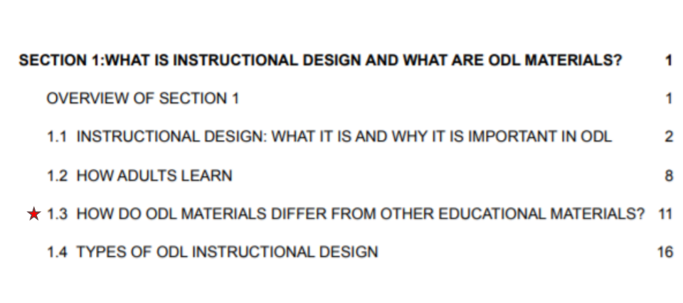

Slide 8
Differences between ODL materials and traditional textbook (p.12)
the wide range of learning devices
the relatively low proportion of text
the space that is often provided for learners to write their answers in, and
the ‘generous’ layout overall

Slide 9
Embedded Devices (p. 13)
learning objectives
tests of prior knowledge
advance organisers
activities
feedback to activities
examples
self-tests
summaries and lists of key points
study tips
hypertext links (in electronic materials)

Slide 10
GUIDELINES
Pitch the content provided at the appropriate level
Write instructions and explanations in a conversational tone
Use the correct level of headings for each section
List the Unit/ Topic Learning Outcomes at the beginning of each unit/ topic
Ensure alignment between the LOs, the activities and the assessments

Slide 11
Provide an advance organiser at the beginning of each unit/ topic
Vary instructional strategies/ resources
Give clear instructions on the expected output of an activity
Vary the types of output required of students
Include self-check activities (e.g. short auto- graded quizzes) in each unit/ topic

Slide 12
Ensure that the stimuli for discussions in the asynchronous forums require students to apply, analyse and evaluate, rather than mere recall (where students may Google and find answers)
Provide a caption for uploaded video and audio files, with indication of approximate duration/ file size
Highlight key points for students to look out when viewing videos. Include a related activity/ required output where possible

Slide 13
Ensure that the online resources provided are from reputable sources
Consistently use a prescribed citation and referencing style
Provide a summary at the end of each unit/ topic (The format for the summary may differ for different units/ topics (e.g. table, mind map, infographic)
When SIM is completed, conduct similarity check using Turnitin (have authors submit the detailed report)

Slide 14
License Deed
You are free to:
Share — copy and redistribute the material in any medium or format
Adapt — remix, transform, and build upon the material
Under the following terms:
Attribution — You must give appropriate credit , provide a link to the license, and indicate if changes were made . You may do so in any reasonable manner, but not in any way that suggests the licensor endorses you or your use
NonCommercial — You may not use the material for commercial purposes .
ShareAlike — If you remix, transform, or build upon the material, you must distribute your contributions under the same license as the original.
Creative Commons Attribution-
NonCommercial-
ShareAlike 4.0 International

Slide 15
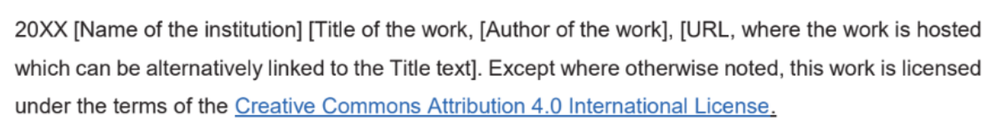
License Declaration
2021 Quest International University Developing Open & Distance Learning Self Instructional Materials, Tina Lim. Except where otherwise noted, this work is licensed under the terms of the Creative Commons Attribution 4.0 International License

Slide 16
If you have modified or adapted this OER, explicitly state that your version is an adaptation or derivative, and optionally describe the nature of your changes.
Example:
This slide is adapted from Developing Open & Distance Learning Self Instructional Materials by Tina Lim, licensed under a Creative Commons Attribution 4.0 International License (CC BY-NC-SA). Changes include …
Attribution Statement
Notes:
https://opentextbc.ca/adaptopentextbook/chapter/adaptation-statement/
https://guides.skylinecollege.edu/c.php?g=1176803&p=8601457
https://nmoer.pressbooks.pub/facultyguide/chapter/adaptation-statement/

Slide 17
The materials provided in this institutional Open Educational Resource (iOER) are intended solely for educational and training (Learning & Development) purposes. Quest International University assumes no responsibility for any misuse, misinterpretation, or unintended application of the content. The views and opinions expressed within these materials are those of the individual authors and do not necessarily reflect the official stance or policy of Quest International University.
No derivative works may use the name, logo, or official branding of Quest International University without prior written approval.
Disclaimer
For any enquiries, kindly email Academic Affairs Division (AAD) at aad@qiu.edu.my

