Slide 1




Developing Assignment Briefs
Author:
Tina Lim
Year: 2021
CC BY-NC-SA 4.0
Designed by Freepik

Slide 2
Constructive Alignment
Assessment Types
The Assignment Brief - Task
The Assignment Brief - Design
The Enhancement
Overview

Slide 3

CONSTRUCTIVE ALIGNMENT
2.
Teaching & Learning
Determine PEO,
PLO and CLO
Identify teaching-
learning methods/
strategies
Develop assessment
instruments to measure attainment of CLO, PLO and PEO
1.
Curriculum
Design
3.
Assessment

Slide 4
ASSESSMENT TYPES
Case Study
Online Discussion
Reflective Journal
Some
Assessment
Types
Report
Critical Analysis
Presentation
Marketing Plan

Slide 5
The assessment type used must be fit for purpose.
The choice of assessment type must be a valid and reliable way of assessing learner evidence of attaining the course learning outcome(s).
For example, practical skills should be assessed by a skills demonstration.

Slide 6
CONTENT OF THE ASSIGNMENT BRIEF
All assessments should have an assignment brief that contains:
clear, unambiguous and comprehensive instructions and / or guidelines,
statement(s) of Course Learning Outcome(s) being assessed,
the percentage weighting of the entire assessment and its parts,
online tools to be used to carry out the task and for submission of assignment (if applicable),

Slide 7
CONTENT OF THE ASSIGNMENT BRIEF
All assessments should have an assignment brief that contains:
clear assessment criteria and appropriate weighting,
parameters of the assignment
(e.g. number of words, format, duration of video/ presentation)
duration given and submission deadline and time, and
related marking rubric(s).

Slide 8
Good to include a clause on the penalty for late submission
e.g. Students who submit any coursework assessment beyond the specified submission date will be subjected to the following penalties:
Up to 1 week late – Deduction of 10% from marks awarded
Up to 2 weeks late – Deduction of 20 % from the marks awarded
Beyond 2 weeks late – 0 marks will be given

Slide 9
Warn students about the consequences of PLAGIARISM and COPYING friend’s assignment
Provide instructions relating to Turnitin submission
Check the language
Refer to the assignment brief output consistently
(e.g. report, proposal, etc.)
Avoid double negatives

Slide 10
GROUP/ COLLABORATIVE ASSIGNMENTS
For projects that require group or collaborative work:
Guidelines should be given on how the students are to carry out the group or collaborative work
(e.g. number of students per group)
The individual contribution of each student should be clearly identified and procedures should be implemented to ensure the reliability of the evidence that each student has attained the learning outcome.

Slide 11
The Task
The Design
The Enhancement

Slide 12
THE ASSIGNMENT BRIEF
TASK
State the related Learning Outcome(s)
State the assessment type/ output
(e.g. Report/ Lesson plan/ Critique)
State the targeted audience
(e.g. Academic/ General public)
State the role, if applicable
(e.g. You are a primary school teacher who has been asked to ...)

Slide 13
THE ASSIGNMENT BRIEF
TASK
Set open-ended questions and those related to higher order thinking skills, where possible
Avoid assignments that require students to describe/ explain concepts (lower order thinking skills) that may enable students to copy from books/ the Internet

Slide 14
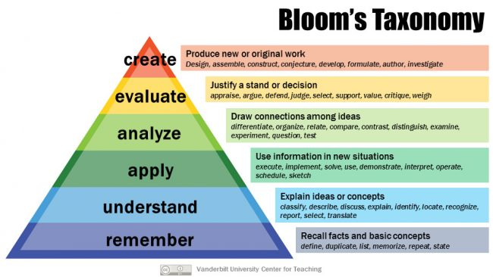
LEVELS OF
THE COGNITIVE DOMAIN
Vanderbilt University

Slide 15
Ensure that the academic workload is reasonable for the duration given for students to complete the task.
Be specific about how and when students are required to submit their assignments.
Check the scheduling of the due dates for assessments

Slide 16
ONLINE FINAL ASSIGNMENTS
All online final assignments should be administered via the official online teaching-learning platform for the course. In the assignment brief, course lecturers should remind students to:
Acknowledge receipt of the assignment brief,
Submit the correct version of their assignments/ answers before the due date and time, and
Ensure they receive acknowledgement of submission of assignment when they hand in to the course lecturer.

Slide 17
THE ASSIGNMENT BRIEF
DESIGN
Consider the layout (format and organization of the brief):
Order of the constituents of the brief – e.g. Assignment title, Core task, Learning outcome, Task components, Assessment criteria, Submission details)
Check appropriateness of the weighting for the different parts, especially for presentation
Take care of line spacing between key constituents
Use visuals where applicable

Slide 18
THE ASSIGNMENT BRIEF
ENHANCEMENT
Test the brief with a colleague or a student from another course
Rather than a single session introducing the assignment, build in regular slots for dialogue about the assignment.
Direct students to appropriate available resources. Provide relevant websites / title of books to refer to

Slide 19
THE ASSIGNMENT BRIEF
ENHANCEMENT
Consider providing exemplars/ samples of successful and unsuccessful completed parallel assignment
Monitor queries/ feedback from students, rephrase instructions if necessary

Slide 20
CHECKLIST
No. | YES/ NA* | Content of Assignment Brief
1 |  | Clear, unambiguous and comprehensive instructions and / or guidelines
2 |  | Statement(s) of Course Learning Outcome(s)
3 |  | Percentage weighting of the entire assessment and its parts
4 |  | Information on online tools to be used to carry out the task and for submission of assignment, where applicable
5 |  | Clear assessment criteria and appropriate weighting
6 |  | Parameters of the assignment
7 |  | Duration allocated for the assignment
8 |  | Submission deadline and time
* Not Applicable

Slide 21
CHECKLIST
No. | YES/ NA* | Content of Assignment Brief
9 |  | Related marking rubric(s)
10 |  | Minimum number of references required as well as the citation style to use, if applicable
11 |  | Guidelines on how group or collaborative work is to be carried out, if applicable
12 |  | Information on the requirement to submit originality checks via Turnitin, if applicable
13 |  | Note on students’ responsibility to submit the correct version of their assignment/ answers before the due date and time
* Not Applicable

Slide 22
License Deed
You are free to:
Share — copy and redistribute the material in any medium or format
Adapt — remix, transform, and build upon the material
Under the following terms:
Attribution — You must give appropriate credit , provide a link to the license, and indicate if changes were made . You may do so in any reasonable manner, but not in any way that suggests the licensor endorses you or your use
NonCommercial — You may not use the material for commercial purposes .
ShareAlike — If you remix, transform, or build upon the material, you must distribute your contributions under the same license as the original.
Creative Commons Attribution-
NonCommercial-
ShareAlike 4.0 International

Slide 23
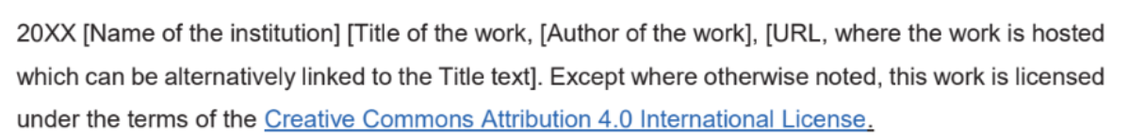
License Declaration
2021 Quest International University Developing Assignment Briefs, Tina Lim. Except where otherwise noted, this work is licensed under the terms of the Creative Commons Attribution 4.0 International License

Slide 24
If you have modified or adapted this OER, explicitly state that your version is an adaptation or derivative, and optionally describe the nature of your changes.
Example:
This slide is adapted from Developing Assignment Briefs by Tina Lim, licensed under a Creative Commons Attribution 4.0 International License (CC BY-NC-SA). Changes include …
Attribution Statement
Notes:
https://opentextbc.ca/adaptopentextbook/chapter/adaptation-statement/
https://guides.skylinecollege.edu/c.php?g=1176803&p=8601457
https://nmoer.pressbooks.pub/facultyguide/chapter/adaptation-statement/

Slide 25
The materials provided in this institutional Open Educational Resource (iOER) are intended solely for educational and training (Learning & Development) purposes. Quest International University assumes no responsibility for any misuse, misinterpretation, or unintended application of the content. The views and opinions expressed within these materials are those of the individual authors and do not necessarily reflect the official stance or policy of Quest International University.
No derivative works may use the name, logo, or official branding of Quest International University without prior written approval.
Disclaimer
For any enquiries, kindly email Academic Affairs Division (AAD) at aad@qiu.edu.my

