Slide 1


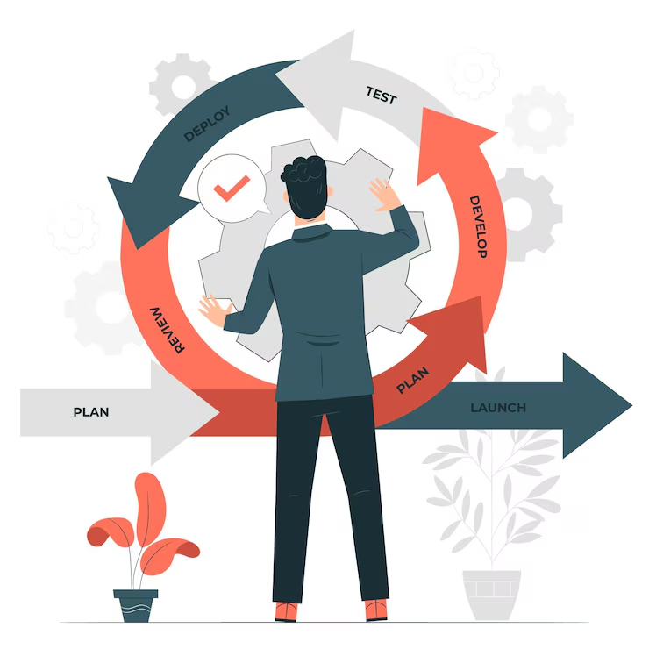

Constructive Alignment (Learning Objectives & Assessments)
Author:
Chin Sook Fui
Year: 2023
CC BY-NC-SA 4.0
Designed by Freepik

Slide 2

Course Outline
Module | Topic | Sub-topics |  | Course Learning Outcomes | Duration
Module 1 | Introduction to Constructive Alignment | 1 | What is constructive alignment? | Explain the key concepts of constructive alignment. (C2) | 2 hours
 |  | 2 | What to be aligned?
 |  | 3 | What to be checked?
 |  | 4 | Mapping CLO to PLO to MQF2.0 Clusters
Module 2 | Learning Objectives and Assessments | 1 | Aligning CLOs to Assessments | Evaluate the constructive alignment between the learning objectives and assessments in a course. (C5) | 2 hours
 |  | 2 | Assessment Types
 |  | 3 | Table of Specifications (TOS)
 |  | 4 | Assessment Paper

Slide 3
Module 1
Introduction to Constructive Alignment
Learning Outcome
Explain the key concepts of constructive alignment. (C2)

Slide 4
What is
Constructive Alignment?
1.1

Slide 5
Constructive
Refers to the idea that students construct meaning through relevant learning activities.
Meaning is not something imparted or transmitted from teacher to learner, but is something learners have to create for themselves.
Teaching is simply a catalyst for learning.
(Biggs, 1999)

Slide 6
Alignment
Refers to what the teacher does, which is to set up a learning environment that supports the learning activities appropriate to achieving the desired learning outcomes.
The key is that the components in the teaching system, especially the teaching methods used and the assessment tasks, are aligned with the learning activities assumed in the intended outcomes.
The learner is in a sense 'trapped', and finds it difficult to escape without learning what he or she is intended to learn.
(Biggs, 1999)

Slide 7
What to be
aligned ?
1.2

Slide 8
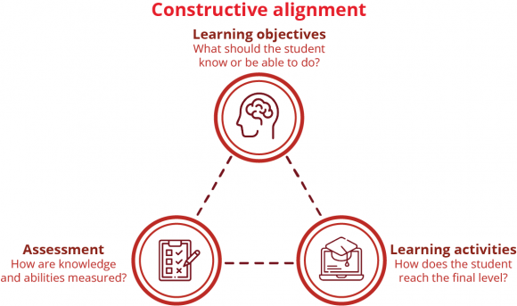
Source: Radboud Universiteit

Slide 9
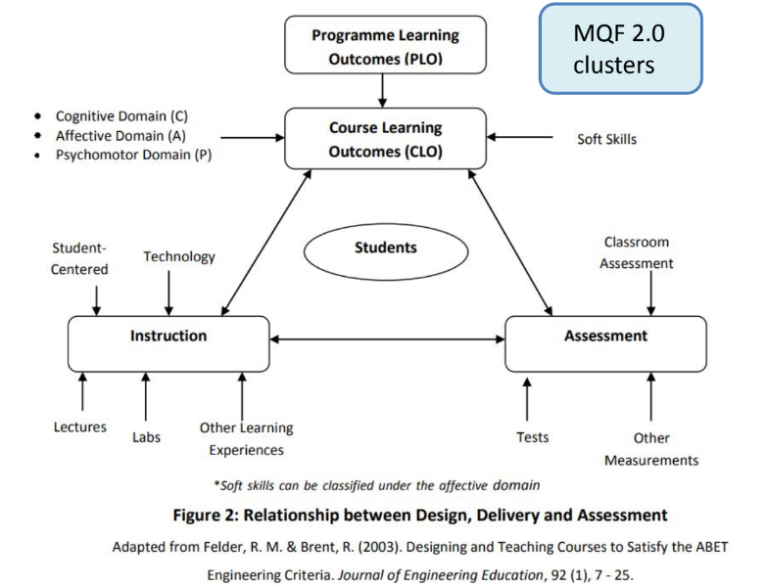

Slide 10
1.3
What to be checked ?
Learning domain & level
Mapping of CLO to PLO to MQF2.0
Assessment: type/ tool, weighting
Teaching- learning activity

Slide 11
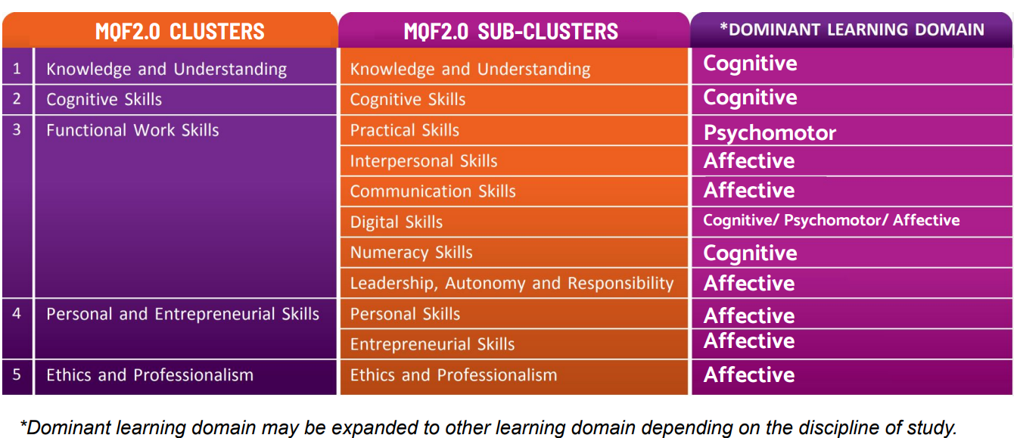
Mapping of PLOs to MQF2.0 Clusters

Slide 12
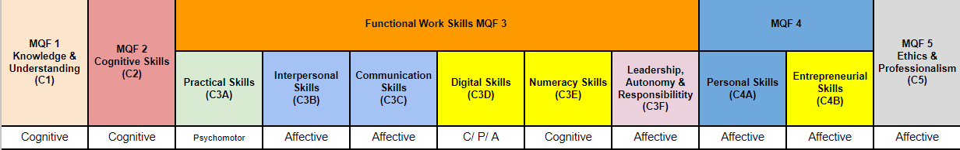
Example (1):
PLO
Describe theoretical and technical knowledge in culinary-related fields.

Slide 13
Example (2):
PLO
Apply a range of essential skills (methods and procedures) within food production operations.

Slide 14
Example (3):
PLO
Communicate using Culinary terminologies confidently, accurately and coherently in appropriate contexts.

Slide 15
Example (4):
PLO
Analyse common health problems using clinical skills.

Slide 16
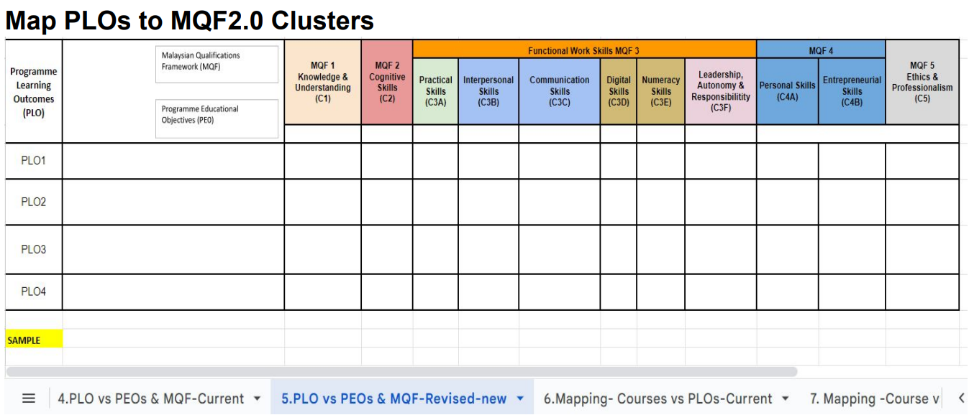

Slide 17
1.4
Mapping CLO to PLO to MQF2.0 Clusters

Slide 18
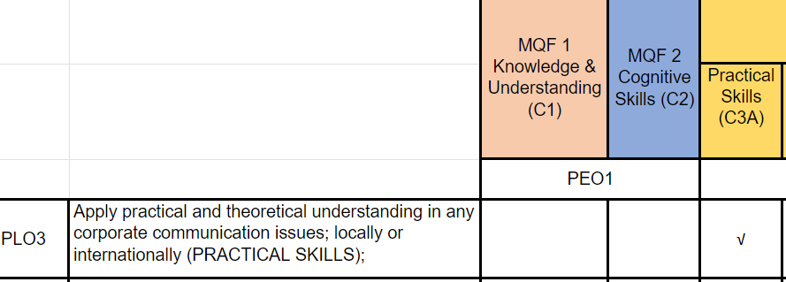
Mapping CLO to PLO to MQF2.0 Clusters
STEP 1
Check the learning domain mapped.
CLO 1 is mapped to Cognitive Learning Domain.
PLO3 is mapped to MQF Cluster 3A (Practical Skills), which is under Psychomotor Learning Domain ❌

Slide 19
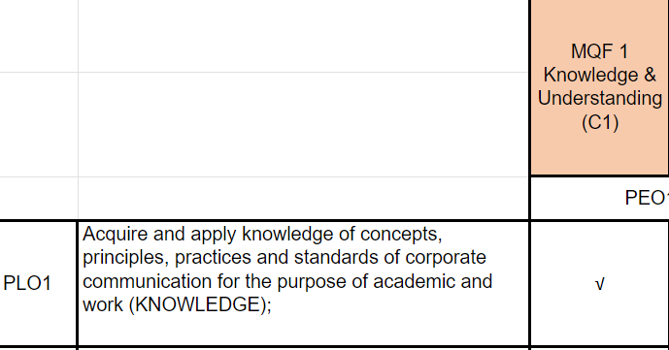
Mapping CLO to PLO to MQF 2.0 Clusters
Instead of PLO3, CLO1 should be mapped to PLO1 which is under Cognitive Learning Domain ✅

Slide 20
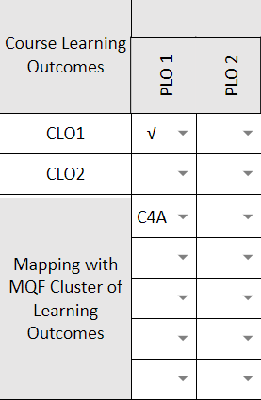
Mapping CLO to PLO to MQF 2.0 Clusters
STEP 2
Check the mapping of CLO to MQF 2.0 Clusters
CLO 1 is mapped PLO1.
PLO 1 is mapped wrongly to MQF2.0 Cluster C4A (Personal Skills). ❌

Slide 21
Module 2
Learning Objectives & Assessments
Learning Outcome
Evaluate the constructive alignment between the learning objectives and assessments in a course. (C5)

Slide 22
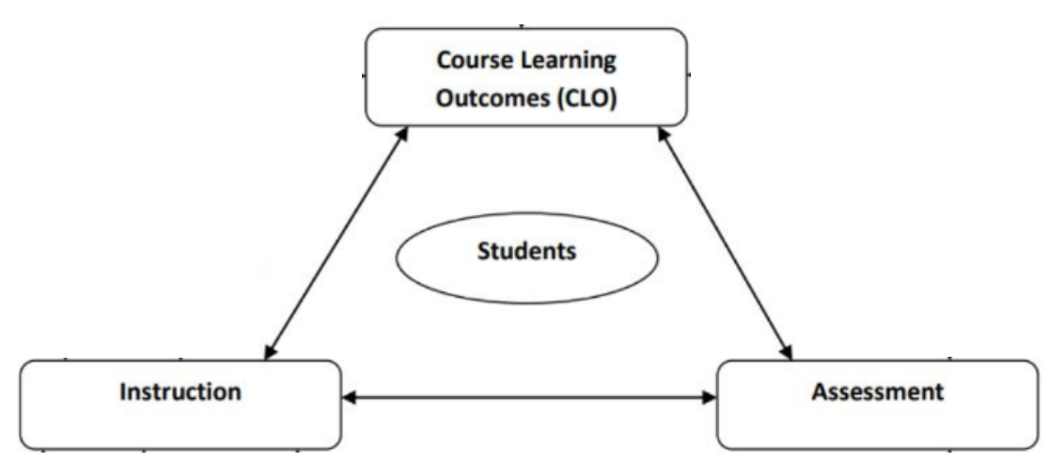
2.1
Aligning CLOs to Assessments

Slide 23
How?
Documents to be checked:
Course Information (Table 4)
Table of Specifications (TOS)
Assessment Paper

Slide 24
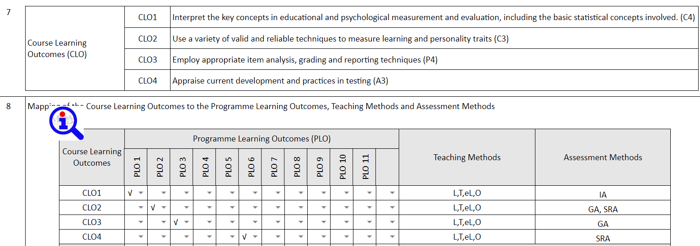
CHECK 1
Course Information
Course Information (Table 4)

Slide 25
CHECK 1
Course Information
CHECK 1
Course Information
Check Table 4
CLOs → Learning domain and level

Slide 26

CHECK 1
Course Information
Example 1:
CLO: Present the research work through effective communication skills and presentation.
What is the learning domain and level?

Slide 27
CHECK 1
Course Information
Example 1:
CLO: Present the research work through effective communication skills and presentation.
What is the learning domain and level?
Answer
Affective
Level 2

Slide 28
CHECK 1
Course Information
Example 2:
CLO: Apply suitable statistical and digital tools to manage the data and publish the findings.
What is the learning domain and level?

Slide 29
CHECK 1
Course Information
Example 2:
CLO: Apply suitable statistical and digital tools to manage the data and publish the findings.
What is the learning domain and level?
Answer
Cognitive
Level 3

Slide 30
CHECK 1
Course Information
Example 3:
CLO: Perform experiments involving enzyme synthesis and purification.
What is the learning domain and level?

Slide 31
CHECK 1
Course Information
Example 3:
CLO: Perform experiments involving enzyme synthesis and purification.
What is the learning domain and level?
Answer
Psychomotor
Level 3

Slide 32
CHECK 1
Course Information
Check Table 4
CLOs → Assessment Methods

Slide 33
2.2
Assessment Types

Slide 34


Example
CLO: Justify personal stand on party hopping in politics.
Which of these assessment types may be suitable?
Quiz
Essay
Demonstration
Online discussion

Slide 35
Example - Assessment Types
Domain | Assessment Types | Description
 | Multiple Choice | Tests knowledge and understanding through a set of predetermined options.
 | Essay | Requires students to provide detailed written responses to demonstrate critical thinking.
 | Short Answer | Asks for concise responses to specific questions, often requiring application of knowledge.
 | Problem-Solving | Requires students to solve complex problems, applying learned concepts and strategies.
 | Concept Mapping | Visual representation of relationships between concepts, assessing understanding and connections.
Cognitive

Slide 36
Example - Assessment Types
Domain | Assessment Types | Description
 | Self-assessment | Encourages students to reflect on their emotions, values, and attitudes towards a topic.
 | Reflective Journal | Prompts students to write about their personal experiences and emotional responses.
 | Surveys | Collects data on students' attitudes, beliefs, and values related to a subject or activity.
 | Interviews | In-depth conversations to explore emotions, opinions, and perspectives on a particular topic.
 | Peer Evaluation | Allows peers to assess and provide feedback on each other's affective responses and behaviors.
Affective

Slide 37
Example - Assessment Types
Domain | Assessment Types | Description
 | Skills checklist | A list of specific skills to be checked off as students demonstrate competency in each.
 | Performance task | Requires students to perform physical or manipulative tasks, assessing motor skills.
 | Simulations | Immersive experiences that mimic real-world scenarios to evaluate practical skills.
 | Portfolio | Compilation of evidence showcasing the development of psychomotor skills over time.
 | Observations | Instructors or assessors observe and rate students' physical actions and movements.
Psycho-motor

Slide 38
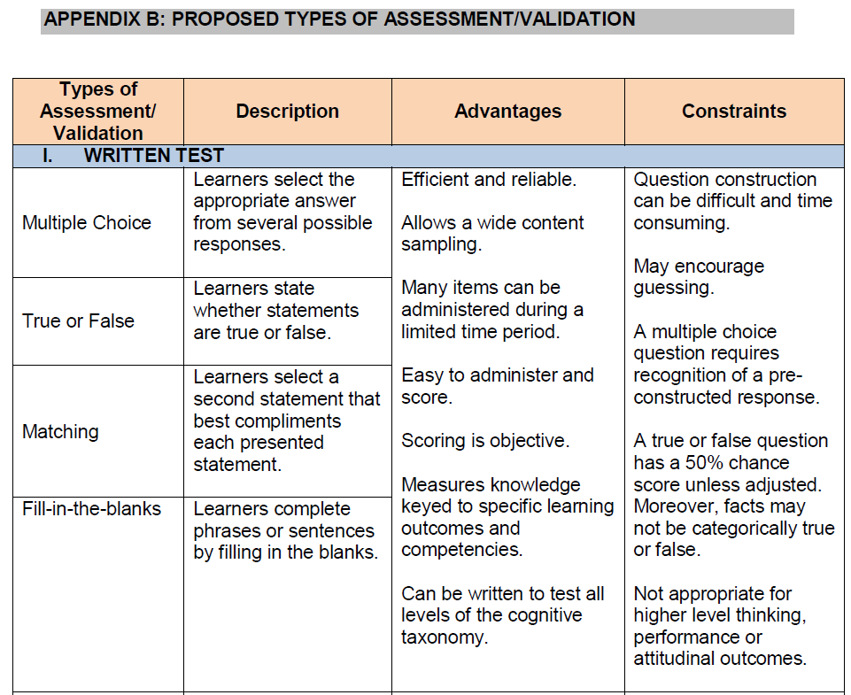
Read more here:
🔗GGP APEL(C) Updated Version 2020
(page 22-25)

Slide 39
2.3
Table of Specifications
(TOS)

Slide 40
CHECK 2
Table of Specifications
Table of Specifications (TOS)
TOS is also known as “Assessment Plan”, “Test Plan” and “Test Blueprint”.
It classifies each test item according to what topic or concept it tests and what learning outcome it addresses.
TOS helps to establish a constructive alignment between learning outcomes and assessments.

Slide 41
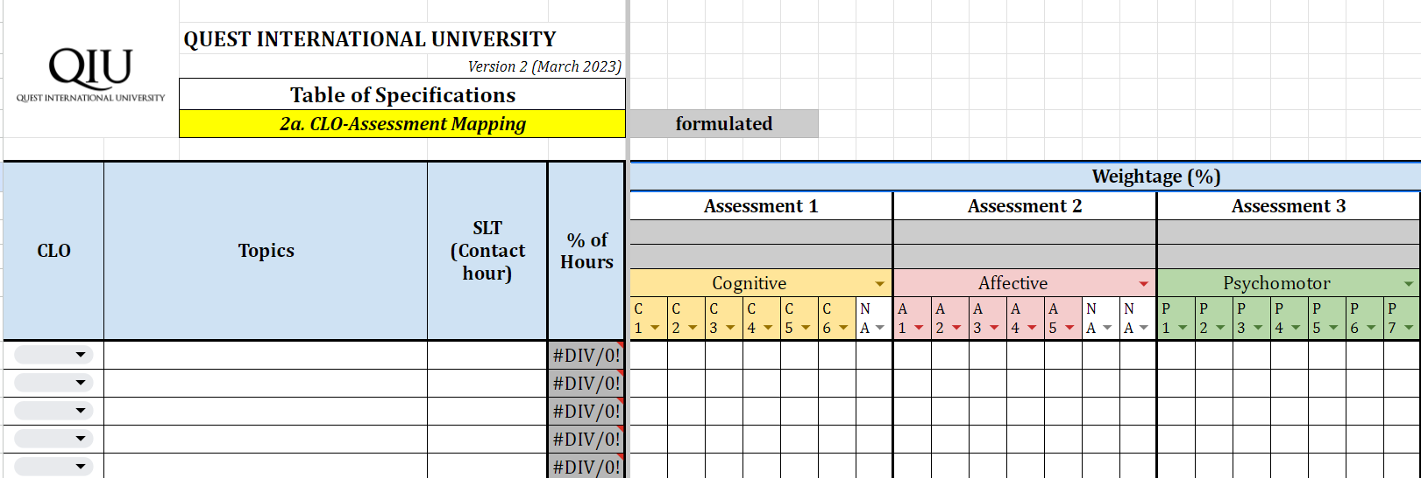
CHECK 2
Table of Specifications
1. Ensure the all assessments are listed as per Table 4.

Slide 42
CHECK 2
Table of Specifications
2. Ensure correct learning domain and level are identified for each assessment.

Slide 43
CHECK 2
Table of Specifications
3. Ensure each assessment is aligned with the CLO mapped as per Table 4.

Slide 44
CHECK 2
Table of Specifications
4. Ensure the assessment weighting % is allocated correctly as per Table 4.

Slide 45
CHECK 2
Table of Specifications
5. Ensure the assessment weighting % allocated is proportionate to the SLT allocated.

Slide 46
2.4
Assessment Paper

Slide 47
CHECK 3
Assessment Paper
Assessment Papers
Check the assessment papers to ensure it’s aligned with the Table 4 & TOS:
  CLO targeted
  Learning domain and level
  Assessment types
  Weighting

Slide 48
Self-Reflection
OR ?
Course Learning Outcomes
Explain the key concept of constructive alignment. (C2)
Evaluate the constructive alignment between the learning objectives and assessments in a course. (C5)

Slide 49
License Deed
You are free to:
Share — copy and redistribute the material in any medium or format
Adapt — remix, transform, and build upon the material
Under the following terms:
Attribution — You must give appropriate credit , provide a link to the license, and indicate if changes were made . You may do so in any reasonable manner, but not in any way that suggests the licensor endorses you or your use
NonCommercial — You may not use the material for commercial purposes .
ShareAlike — If you remix, transform, or build upon the material, you must distribute your contributions under the same license as the original.
Creative Commons Attribution-
NonCommercial-
ShareAlike 4.0 International

Slide 50
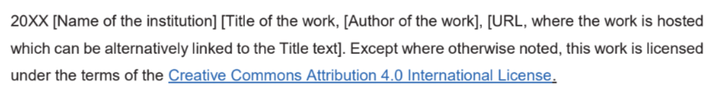
License Declaration
2023 Quest International University Constructive Alignment (Learning Objectives & Assessments), Chin Sook Fui. Except where otherwise noted, this work is licensed under the terms of the Creative Commons Attribution 4.0 International License

Slide 51
If you have modified or adapted this OER, explicitly state that your version is an adaptation or derivative, and optionally describe the nature of your changes.
Example:
This slide is adapted from Constructive Alignment (Learning Objectives & Assessments) by Chin Sook Fui, licensed under a Creative Commons Attribution 4.0 International License (CC BY-NC-SA). Changes include …
Attribution Statement
Notes:
https://opentextbc.ca/adaptopentextbook/chapter/adaptation-statement/
https://guides.skylinecollege.edu/c.php?g=1176803&p=8601457
https://nmoer.pressbooks.pub/facultyguide/chapter/adaptation-statement/

Slide 52
The materials provided in this institutional Open Educational Resource (iOER) are intended solely for educational and training (Learning & Development) purposes. Quest International University assumes no responsibility for any misuse, misinterpretation, or unintended application of the content. The views and opinions expressed within these materials are those of the individual authors and do not necessarily reflect the official stance or policy of Quest International University.
No derivative works may use the name, logo, or official branding of Quest International University without prior written approval.
Disclaimer
For any enquiries, kindly email Academic Affairs Division (AAD) at aad@qiu.edu.my

