Slide 1




Checking CLO Mapping to PLO and MQF2.0 Clusters
Authors:
Tina Lim
Chin Sook Fui
Year: 2023
CC BY-NC-SA 4.0
Designed by Freepik

Slide 2
Mapping PLO to MQF2.0 Clusters
Table 4 & Mapping CLO to PLO and MQF2.0 Clusters
Overview

Slide 3

01 Mapping of PLOs to MQF2.0 Clusters
MQF2.0 Clusters?
In 2017, MQA has outlined 5 clusters of learning outcomes.
As a general practice, each programme should address all clusters of learning outcomes appropriately.
Reference: 5 Clusters of Learning Outcomes MQF2.0 (JPT,MOHE-2021)

Slide 4
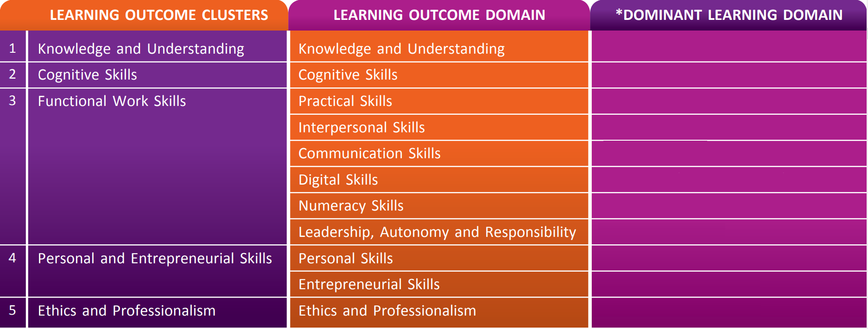
MQF2.0
MQF2.0 CLUSTERS
MQF2.0 SUB-CLUSTERS
Cognitive
Cognitive
Psychomotor
Affective
Affective
Cognitive/ Psychomotor/ Affective
Cognitive
Affective
Affective
Affective
Affective
*Dominant learning domain may be expanded to other learning domain depending on the discipline of study.

Slide 5
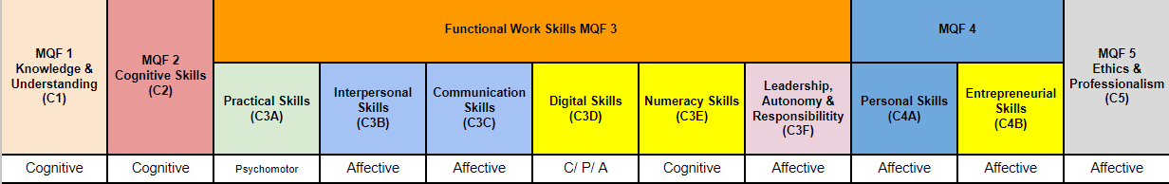
Example:
PLO
Describe theoretical and technical knowledge in culinary-related fields.

Slide 6
Example:
PLO
Apply a range of essential skills (methods and procedures) within food production operations.

Slide 7
Example:
PLO
Communicate using Culinary terminologies confidently, accurately and coherently in appropriate contexts.

Slide 8
Example:
PLO
Analyse common health problems using clinical skills.

Slide 9
Example:
PLO
Engage in self-directed lifelong learning and career enhancement activities in the field of food science.

Slide 10
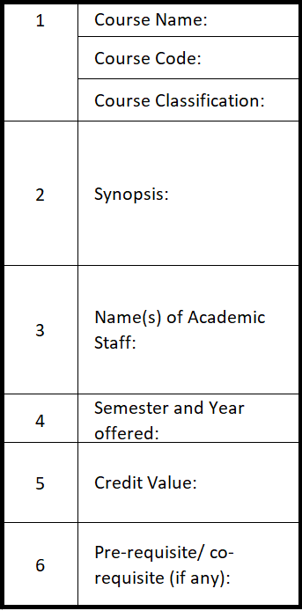
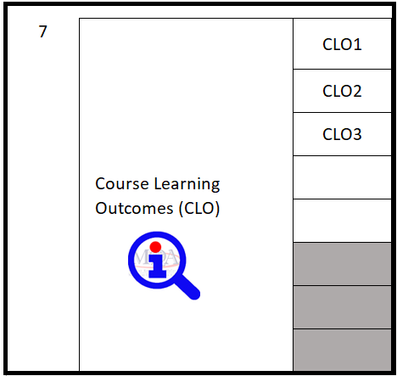

02
Table 4 & Mapping CLO to PLO and MQF2.0 Clusters
Table 4
It is the COURSE INFORMATION TEMPLATE (EXCEL) provided by MQA, showing the summary of course information

Slide 11
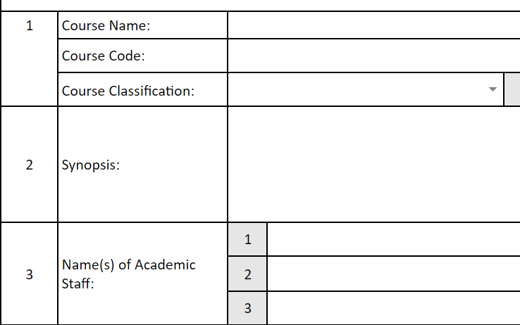
Follow the university nomenclature
Use Dropdown menu. If none of the categories fit, key in the grey box next to it.
Clear, concise, and easy to understand (<80 words)
Explain significant learning experiences and benefits students can expect
Ensure that it covers the outcomes identified in the course outline
Key in FULL name(s)
Check if qualified to teach the course as recommended in the Programme Standard

Slide 12
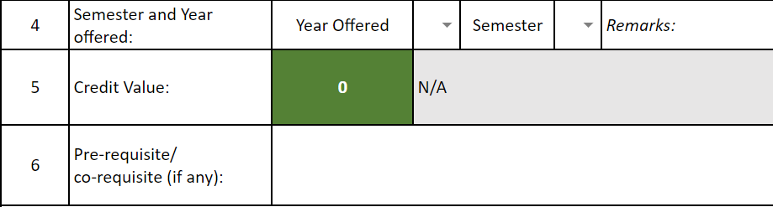
Ensure that it follows the programme structure
Where applicable:
E.g. BLS 50%/ 12-weeks internship
Generated automatically based on the total SLT allocated.
E.g.
80 hours of SLT = 2 credits; 120 hours = 3 credits
95 hours of SLT = ? credits? Allowed?
Indicate the pre-requisite or co-requisite course(s), if any.
Use Course Code followed by Course Name

Slide 13
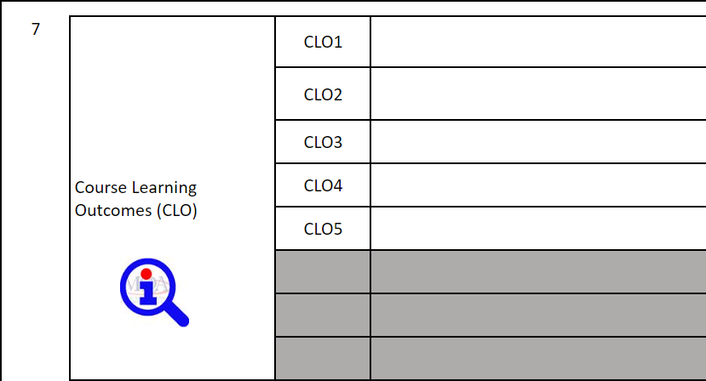
Indicate the most dominant learning domain and level (Cognitive, Affective OR Psychomotor).
Example:
Describe the functions of xxxxxxxx (C2, PLO3).
CLOs must be explicit and measurable.

Slide 14
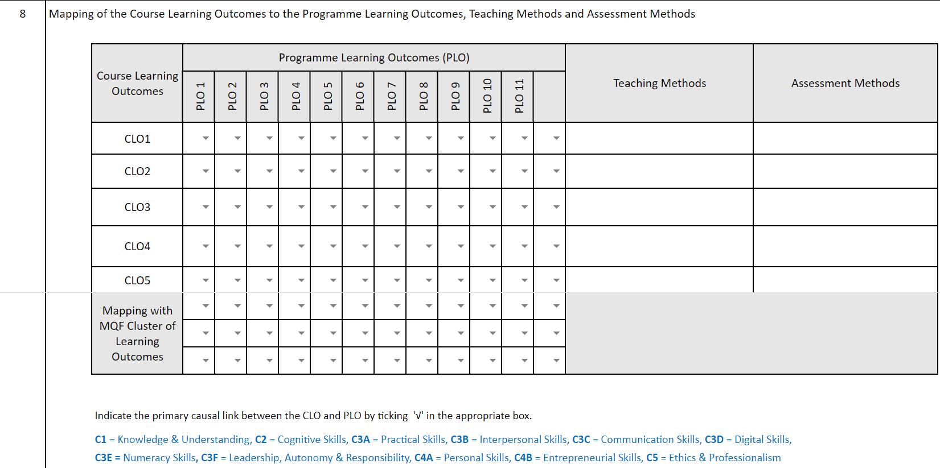
Map accordingly

Slide 15
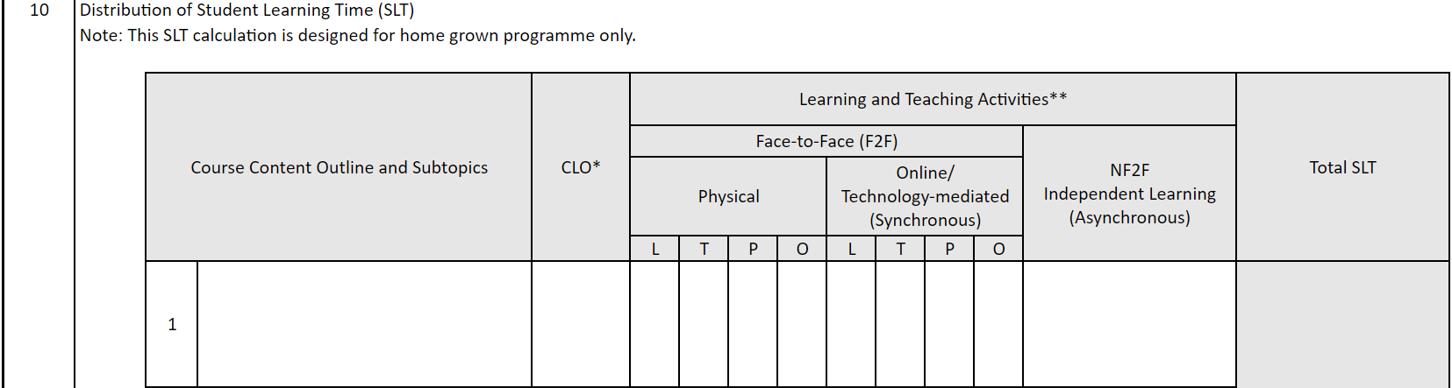
Allocate SLT accordingly
1 credit equivalent to 40 notional hours of SLT.
Typically, for each credit, 15 hours of f2f SLT are allocated.
Example:
2 credits x 15 f2f SLT = 30 f2f SLT
3 credits x 15 f2f SLT = 45 f2f SLT
4 credits x 15 f2f SLT = 60 f2f SLT
Note For a 3-credit course, typically, 14 weeks of learning is INCLUDING Continuous Assessment (CA).
39 hrs + 3 hrs = 42 hrs
classes CA

Slide 16
Must be aligned with Item 8

Slide 17
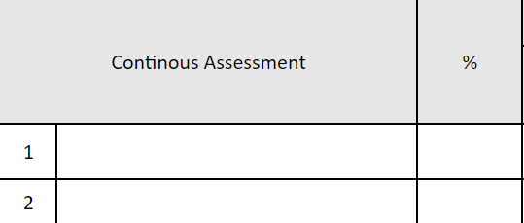
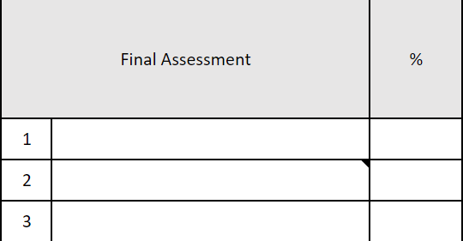
Must be aligned with Item 8

Slide 18
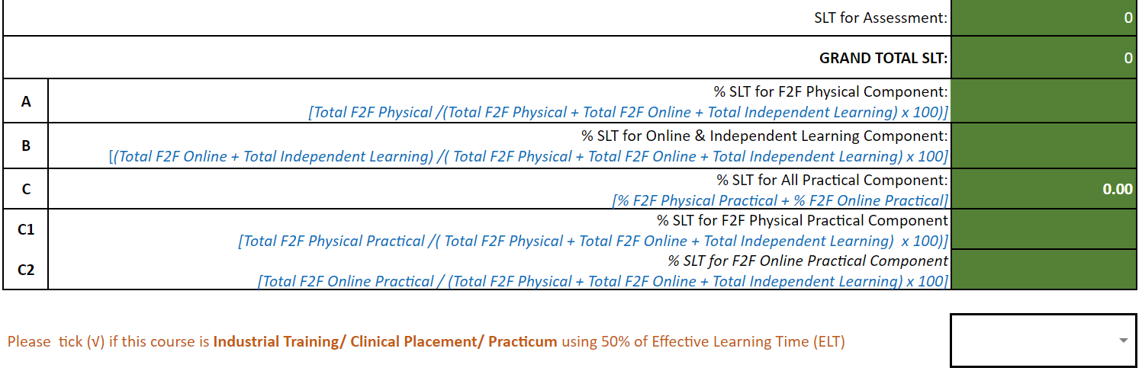
Auto computed
Tick if applicable
Note
The credit value in Item 5 will be computed automatically.
Industrial Training/ Clinical Placement/ Practicum
1 credit = 2 weeks

Slide 19
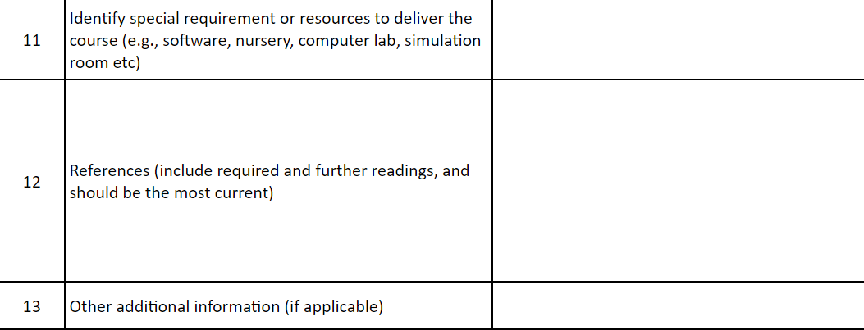
Recommended to use APA style, click here for examples
Published not more than 5 years, refer to QIU Librarian for list of available e-books/ books

Slide 20
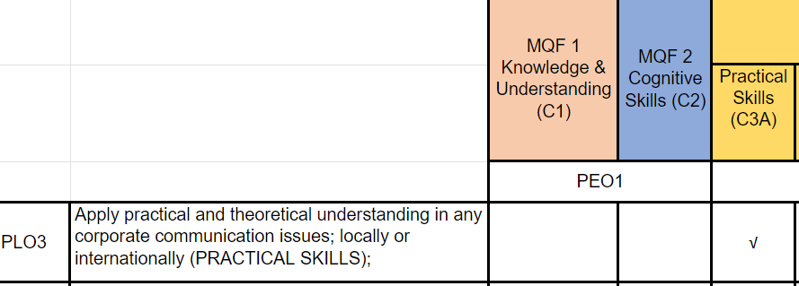
Mapping CLO to PLO to MQF 2.0 Clusters
STEP 1
Check the learning domain mapped.
CLO 1 is mapped to Cognitive Learning Domain.
PLO3 is mapped to MQF Cluster 3A (Practical Skills), which is under Psychomotor Learning Domain ❌

Slide 21
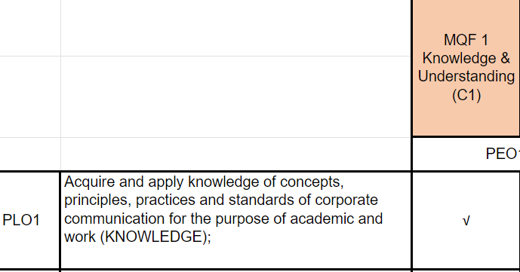
Mapping CLO to PLO to MQF 2.0 Clusters
Instead of PLO3, CLO1 should be mapped to PLO1 which is under Cognitive Learning Domain ✅

Slide 22
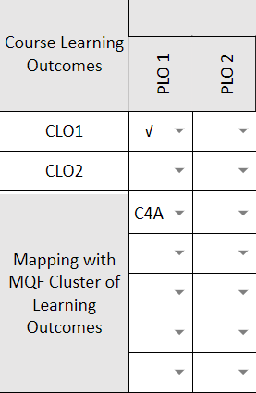
Mapping CLO to PLO to MQF 2.0 Clusters
STEP 2
Check the mapping of CLO to MQF 2.0 Clusters
CLO 1 is mapped PLO1.
PLO 1 is mapped wrongly to MQF2.0 Cluster C4A (Personal Skills). ❌

Slide 23
License Deed
You are free to:
Share — copy and redistribute the material in any medium or format
Adapt — remix, transform, and build upon the material
Under the following terms:
Attribution — You must give appropriate credit , provide a link to the license, and indicate if changes were made . You may do so in any reasonable manner, but not in any way that suggests the licensor endorses you or your use
NonCommercial — You may not use the material for commercial purposes .
ShareAlike — If you remix, transform, or build upon the material, you must distribute your contributions under the same license as the original.
Creative Commons Attribution-
NonCommercial-
ShareAlike 4.0 International

Slide 24
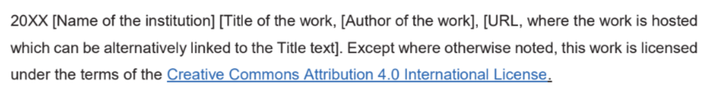
License Declaration
2023 Quest International University Checking CLO Mapping to PLO and MQF2.0 Clusters, Tina Lim, Chin Sook Fui. Except where otherwise noted, this work is licensed under the terms of the Creative Commons Attribution 4.0 International License

Slide 25
If you have modified or adapted this OER, explicitly state that your version is an adaptation or derivative, and optionally describe the nature of your changes.
Example:
This slide is adapted from Checking CLO Mapping to PLO and MQF2.0 Clusters by Tina Lim, Chin Sook Fui, licensed under a Creative Commons Attribution 4.0 International License (CC BY-NC-SA). Changes include …
Attribution Statement
Notes:
https://opentextbc.ca/adaptopentextbook/chapter/adaptation-statement/
https://guides.skylinecollege.edu/c.php?g=1176803&p=8601457
https://nmoer.pressbooks.pub/facultyguide/chapter/adaptation-statement/

Slide 26
The materials provided in this institutional Open Educational Resource (iOER) are intended solely for educational and training (Learning & Development) purposes. Quest International University assumes no responsibility for any misuse, misinterpretation, or unintended application of the content. The views and opinions expressed within these materials are those of the individual authors and do not necessarily reflect the official stance or policy of Quest International University.
No derivative works may use the name, logo, or official branding of Quest International University without prior written approval.
Disclaimer
For any enquiries, kindly email Academic Affairs Division (AAD) at aad@qiu.edu.my

