Slide 1




Blended Learning Substitute
Author:
Tina Lim
Year: 2022
CC BY-NC-SA 4.0
Designed by Freepik
Notes:
Image: https://www.freepik.com/

Slide 2


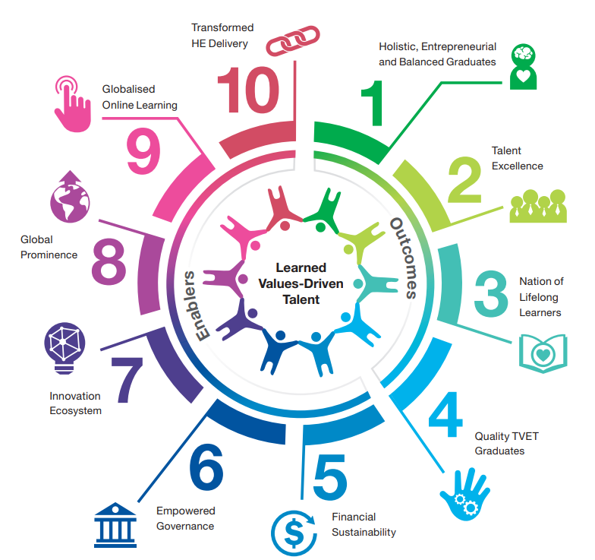
Initiative under Shift #9 of the MEB (HE):
Making online learning an integral component of higher education, with 70% of courses being offered in the blended mode by 2025

Slide 3
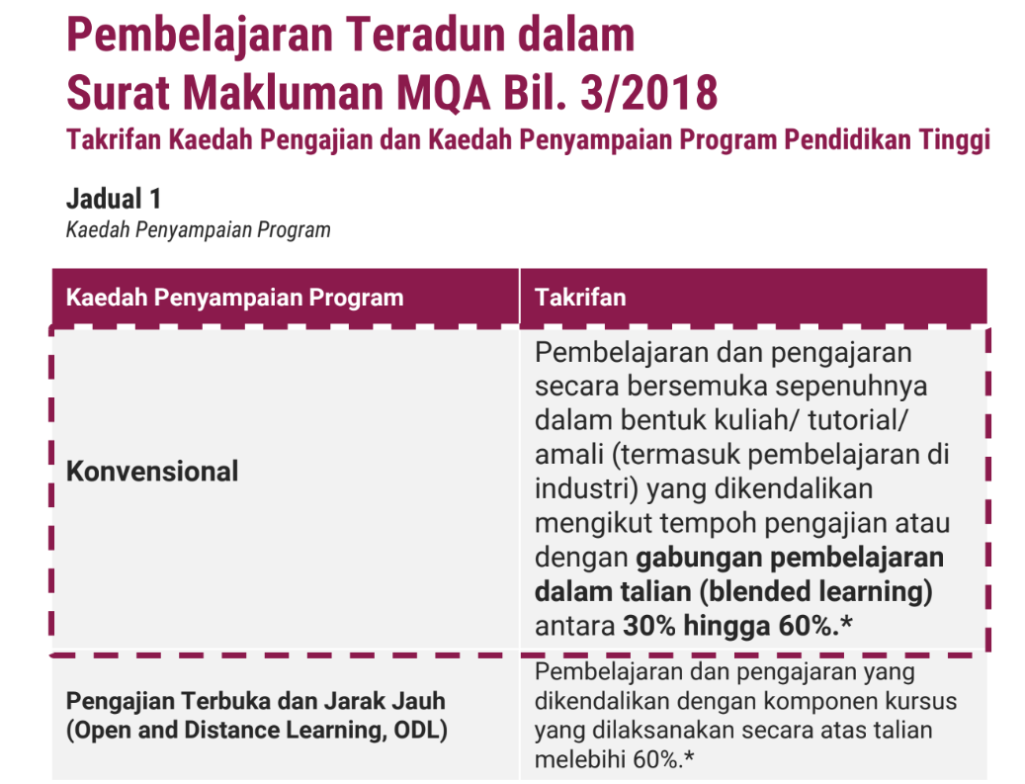

Slide 4
Blended Learning
Programme | Conventional Programmes 30% to 60% of SLT in online mode
Course | Courses in BLS Mode 30% to 80% In online mode

Slide 5
Definition
Operational Definition of Blended Learning Substitute (BLS)
Learning design that consists of 30% to 80% of total SLT for a course in an online mode
Formula for the Online Mode is 40 : 40 : 20

Slide 6



Documentation of BLS for a course is through the Teaching Plan derived from the course syllabus.
Material
Activity
Assessment
All THREE (3) elements are directly linked to the attainment of the CLOs and are clearly stated in the Teaching Plan.

Slide 7
Examples of Blended Learning Substitute Elements
40% T-L Material
40% T-L Activity
20% Assessment
Online materials used to deliver content
Online materials using Web 2.0 tools
Online assessment
• Video, audio clip, podcast,
screencast
• Digital storytelling
• Animation
• Virtual simulation/ virtual reality
• Lecture notes/ slides
• Interactive content
• Virtual laboratory
• Kahoot
• Padlet
• Edpuzzle
• Discussion forum/ chat
• Online quiz
• e-Portfolio
• Reflection
The recommended weighting of 40%-40%-20% for the three elements of BLS may be adjusted to other appropriate percentages according to the HEI’s needs, by providing clear and measurable justifications.

Slide 8
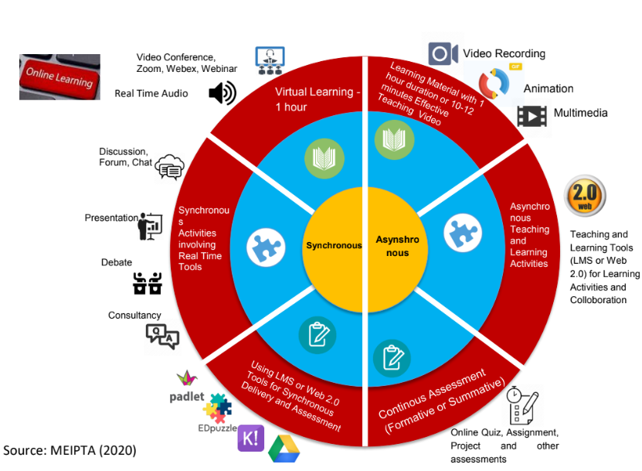
Examples of Blended Learning Substitute Elements
Time equivalent to physical f2f session
12 minute video equivalent to
1 hour SLT
3 – 5 minutes
per screen
1.5 minutes per MCQ
20 minutes per structured
25 minutes per essay

Slide 9
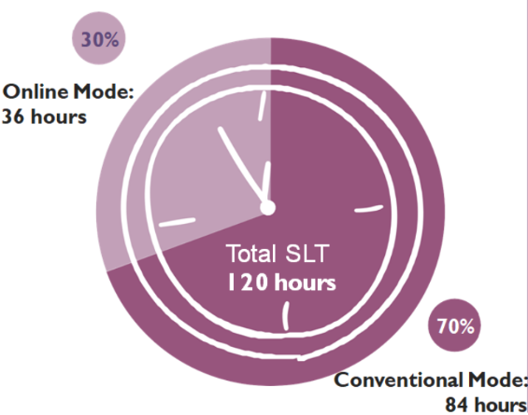
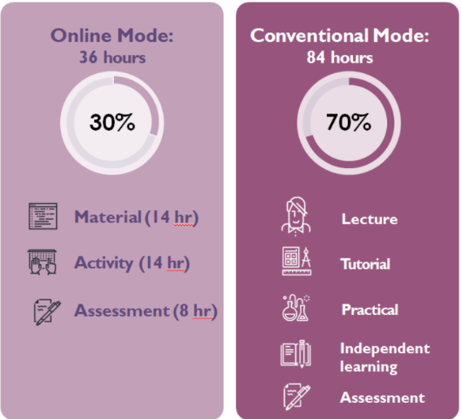
Sample 1
3 credit hour BLS course with Online 30%

Slide 10
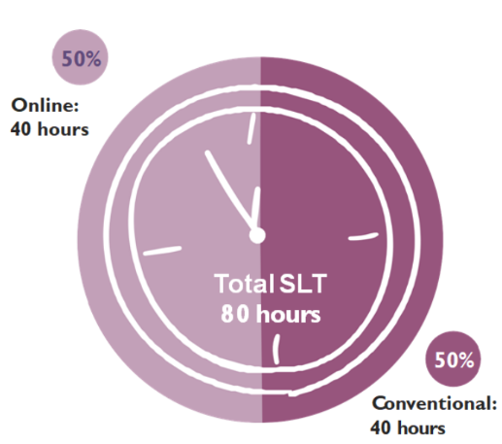
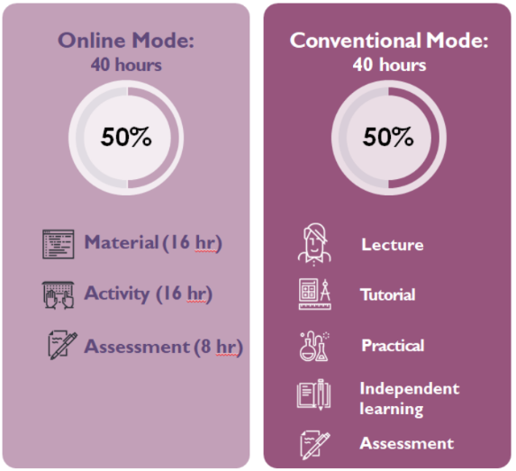
Sample 2
2 credit hour BLS course with Online 50%

Slide 11
NOTE:
Weighting has to be the same for all cohorts
Weighting is locked, teaching-learning activities materials and assessments can be changed for different intakes
No need to submit to MQA if comply with rule of % courses having % online and if there is no change in PLO, CLO, etc.
Need Senate approval

Slide 12
NOTE:
Online Assessment for FA/ FE is allowed
To consider readiness of staff before planning and implementing BLS
Teaching Workload for BLS: Assume same as that for conventional mode
For timetabling purposes (allocation of facility), the BLS percentage should be stated

Slide 13
License Deed
You are free to:
Share — copy and redistribute the material in any medium or format
Adapt — remix, transform, and build upon the material
Under the following terms:
Attribution — You must give appropriate credit , provide a link to the license, and indicate if changes were made . You may do so in any reasonable manner, but not in any way that suggests the licensor endorses you or your use
NonCommercial — You may not use the material for commercial purposes .
ShareAlike — If you remix, transform, or build upon the material, you must distribute your contributions under the same license as the original.
Creative Commons Attribution-
NonCommercial-
ShareAlike 4.0 International

Slide 14
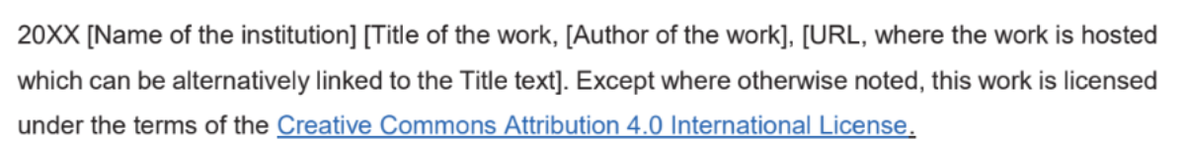
License Declaration
2022 Quest International University Blended Learning Substitute, Tina Lim. Except where otherwise noted, this work is licensed under the terms of the Creative Commons Attribution 4.0 International License

Slide 15
If you have modified or adapted this OER, explicitly state that your version is an adaptation or derivative, and optionally describe the nature of your changes.
Example:
This slide is adapted from Blended Learning Substitute by Tina Lim, licensed under a Creative Commons Attribution 4.0 International License (CC BY-NC-SA). Changes include …
Attribution Statement
Notes:
https://opentextbc.ca/adaptopentextbook/chapter/adaptation-statement/
https://guides.skylinecollege.edu/c.php?g=1176803&p=8601457
https://nmoer.pressbooks.pub/facultyguide/chapter/adaptation-statement/

Slide 16
The materials provided in this institutional Open Educational Resource (iOER) are intended solely for educational and training (Learning & Development) purposes. Quest International University assumes no responsibility for any misuse, misinterpretation, or unintended application of the content. The views and opinions expressed within these materials are those of the individual authors and do not necessarily reflect the official stance or policy of Quest International University.
No derivative works may use the name, logo, or official branding of Quest International University without prior written approval.
Disclaimer
For any enquiries, kindly email Academic Affairs Division (AAD) at aad@qiu.edu.my

