Slide 1




Assessing Oral Presentations
Authors:
Chan Nee Nee
Muthualagan Thangavelu
Divya Rose Peter
Nurfarahin Mohamed Ishak
Year: 2021
CC BY-NC-SA 4.0
Designed by Freepik
Notes:
Image: https://www.freepik.com/

Slide 2
Effective oral presentations
Preparing for question time
Responding to questions
Asking good questions
Assessing with rubrics
Overview

Slide 3


What are effective oral presentations?
Designed by Freepik

Slide 4
Group Oral Presentation
Hook the audience at the beginning
Introduce the team
Write transitions
Move
Utilize visual aids well
Build in strategic pauses
Pay attention to each other-presenter boredom
Conclude the speech
Practise

Slide 5

Dealing with questions
Designed by Freepik

Slide 6
Preparing for question time
The nature of the audience
Prepare answers for likely questions
Questions you want to answer
Questions you do not want to answer

Slide 7
Responding to questions
Speak with confidence
Use eye contact and positive body language
Maintain eye contact with the person who asked the question.
Notice any nervous habits you may have (like fidgeting or playing with a pen).
Manage the allocated time
Control the amount of time you spend answering each question

Slide 8
Strategies for managing difficult questions:
If you're asked a difficult question, take your time to think before answering.
Don’t rush to speak if you’re not ready.
You can ask for a moment to think.
You can also ask the person to rephrase the question.
This gives you more thinking time and may help you understand the question better.

Slide 9
How to ask good questions?
Use the 5 Ws and 1 H strategy
Who?
What?
When?
Where?
Why?
How?

Slide 10
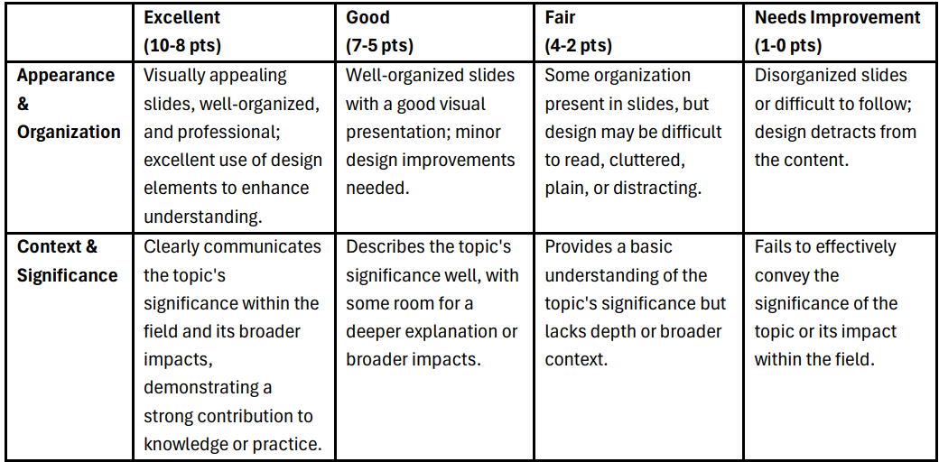
Assessing with rubrics: Example

Slide 11
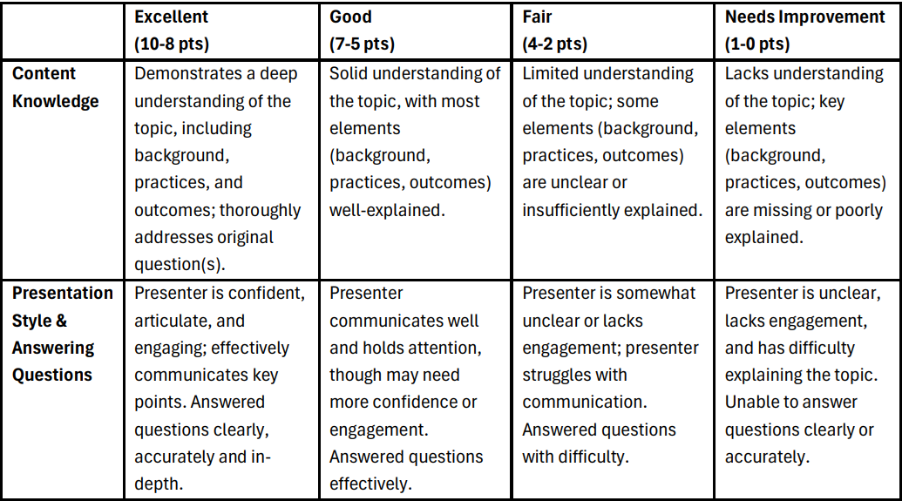
Source: Michigan State University

Slide 12
License Deed
You are free to:
Share — copy and redistribute the material in any medium or format
Adapt — remix, transform, and build upon the material
Under the following terms:
Attribution — You must give appropriate credit , provide a link to the license, and indicate if changes were made . You may do so in any reasonable manner, but not in any way that suggests the licensor endorses you or your use
NonCommercial — You may not use the material for commercial purposes .
ShareAlike — If you remix, transform, or build upon the material, you must distribute your contributions under the same license as the original.
Creative Commons Attribution-
NonCommercial-
ShareAlike 4.0 International

Slide 13
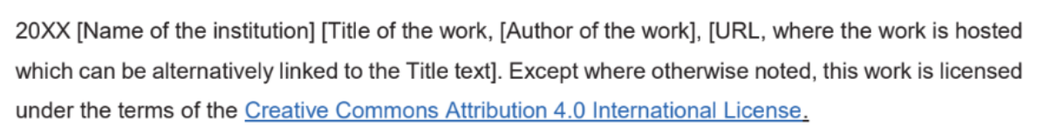
License Declaration
2021 Quest International University Assessing Oral Presentations, Chan Nee Nee, Muthualagan Thangavelu, Divya Rose Peter, Nurfarahin Mohamed Ishak. Except where otherwise noted, this work is licensed under the terms of the Creative Commons Attribution 4.0 International License

Slide 14
If you have modified or adapted this OER, explicitly state that your version is an adaptation or derivative, and optionally describe the nature of your changes.
Example:
This slide is adapted from Assessing Oral Presentations by Chan Nee Nee, Muthualagan Thangavelu, Divya Rose Peter, Nurfarahin Mohamed Ishak, licensed under a Creative Commons Attribution 4.0 International License (CC BY-NC-SA). Changes include …
Attribution Statement
Notes:
https://opentextbc.ca/adaptopentextbook/chapter/adaptation-statement/
https://guides.skylinecollege.edu/c.php?g=1176803&p=8601457
https://nmoer.pressbooks.pub/facultyguide/chapter/adaptation-statement/

Slide 15
The materials provided in this institutional Open Educational Resource (iOER) are intended solely for educational and training (Learning & Development) purposes. Quest International University assumes no responsibility for any misuse, misinterpretation, or unintended application of the content. The views and opinions expressed within these materials are those of the individual authors and do not necessarily reflect the official stance or policy of Quest International University.
No derivative works may use the name, logo, or official branding of Quest International University without prior written approval.
Disclaimer
For any enquiries, kindly email Academic Affairs Division (AAD) at aad@qiu.edu.my

